Slide 1
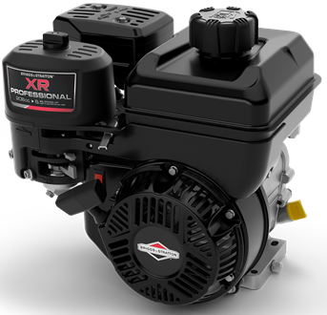
Model 130G32 Horizontal OHV
Disassembly and
Reassembly

Slide 2
Cylinder, Piston & Crankshaft
1. Required Instruction
Small Engines Text - Chapter 3 (Pages 51-80) CE8020
Small Engines Workbook Chapter 3 - Test 1 CE8021
2. Demonstration of Procedure
Instructor models procedure
3. Remove Piston/Connecting Rod and Crankshaft
Students perform procedure

Slide 3
Required Tools
8, 10, 12, 13, & 21mm Sockets
Ratchet Wrench – 3/8 Drive
5/8 in. Spark plug socket
6” Extension – 3/8 Drive
Inch Pound Torque Wrench
Foot Pound Torque Wrench
Needle Nose Pliers
19620 Fuel Line Tool
Hose Clamp Tool
½ in. Breaker Bar
Strap Wrench
Notes:
Required Tools
If available, use the 19620 fuel line removal tool – not in picture
Have an appropriate container handy to catch gasoline that may/will spill from the carburetor bowl.

Slide 4
Systematic Approach
This is a step-by-step disassembly process
It is not a race
Take your time when disassembling the engine and listen for direction from the instructor
Lay assemblies in order as they were removed
Keep fasteners with removed assemblies or thread them loosely back in bolt holes
Do not work ahead

Slide 5
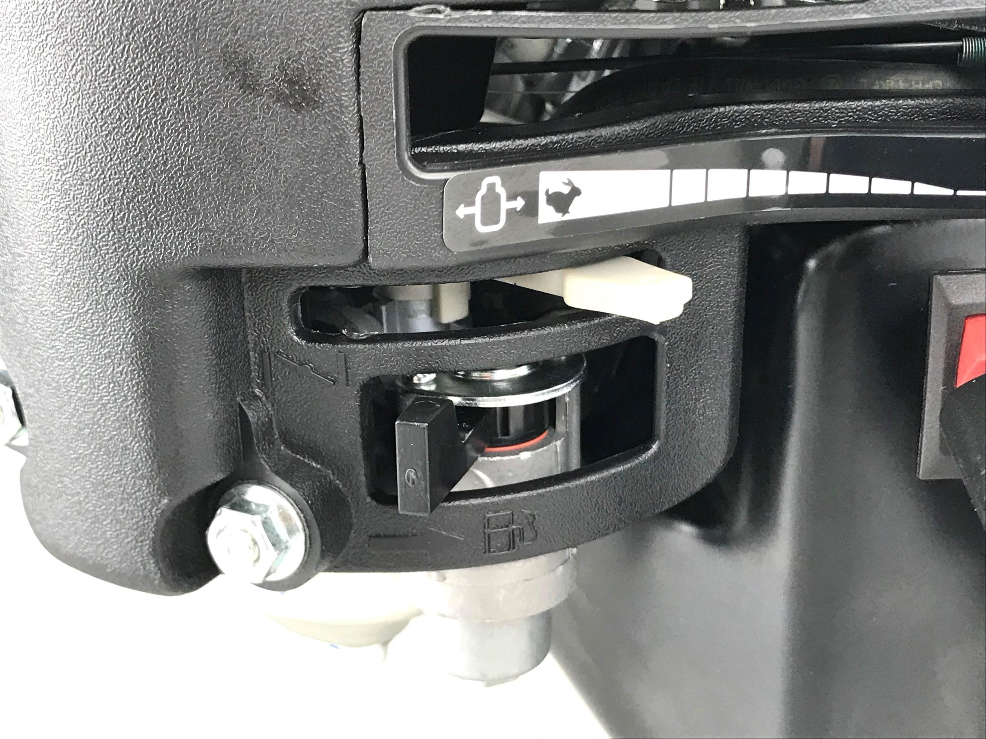
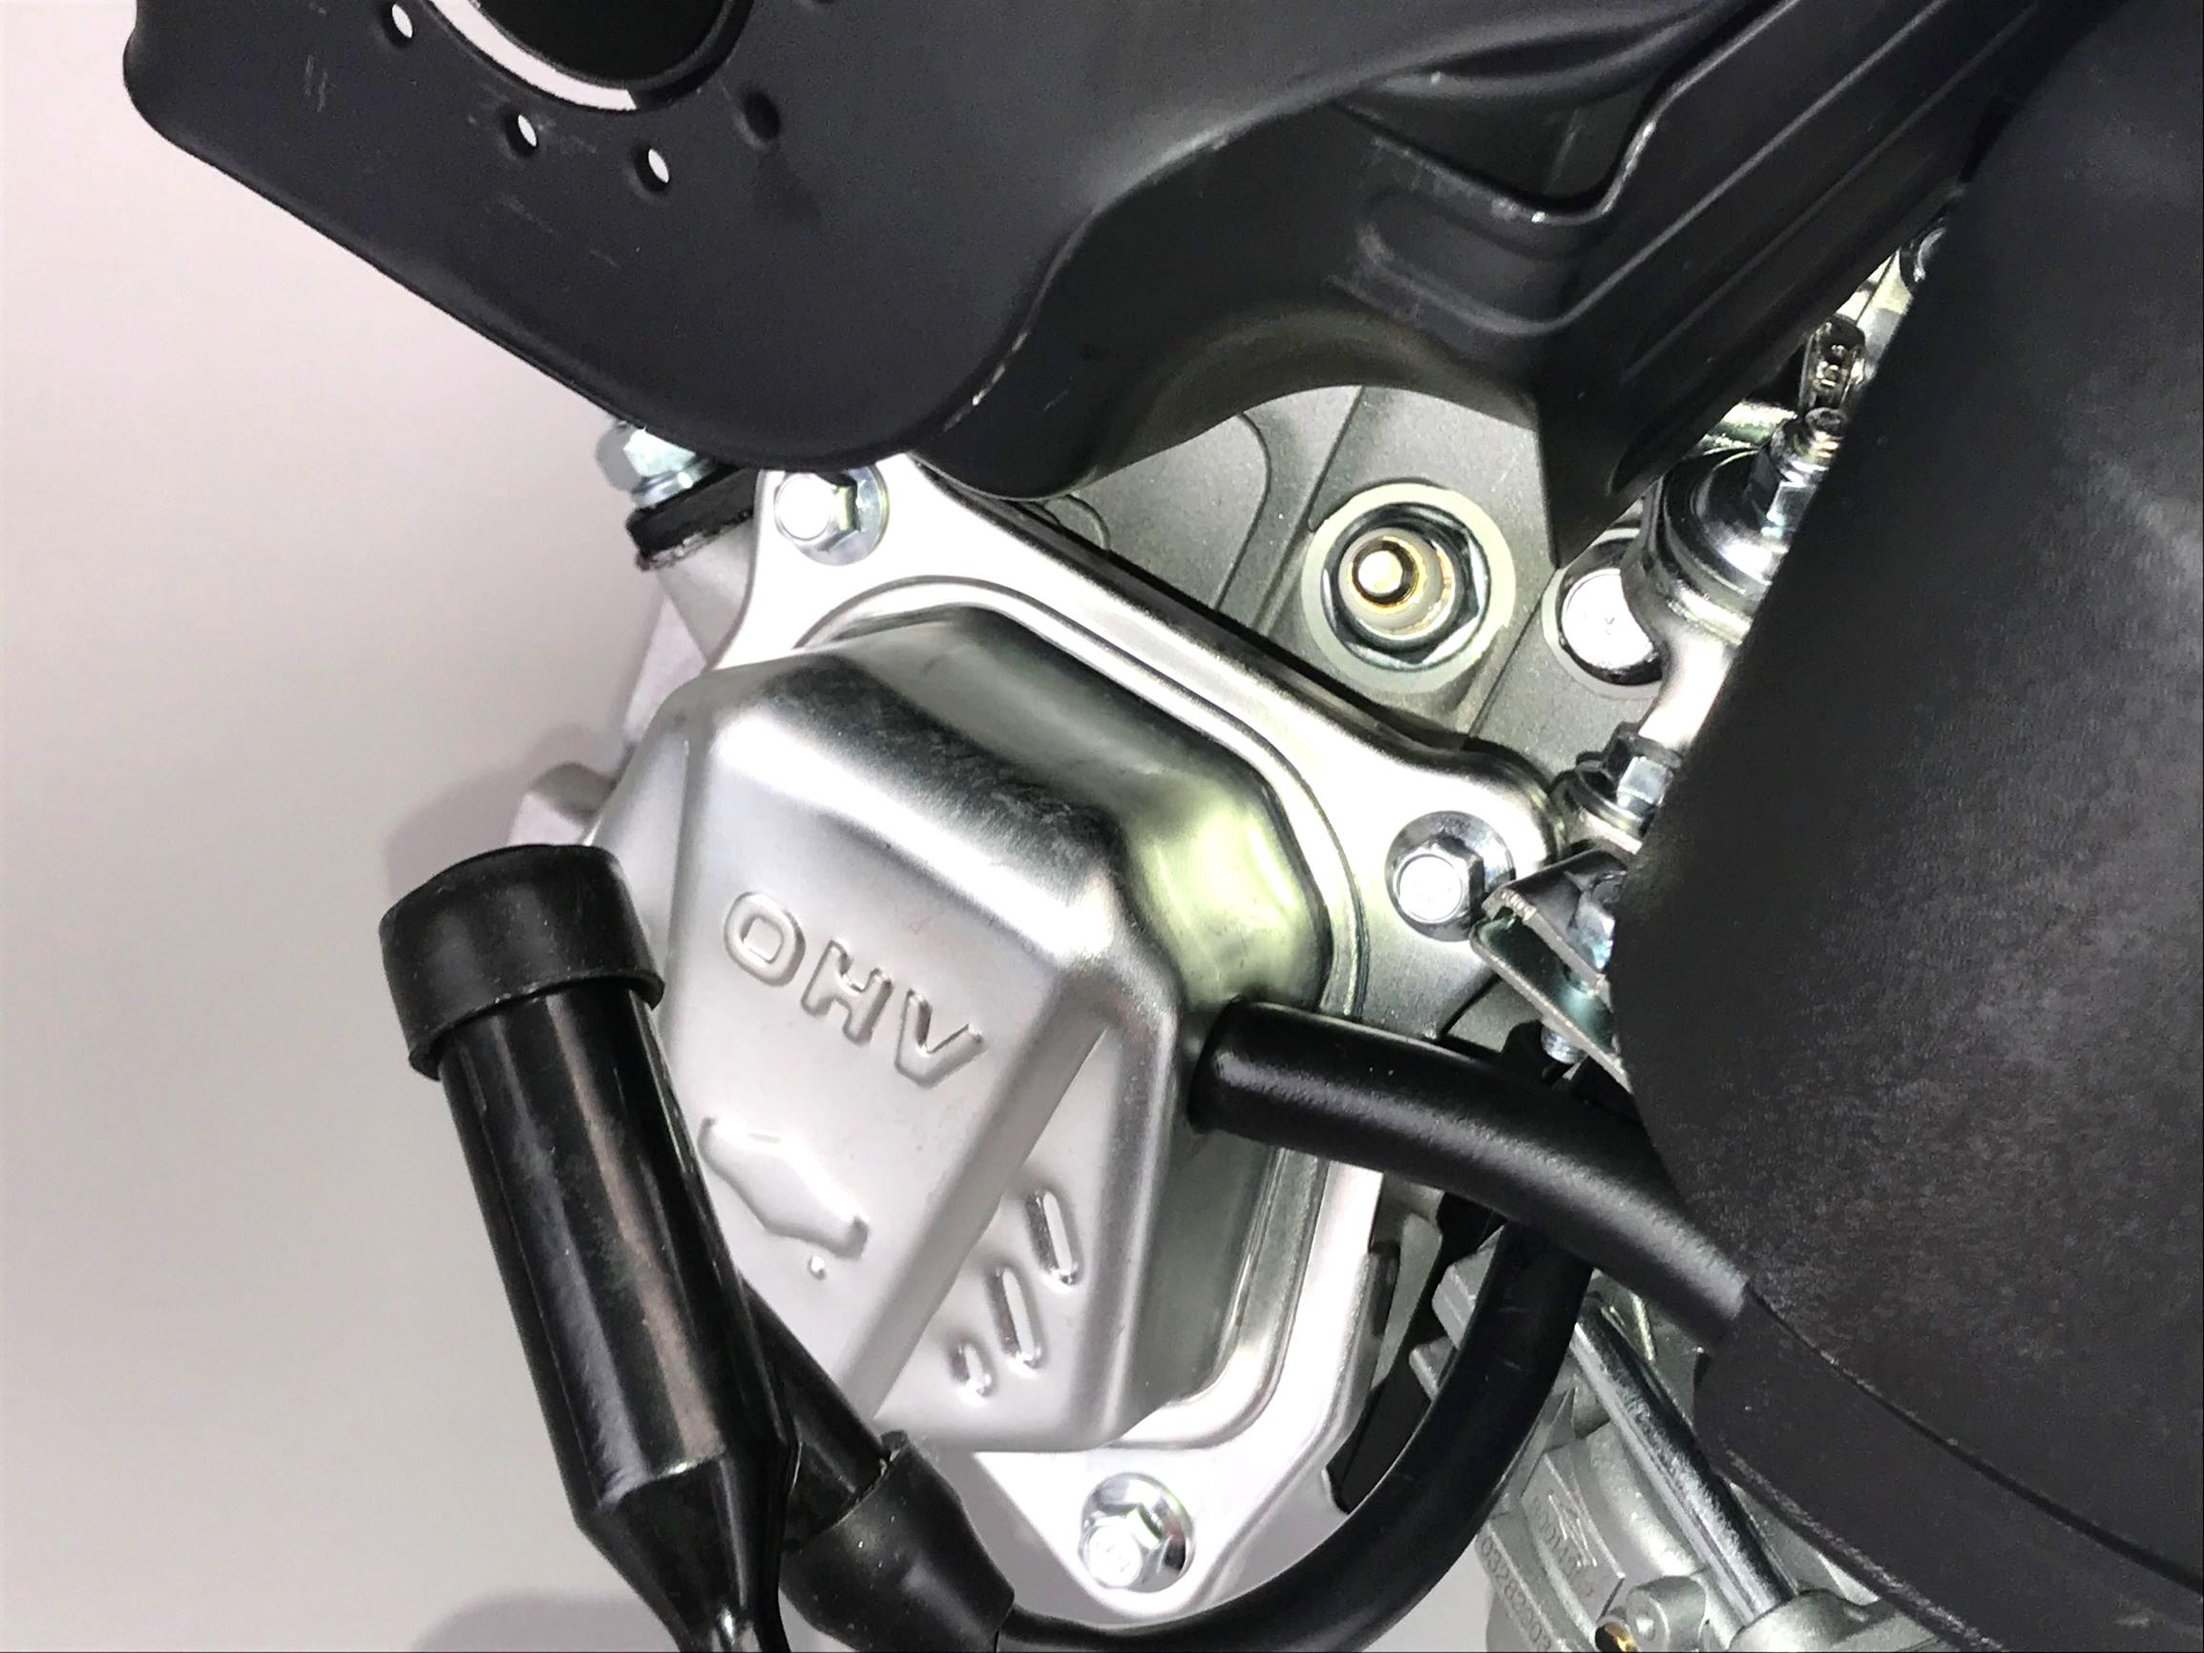
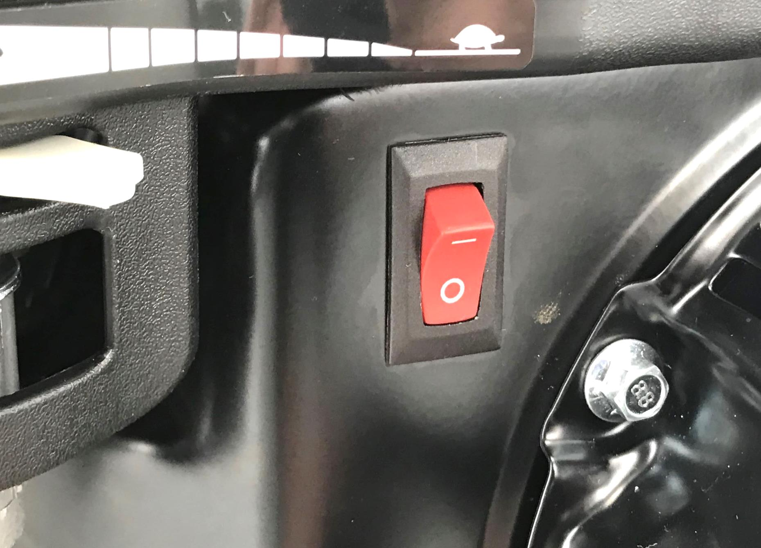
Let’s Begin
Close fuel shut-off valve
Disconnect spark plug lead from spark plug
Move ignition switch into the stop position
Notes:
Safety Issues.
Prevent accidental starting of engine.

Slide 6
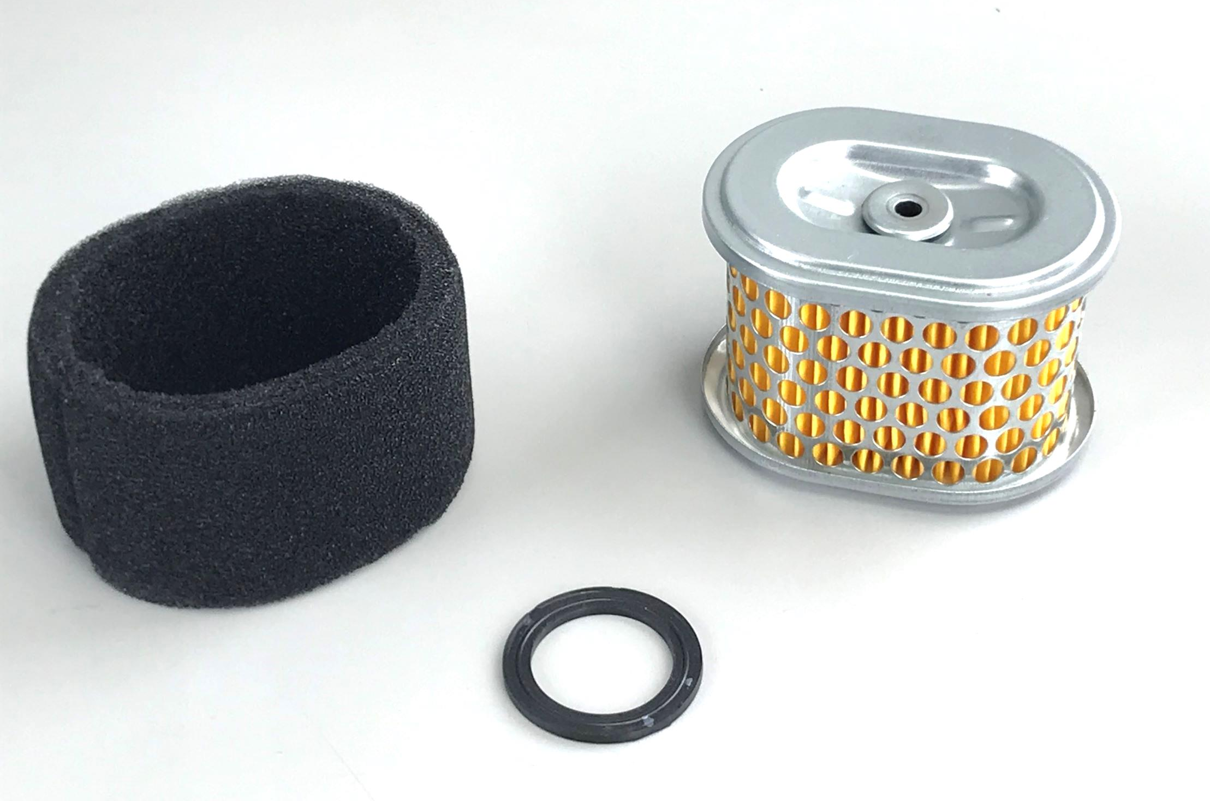
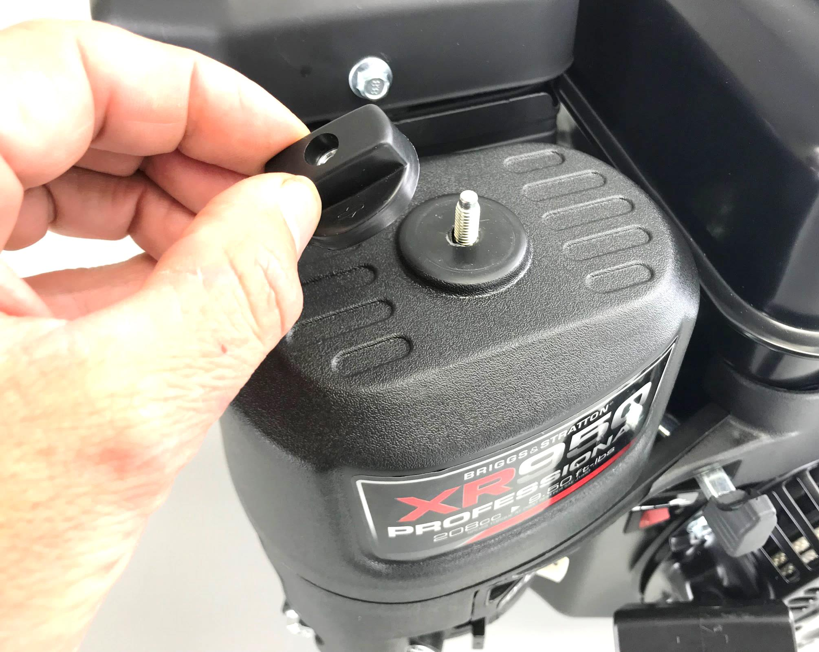
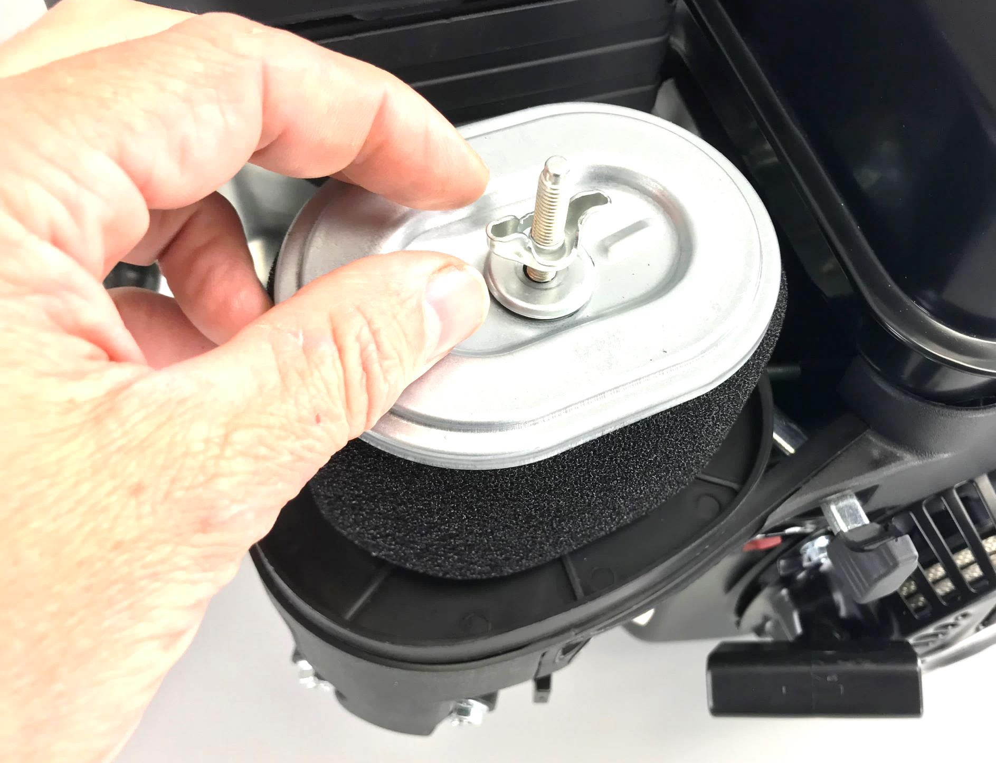
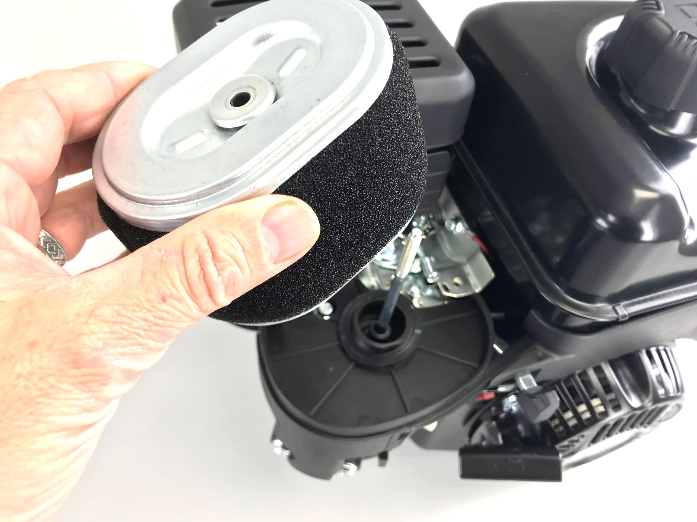
Remove Air Cleaner Cover and Filter
Inspect paper filter for tears
Foam pre-cleaner washable if equipped, replace if necessary
Rubber washer located under filter
Notes:
Remove sparkplug lead, turn fuel valve off or drain tank.
Remove Air Cleaner Cover Knob, Cover, Wing Nut, Air Cleaner Cartridge And Sealing Gasket Below Cartridge
Air-Cooled Engines Work In Some Of The Harshest Conditions. Air Must Be Filtered To Prevent Dirt From Wearing Components And Causing Engine Failure
Some Units May Have A Foam Pre-Filter. Pre-Filter Promotes Longer Life Of Paper Filter
Never Use Compressed Air To Clean A Paper Cartridge. Air Could Make A Hole In The Paper. Tap Cartridge Gently On A Hard Surface To Clean. If Very Dirty, Or Soaked With Gas Or Oil, Cartridge Must Be Replaced.
Pre-Filter Can Be Washed With Hot Water And Dish Soap. Ring Out, And Squeeze In Paper Towel To Dry. Do Not Oil Pre-Cleaner.

Slide 7
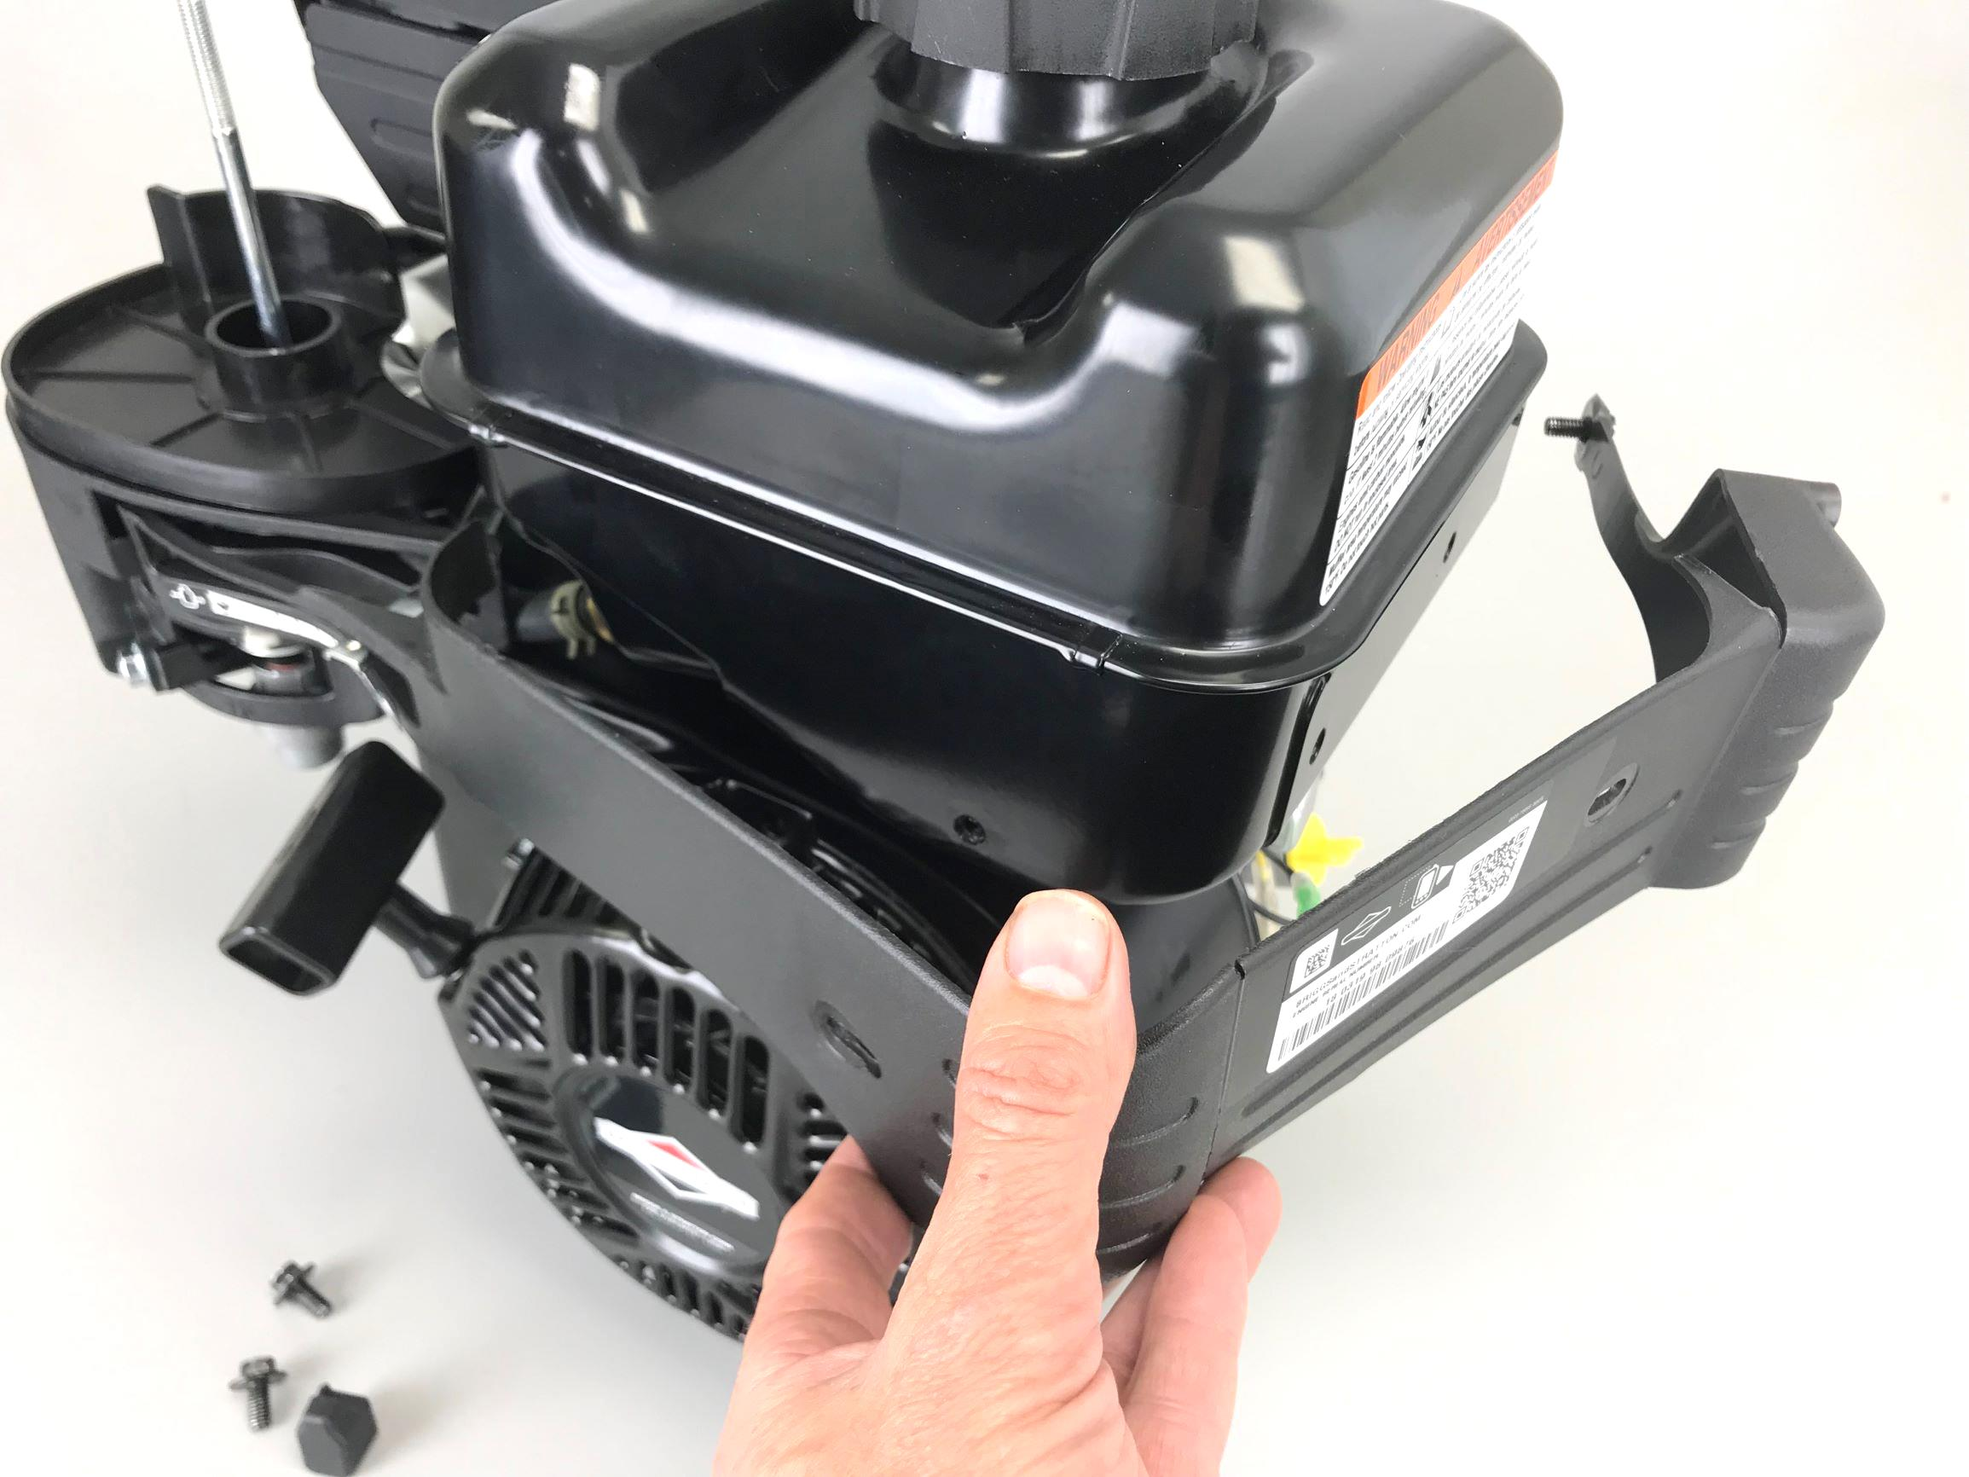
Remove Trim Panel
Pull throttle lever knob off
Remove three 8mm screws
Notes:
Remove knob
Remove 3, 8mm screws

Slide 8
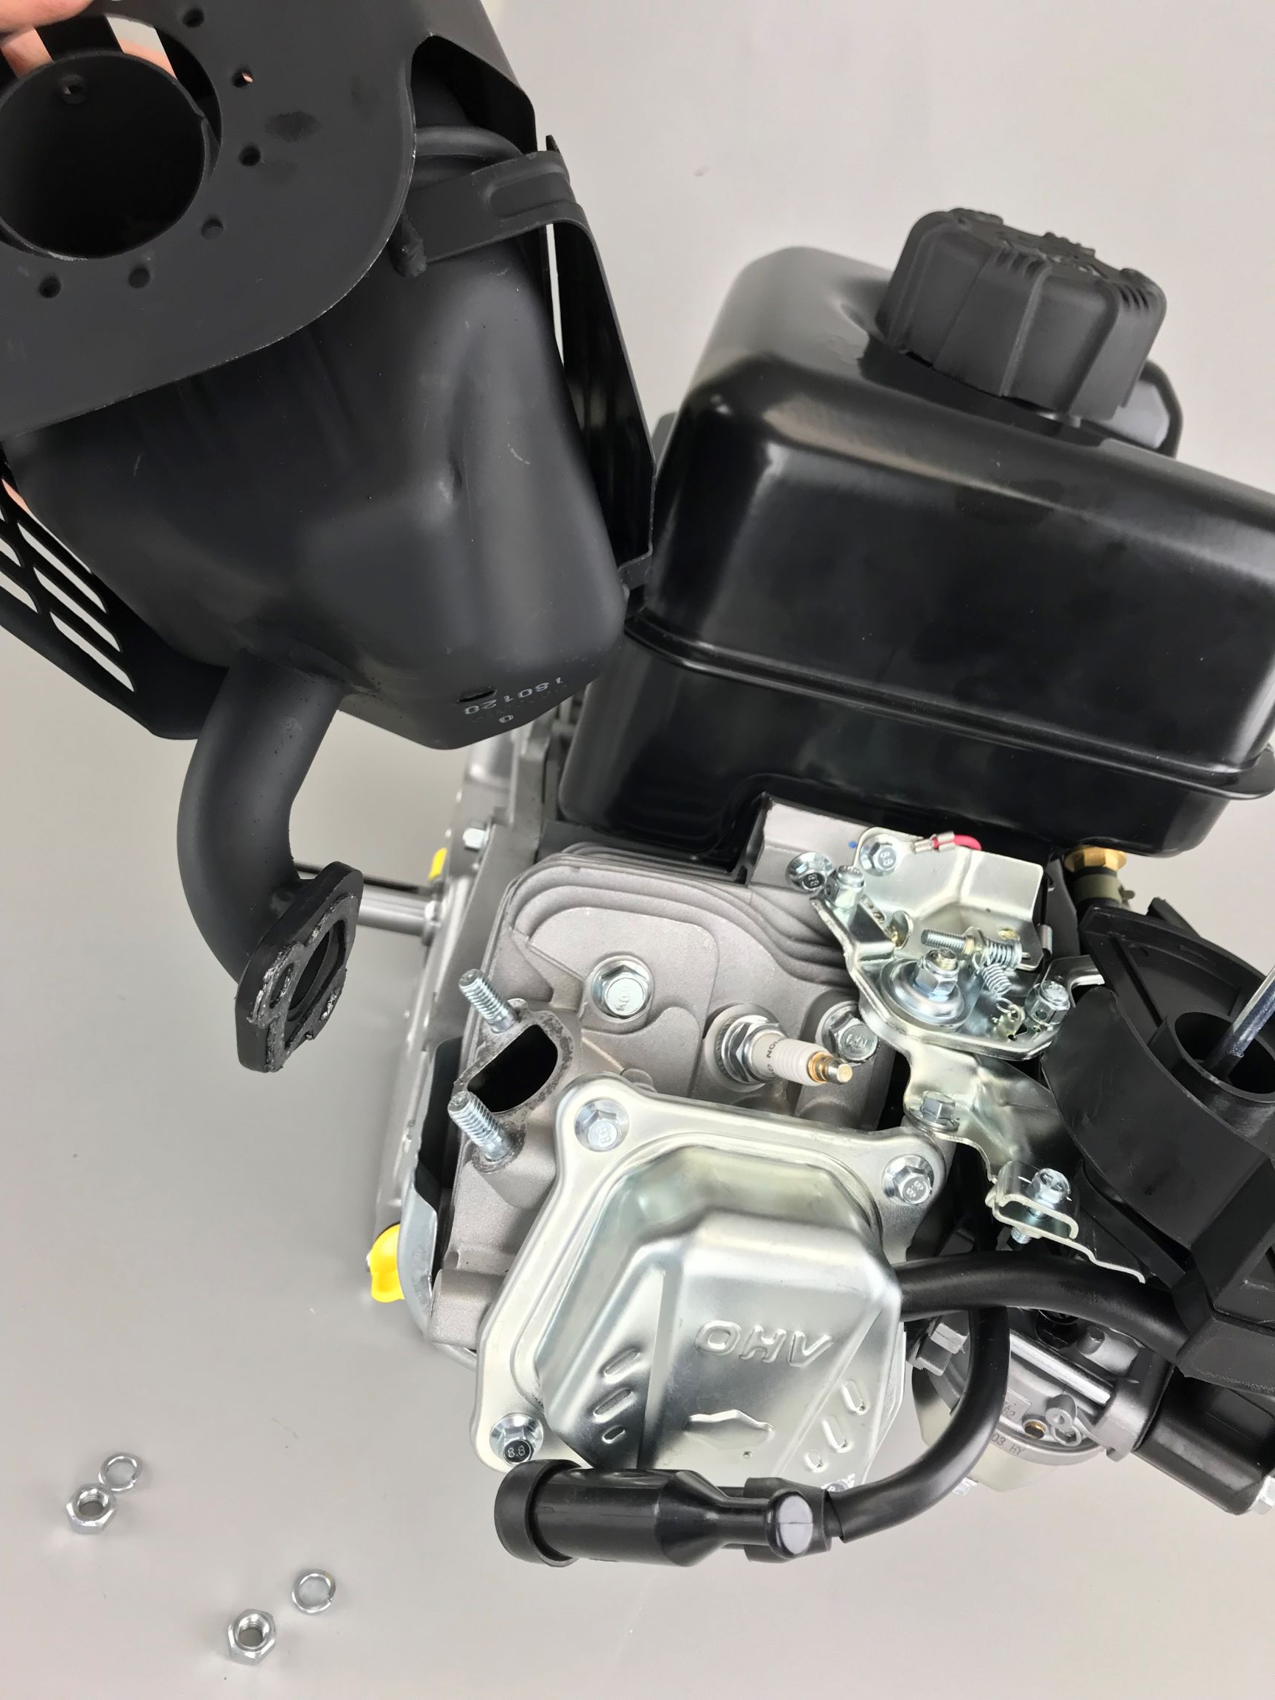
Remove Muffler
Use 13mm socket to remove two Nuts and Lock Washers
Inspect Exhaust Gasket for damage
Notes:
Optional: Remove Muffler Heat Shield
Guard To Prevent Touching Hot Muffler.
Note: Shield Still Gets Hot.
Muffler guards and other safety devices are now required by government standards.

Slide 9
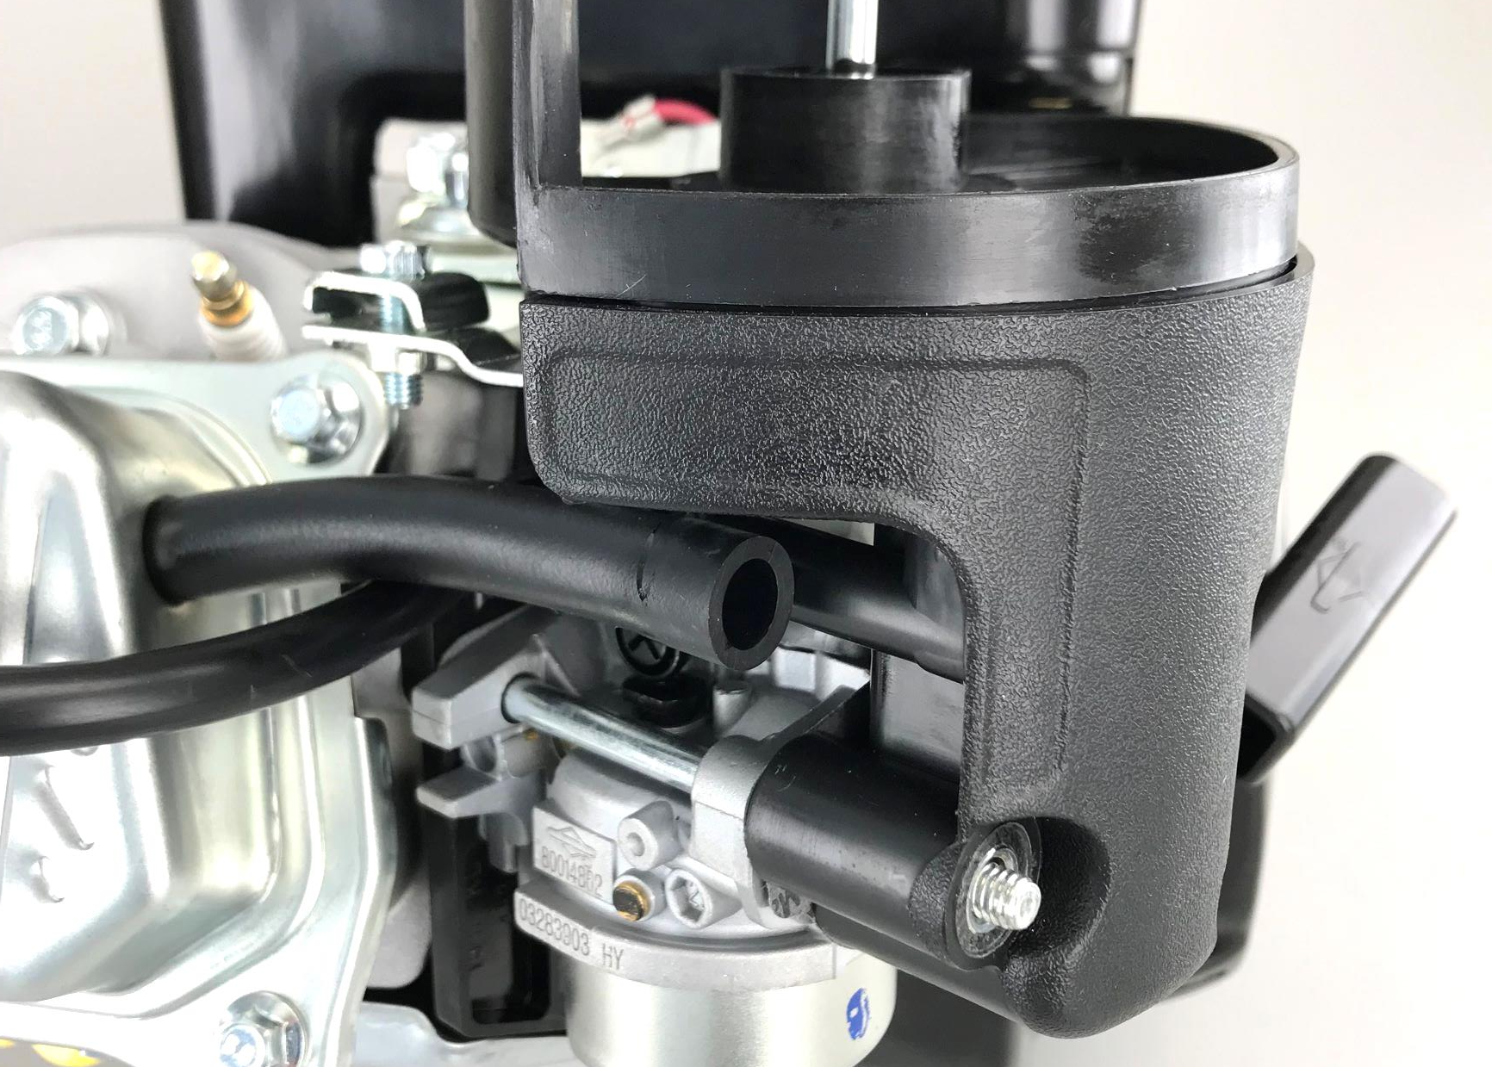
Remove Air Cleaner Backing Plate/Base
First disconnect Breather Hose from the air cleaner base that connects to valve cover
Notes:
Breather tube allow the air that is compressed in the crankcase during the down stroke of the piston to be recirculated back into the carburetor

Slide 10
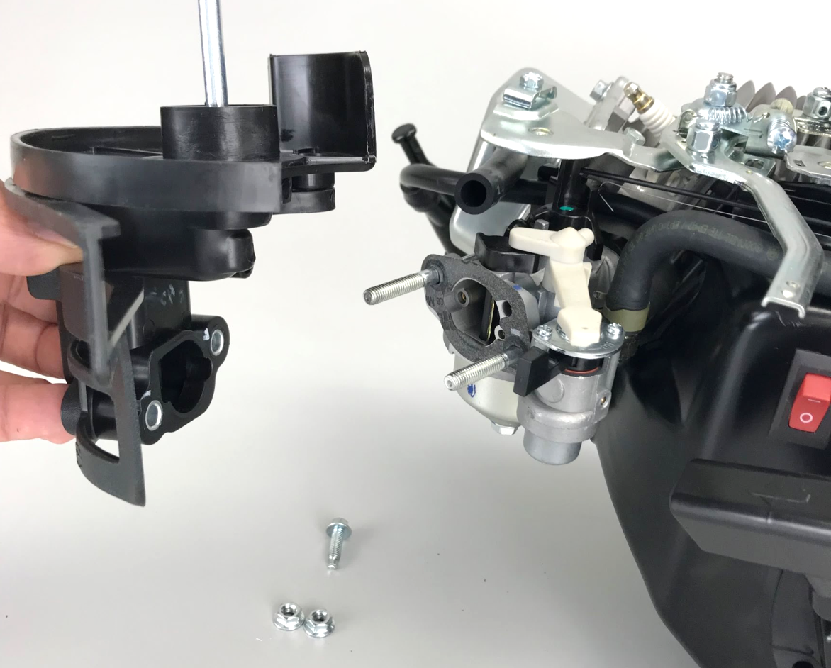
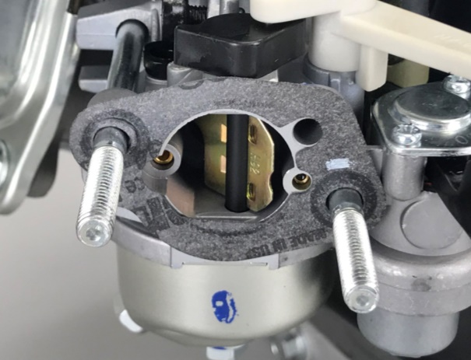
Remove Air Cleaner Backing Plate/Base
Use 8mm socket for top screw
Use 10mm socket for two flange nuts
Note orientation of gasket, inspect for damage
Notes:
Control lever may need to be adjusted in order or help facilitate removal of the carburetor.
This is the only screw of it’s length on the engine so keep it separate.

Slide 11
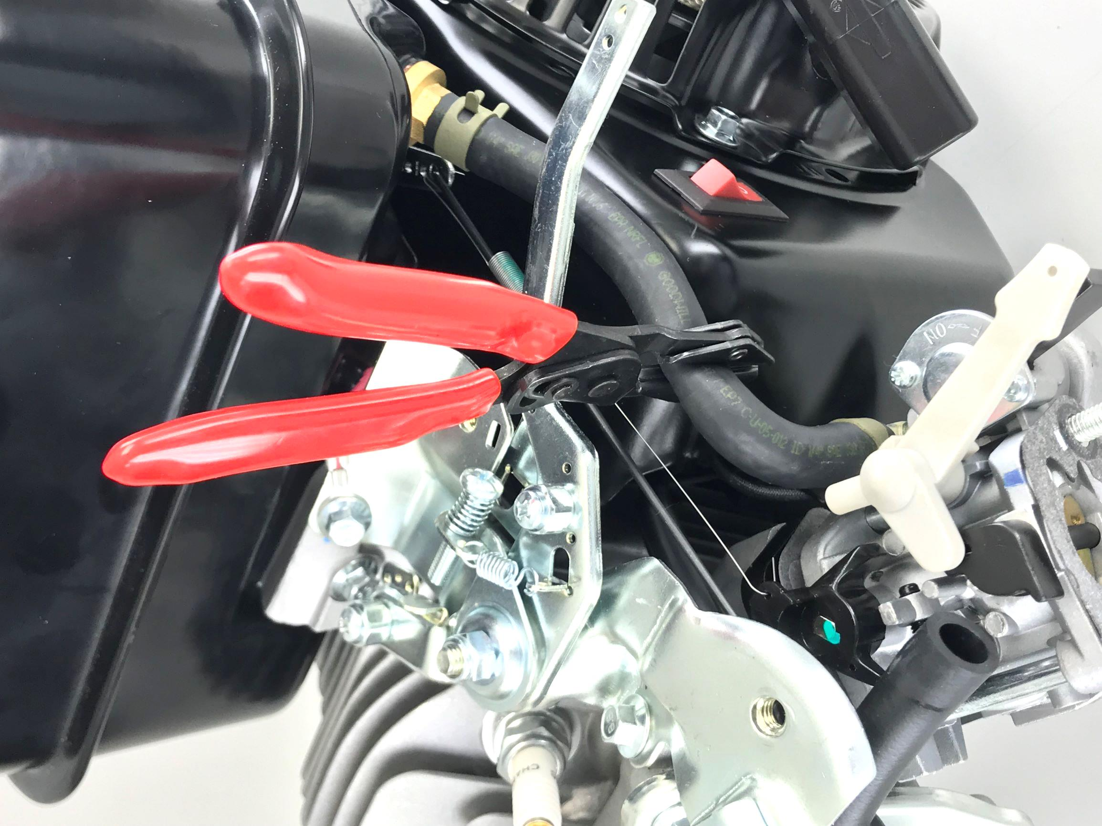
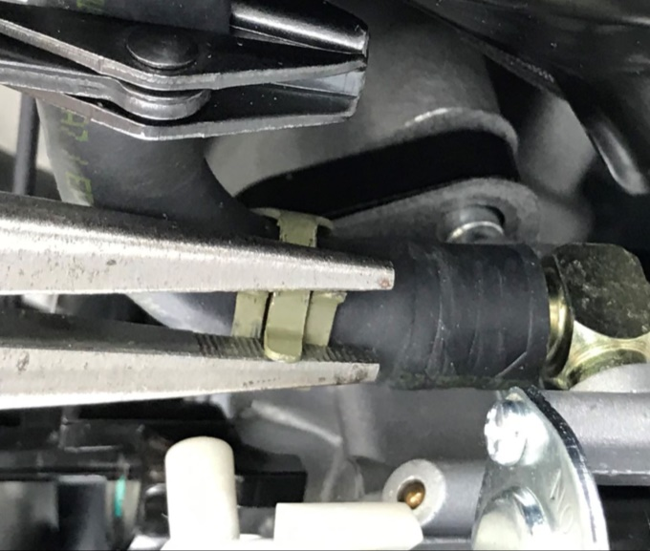
Disconnect Fuel Line
Clamp off fuel line using the hose clamp tool
Use a needle nose pliers to pinch and slide hose clamp away from
carburetor
Notes:
Before removing fuel tank clamp off fuel line and fuel hose.
Pinch and slide green hose clamp approximately 1” up the fuel line
Use fuel line removal tool to assist in removing fuel line from carburetor inlet port.
Use caution as some fuel is bound to dribble from the line, carb or tank.

Slide 12
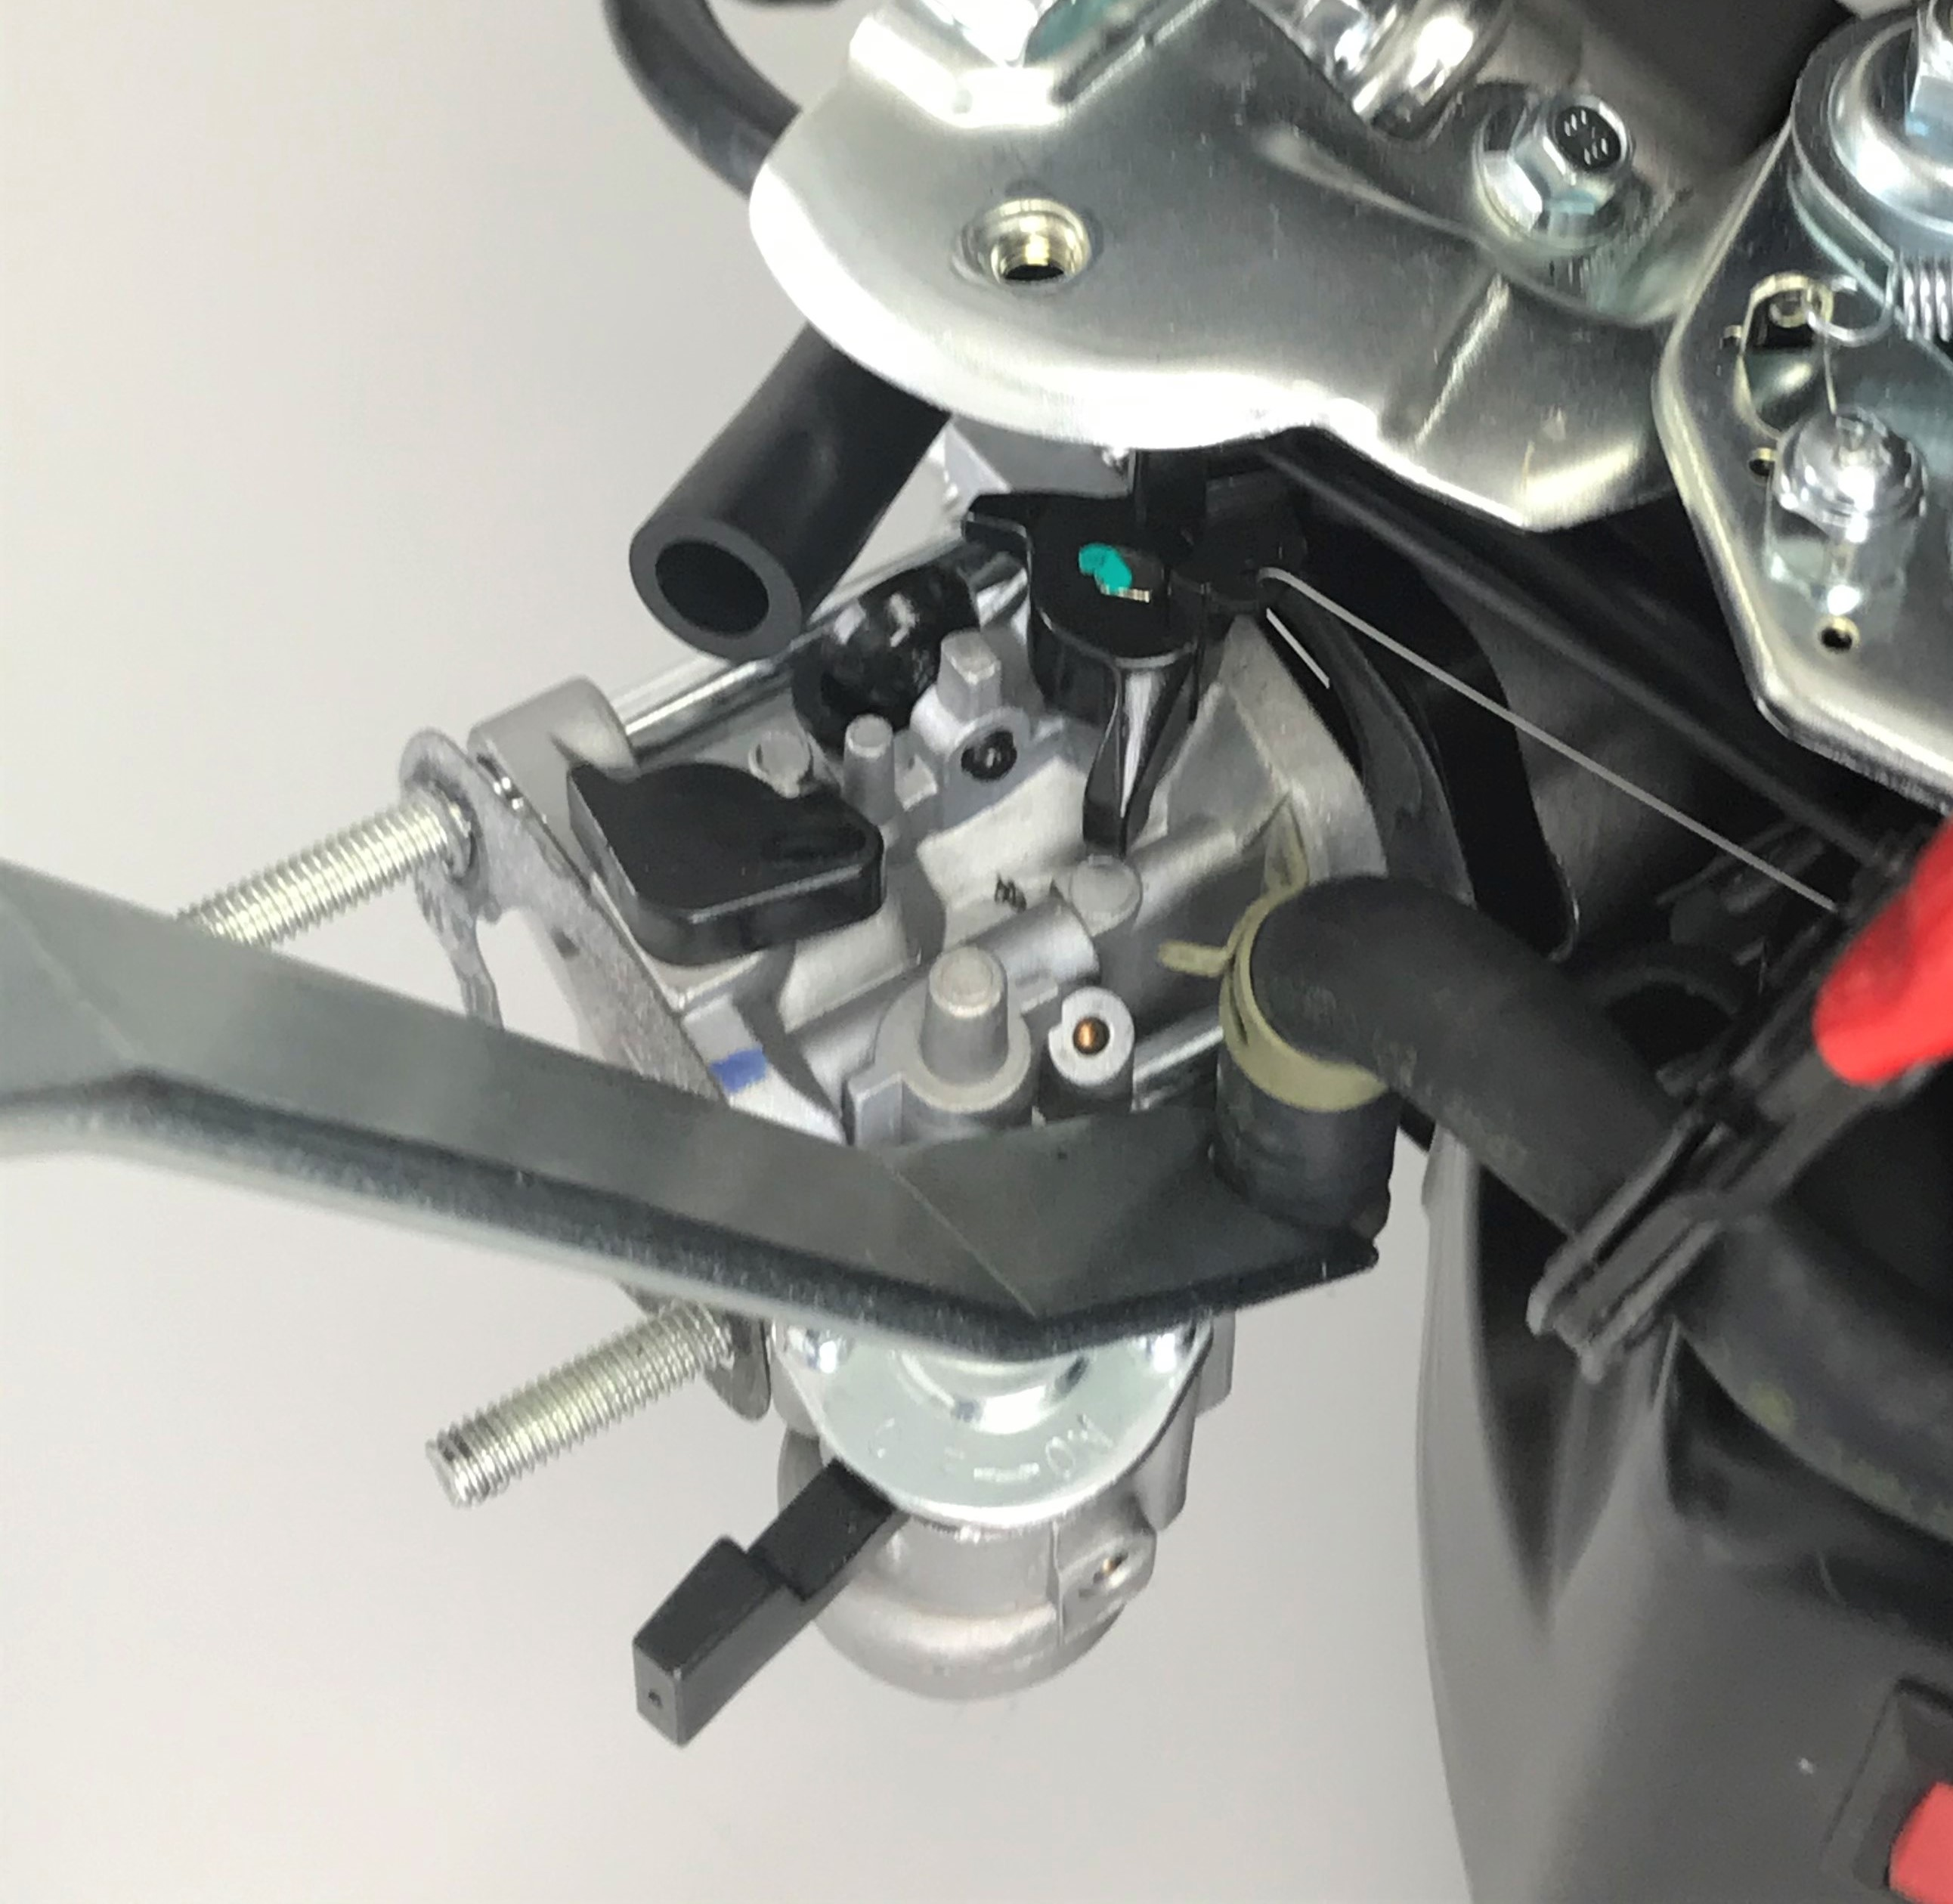
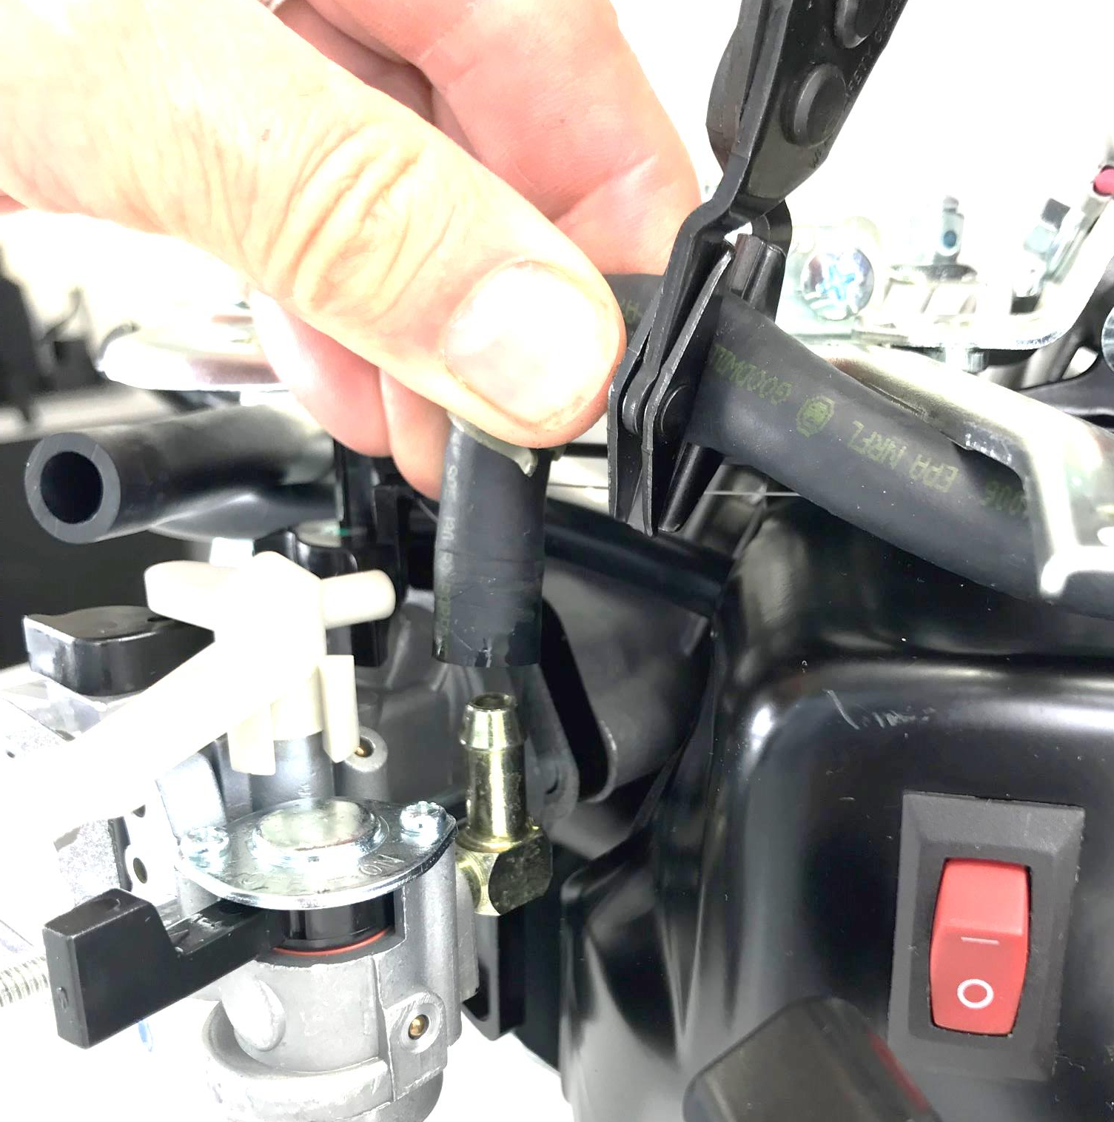
Disconnect Fuel Line
Use fuel line removal tool to assist in removing fuel line from carburetor inlet port
Notes:
Use Fuel Line Removal tool to assist in removing fuel line from Carburetor Inlet Port.
Use caution as some fuel is bound to dribble from the line, carb or tank.
A good idea is to place absorbent towel down to catch any that may drip out.

Slide 13
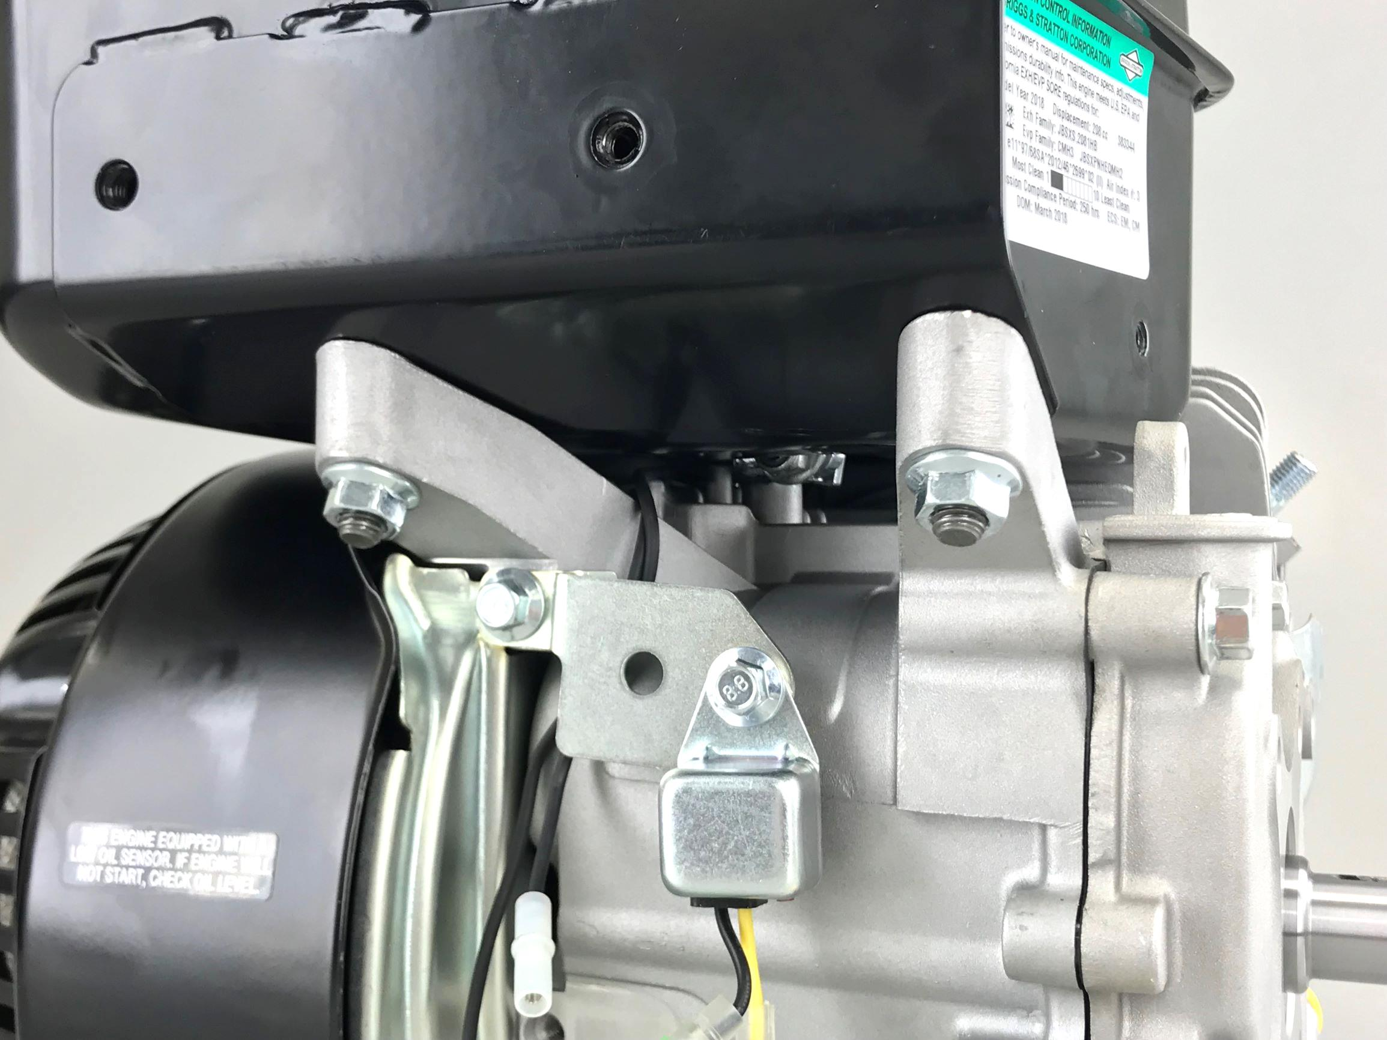
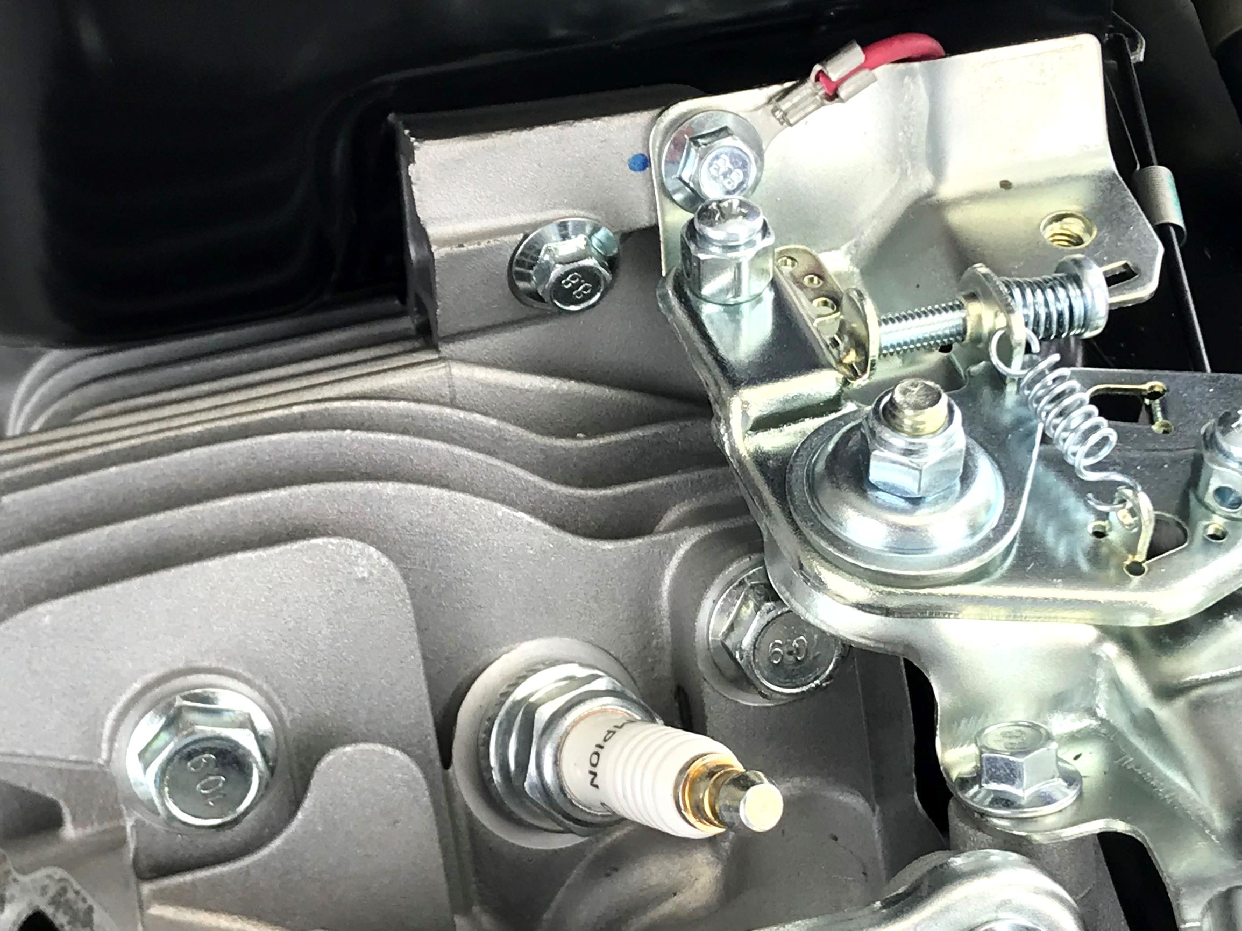
Remove Fuel Tank
Use 12mm socket for two flange nuts above low oil module
Use 8mm socket for screw just above spark plug
Notes:
Fuel line can be left connected to fuel tank to prevent fuel leakage.
Tank serves as reservoir for fuel
Cap has threads that allow air to be vented. Must use proper cap.
Fuel tanks and lines are now coated to prevent evaporative fuel emissions
Keep screw and nuts separate – they are different than others

Slide 14
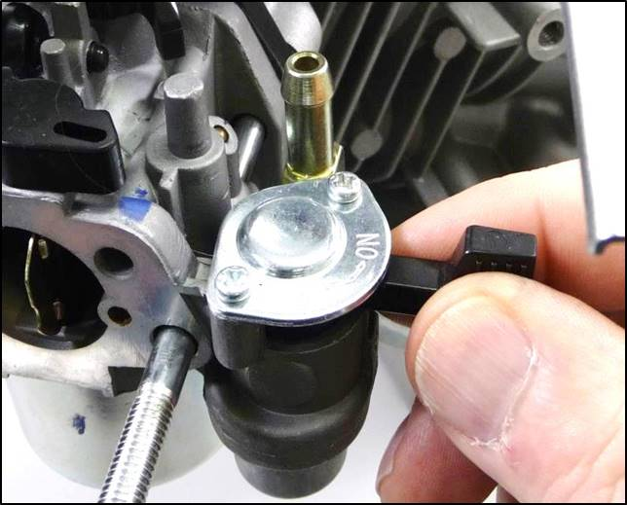
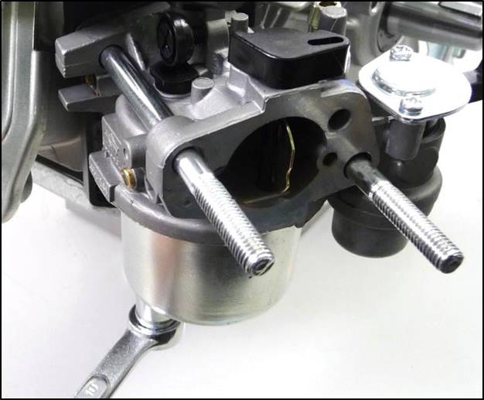
Drain Fuel Bowl
Turn fuel valve “ON”
Remove the 10mm bowl screw and drain fuel into a approved container
Notes:
Drain fuel into an approved container

Slide 15
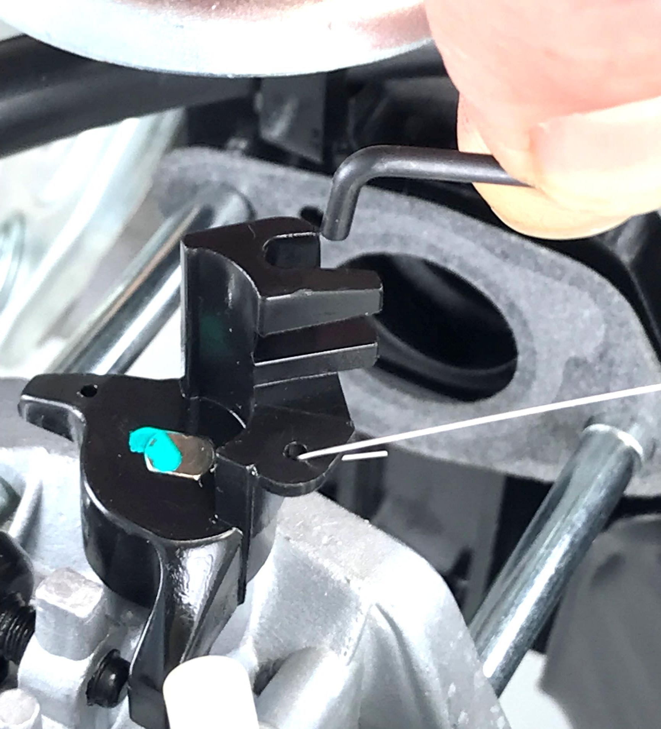
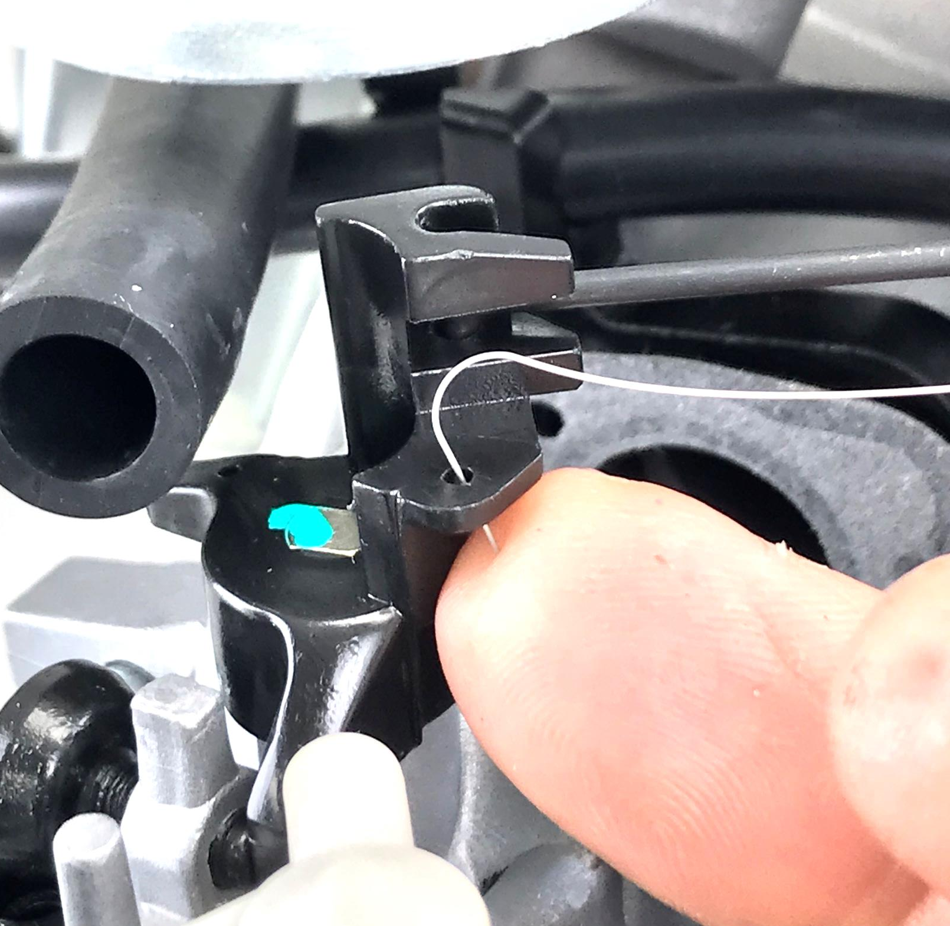
Remove Carburetor
Slide carburetor along studs for an inch or two
Pull upwards on governor link to disconnect
Disconnect link spring by pushing from
underneath
Notes:
Sliding carb along studs allows throttle shaft to rotate to allow “L” bend of governor link to disengage from the shaft.
Disconnect but do not damage spring.
Note fuel line routing as refers to wires, governor link and link spring.
Line will have to be rerouted the same way upon reassembly.

Slide 16
Remove Float Bowl
Remove bowl nut with 10mm tool
Observe float and inlet needle movement

Slide 17
Remove Float Bowl
Observe float and inlet needle movement
Inlet needle is spring loaded
Notes:
Take note of where the bowl drain screw is so it can be reinstalled facing the same way.

Slide 18
Remove Float and Needle Valve
Use pliers to remove hinge pin
Examine slot in float for inlet needle and orientation of spring
Examine seat in carburetor body

Slide 19
Remove Idle Stop Screw
Count and record the number of turns required to remove.
Notes:
This screw sets the engine curb idle speed.
We’re counting turns so it can be reinstalled reasonably close to where it was.

Slide 20
Remove Pilot Jet
Gently pry up with screwdriver or pull out with pliers.
Notes:
What does it do?
Combines metered air and fuel to support operation of the idle circuit.

Slide 21
Remove Main Jet & Emulsion Tube
Unscrew jet with narrow, flat-blade screwdriver.
Notes:
The small brass piece is the main jet.
All the fuel the engine burns must come through this jet.
The larger brass piece is the emulsion tube.
The small holes through the side of the piece allow air to bubble in and mix with the fuel.
This breaks up the fuel into smaller droplets and increases the surface area of fuel exposed to air.
This aids in the vaporization of the fuel.

Slide 22
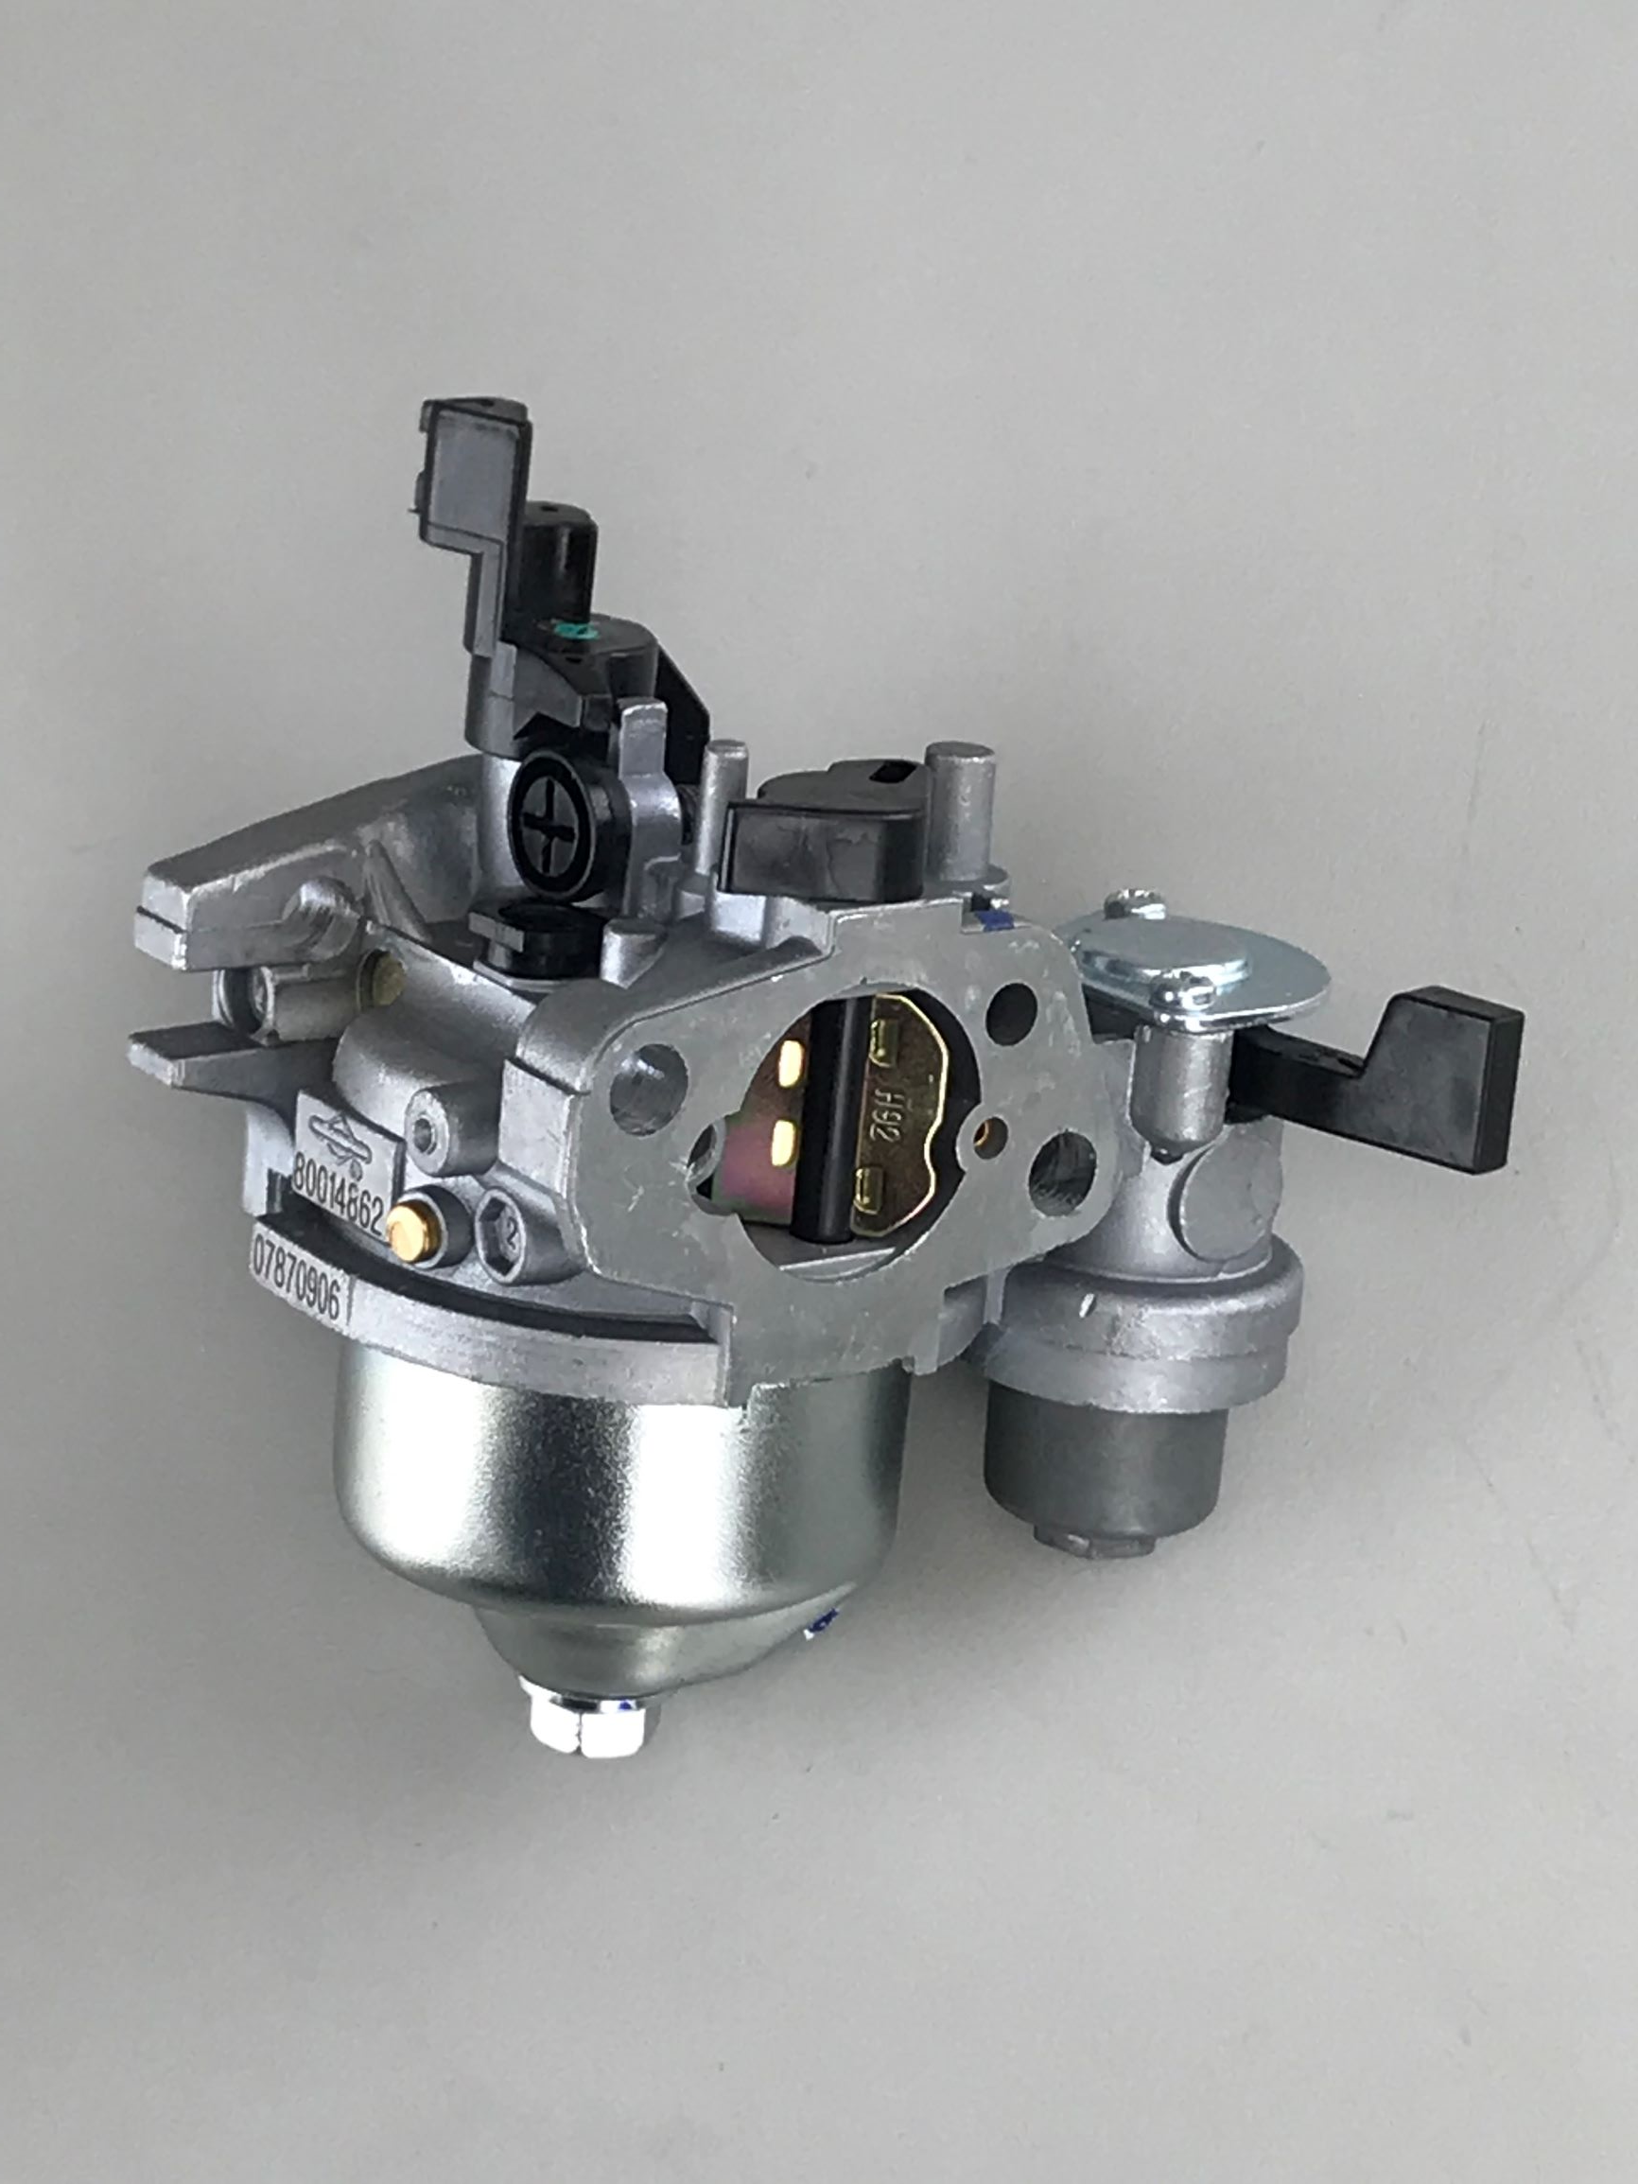
Reassemble Carburetor
Assembly the carburetor following the next few steps and set aside.

Slide 23
Install Main Jet & Emulsion Tube
Slide emulsion tube into carburetor body
Screw jet tight to emulsion tube
Use a narrow screwdriver to prevent thread damage to carburetor body

Slide 24
Install Pilot Jet
Note orientation of flat sections
Press jet by hand until it seats

Slide 25
Install Idle Stop Screw
Screw in the same number of turns it took to remove
This should set the idle speed close to where it was originally

Slide 26
Install Float and Needle Valve
Float should be level with gasket surface when held with the float up.

Slide 27
Attach Float Bowl
Verify bowl gasket is properly installed
Assemble bowl to carburetor
Install bowl nut with 10mm tool
Torque to 50 lbs-in.

Slide 28
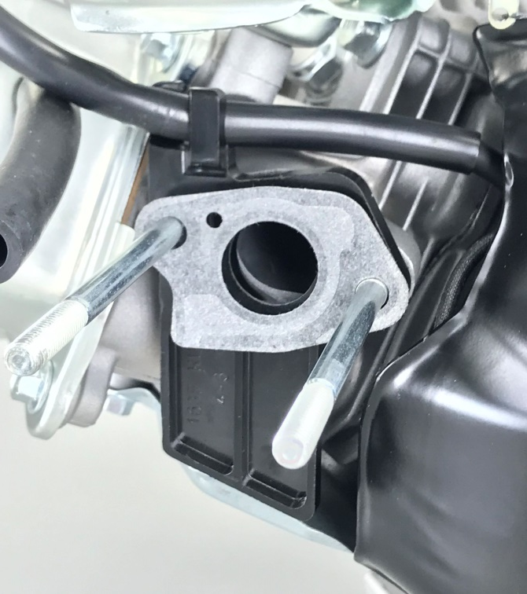
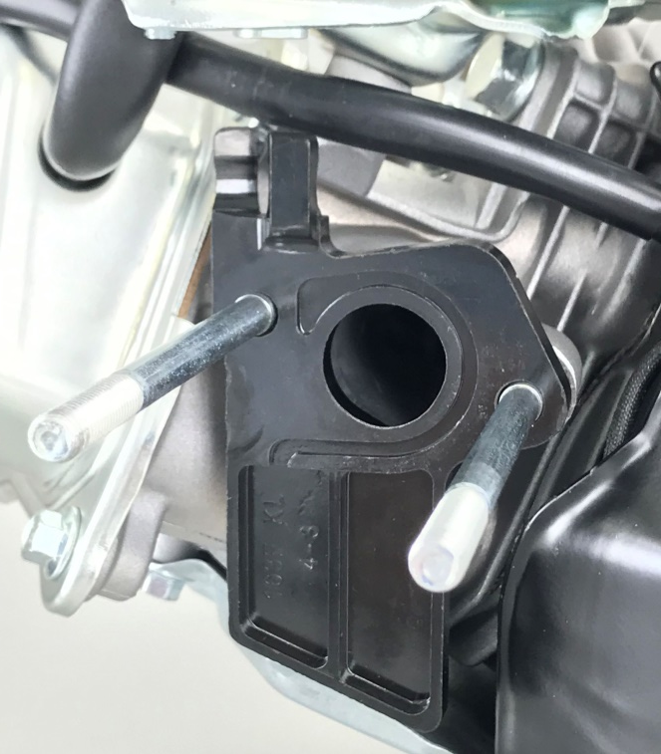
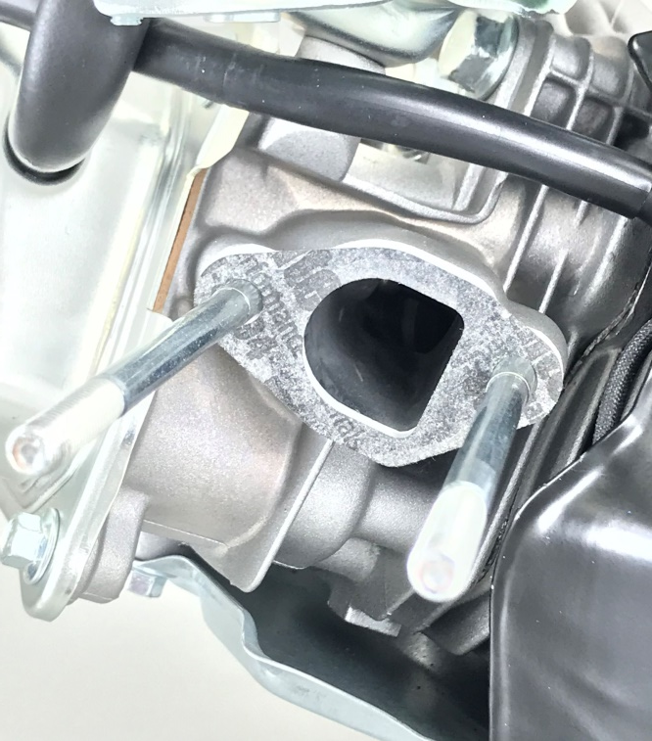
Remove Gaskets and Spacer
Note orientation of each gasket and Carburetor Spacer
Remove Spark Plug Wire from integral holder on Spacer
Carburetor Gasket Carburetor Spacer Spacer Gasket
Notes:
Make sure gaskets are installed and properly oriented.

Slide 29
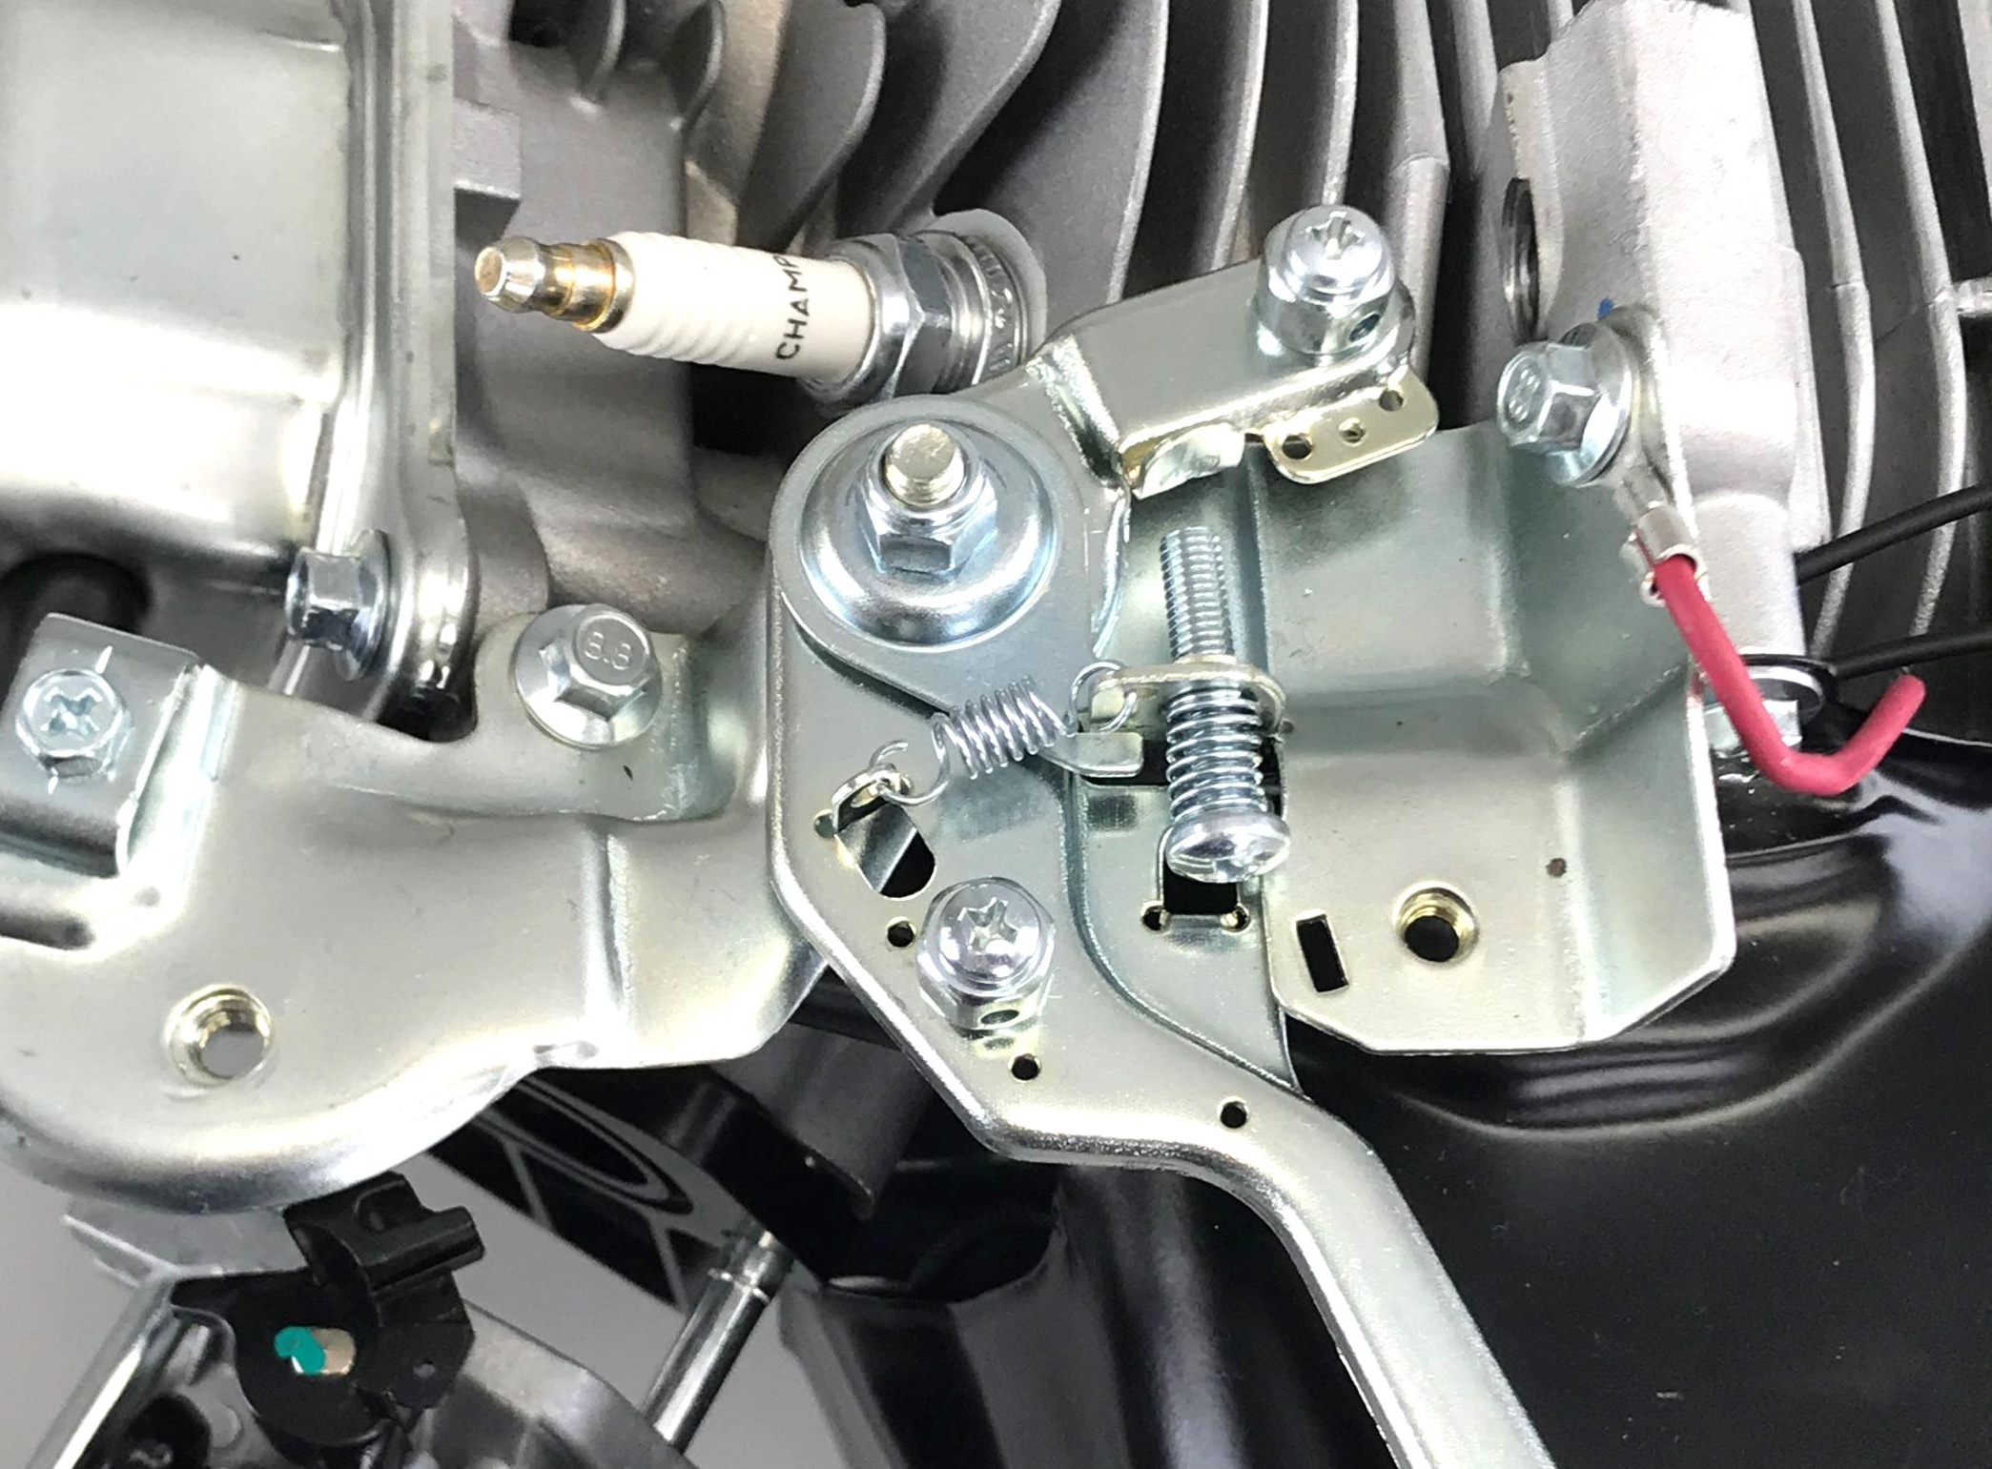
Remove Speed Control Bracket
Remove 2 screws with 8mm socket
Note Throttle Control Level may need to be reposition to access the upper screw
Note routing of RED ground wire
Notes:
Note routing of RED wire.

Slide 30
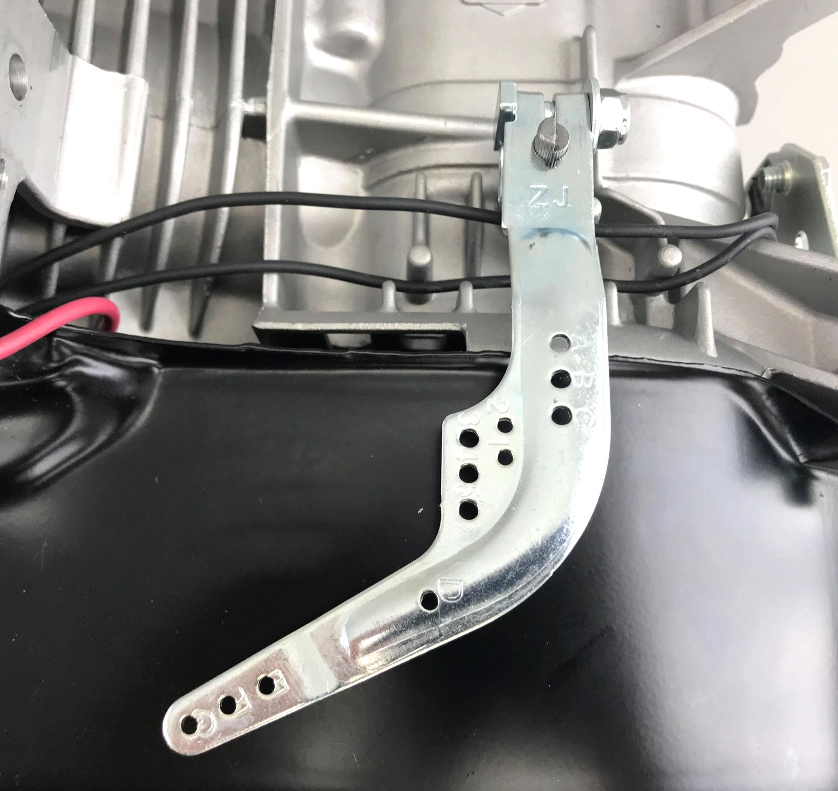
Remove Governor Control Lever
Disconnect governor linkage and springs
Use a 10mm wrench
Loosen pinch bolt nut, but do not remove
Lift governor control lever off the governor shaft

Slide 31
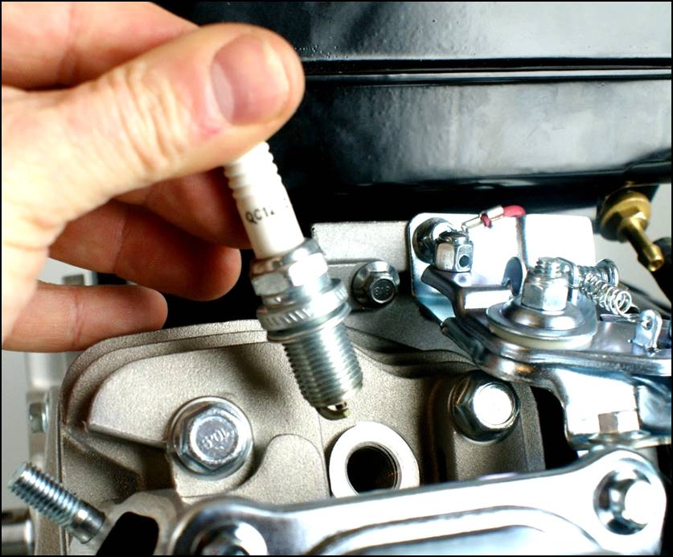
Remove Spark Plug
Use 5/8 in. spark plug socket
To ensure no damage is done to the spark plug, avoid applying any side load to the wrench
Notes:
Avoid applying any side load to the wrench, to ensure no damage is done to the spark plug

Slide 32
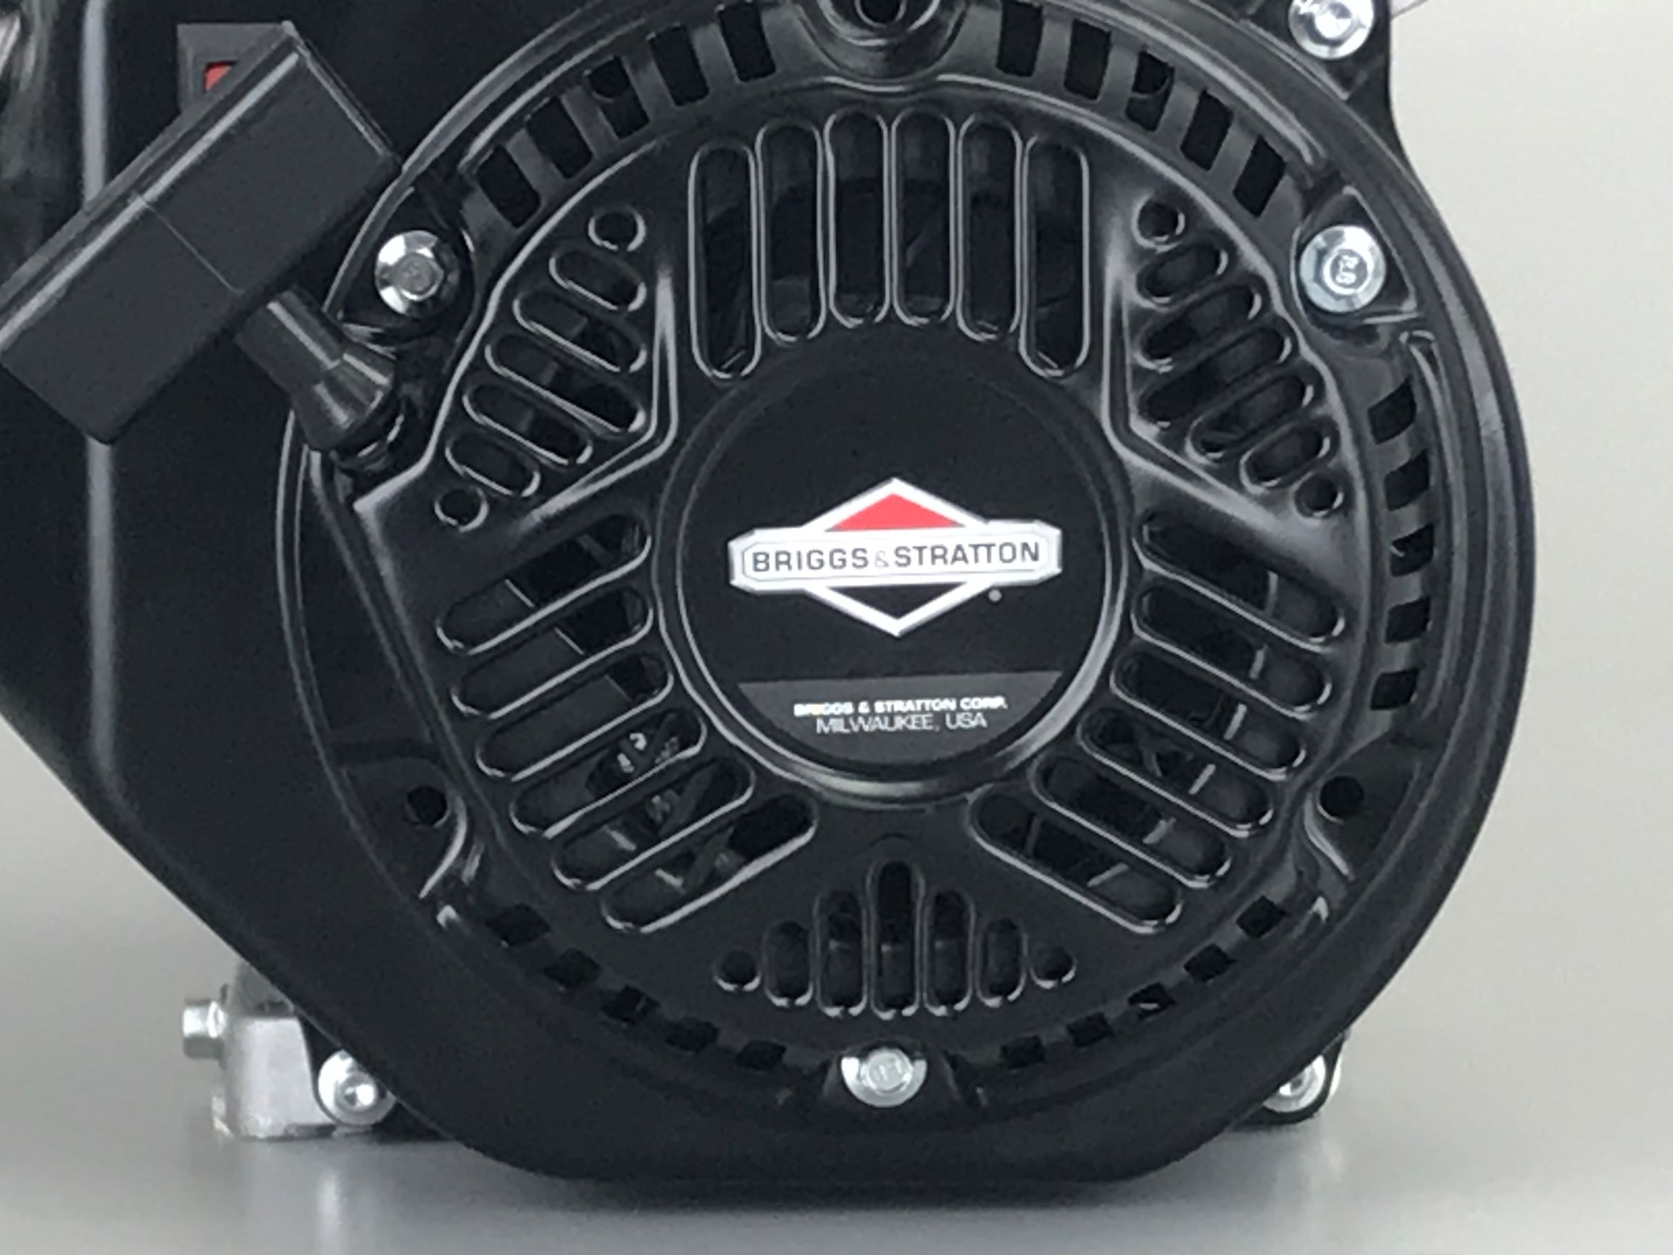
Remove Rewind Starter
Use 8mm socket to remove three screws
Notes:
This step can be optional.
Rewind and Blower Housing can be removed as one component.

Slide 33
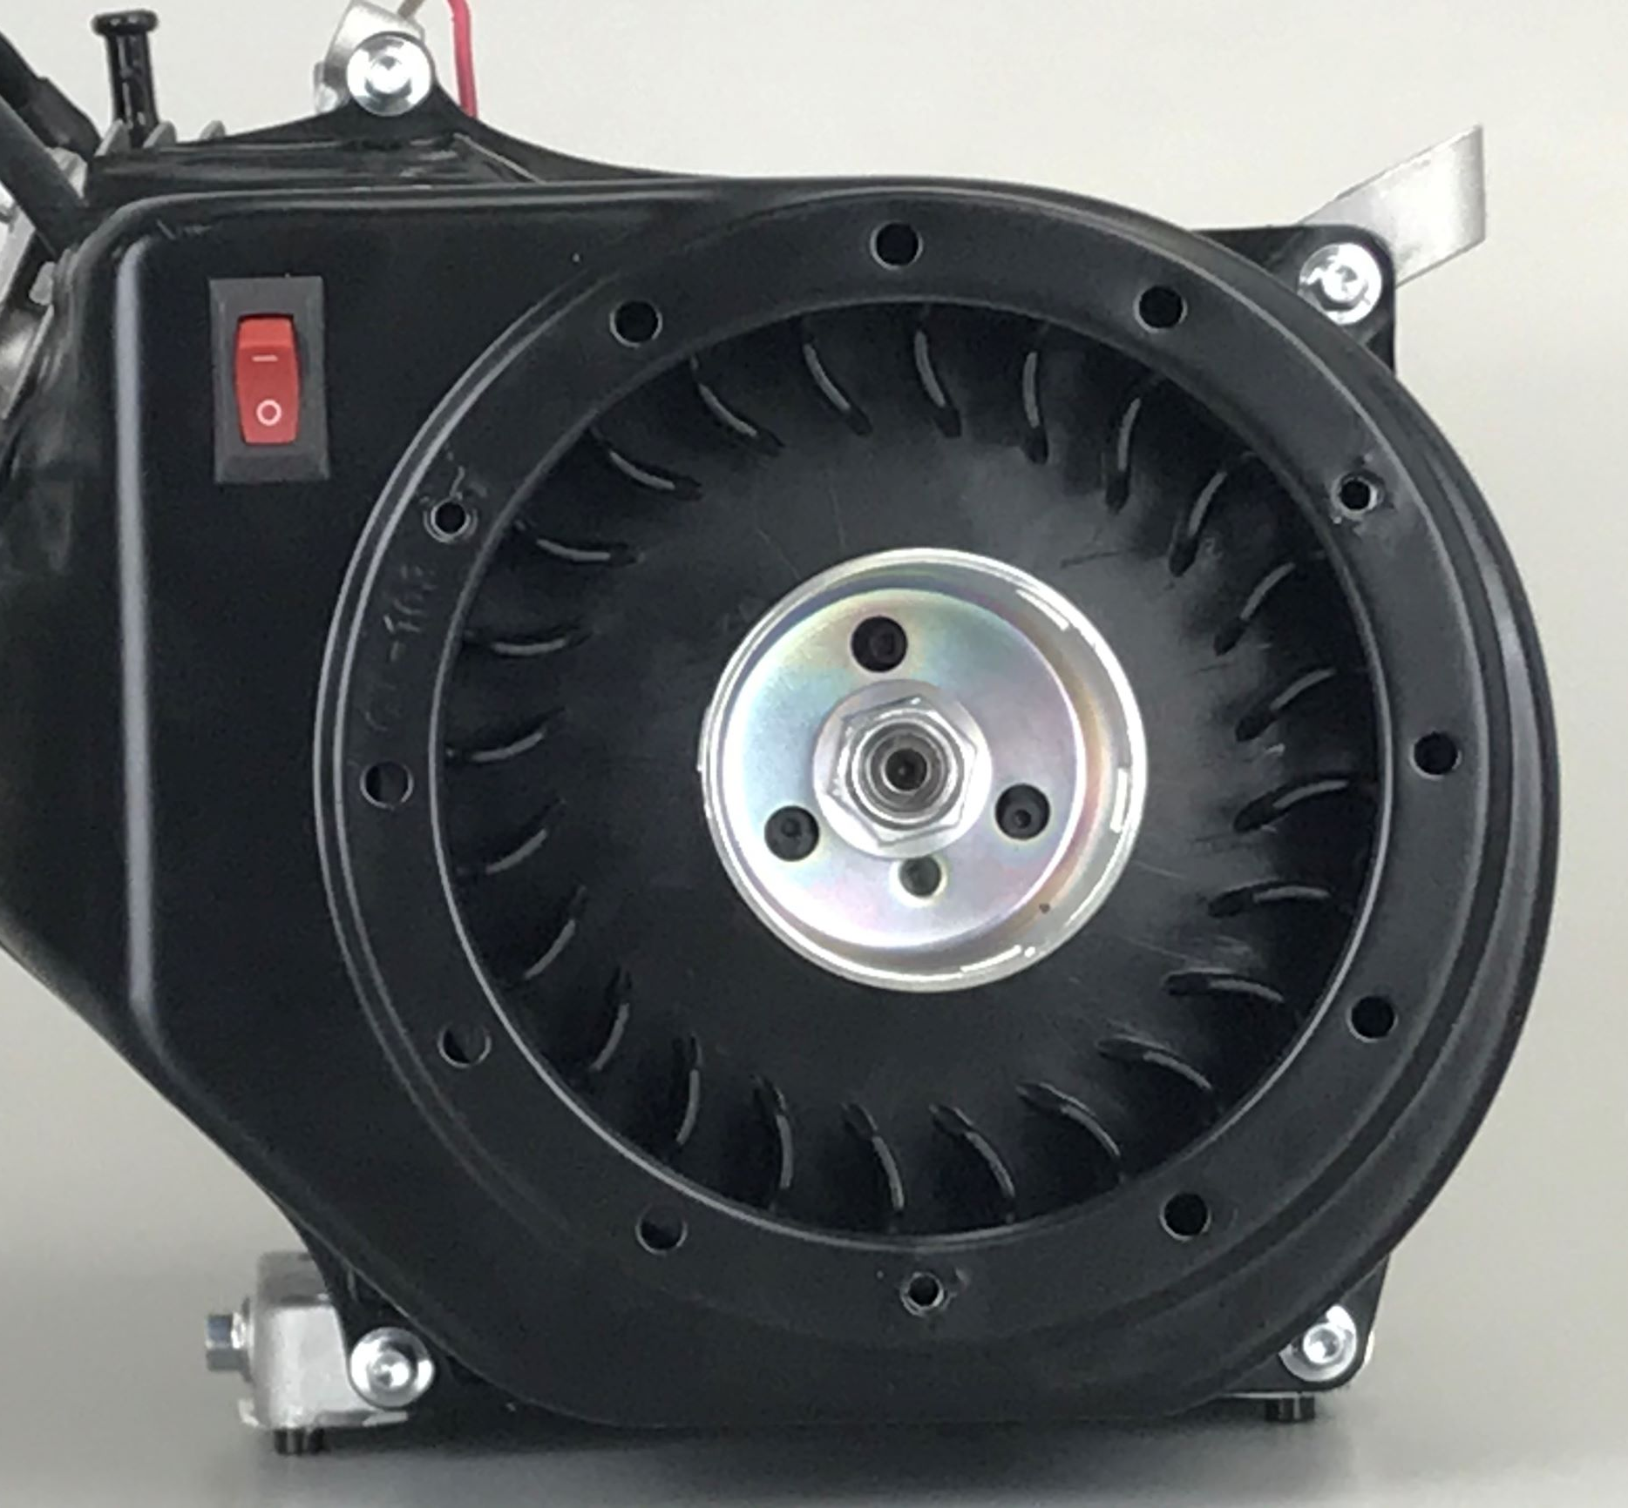
Remove Blower Housing
Use 8mm socket to remove four screws
Carefully pull blower housing away from engine
Three wires are connected to the switch
Notes:
Using an 8mm socket, remove the 4 screws that secure the blower housing to the engine.

Slide 34
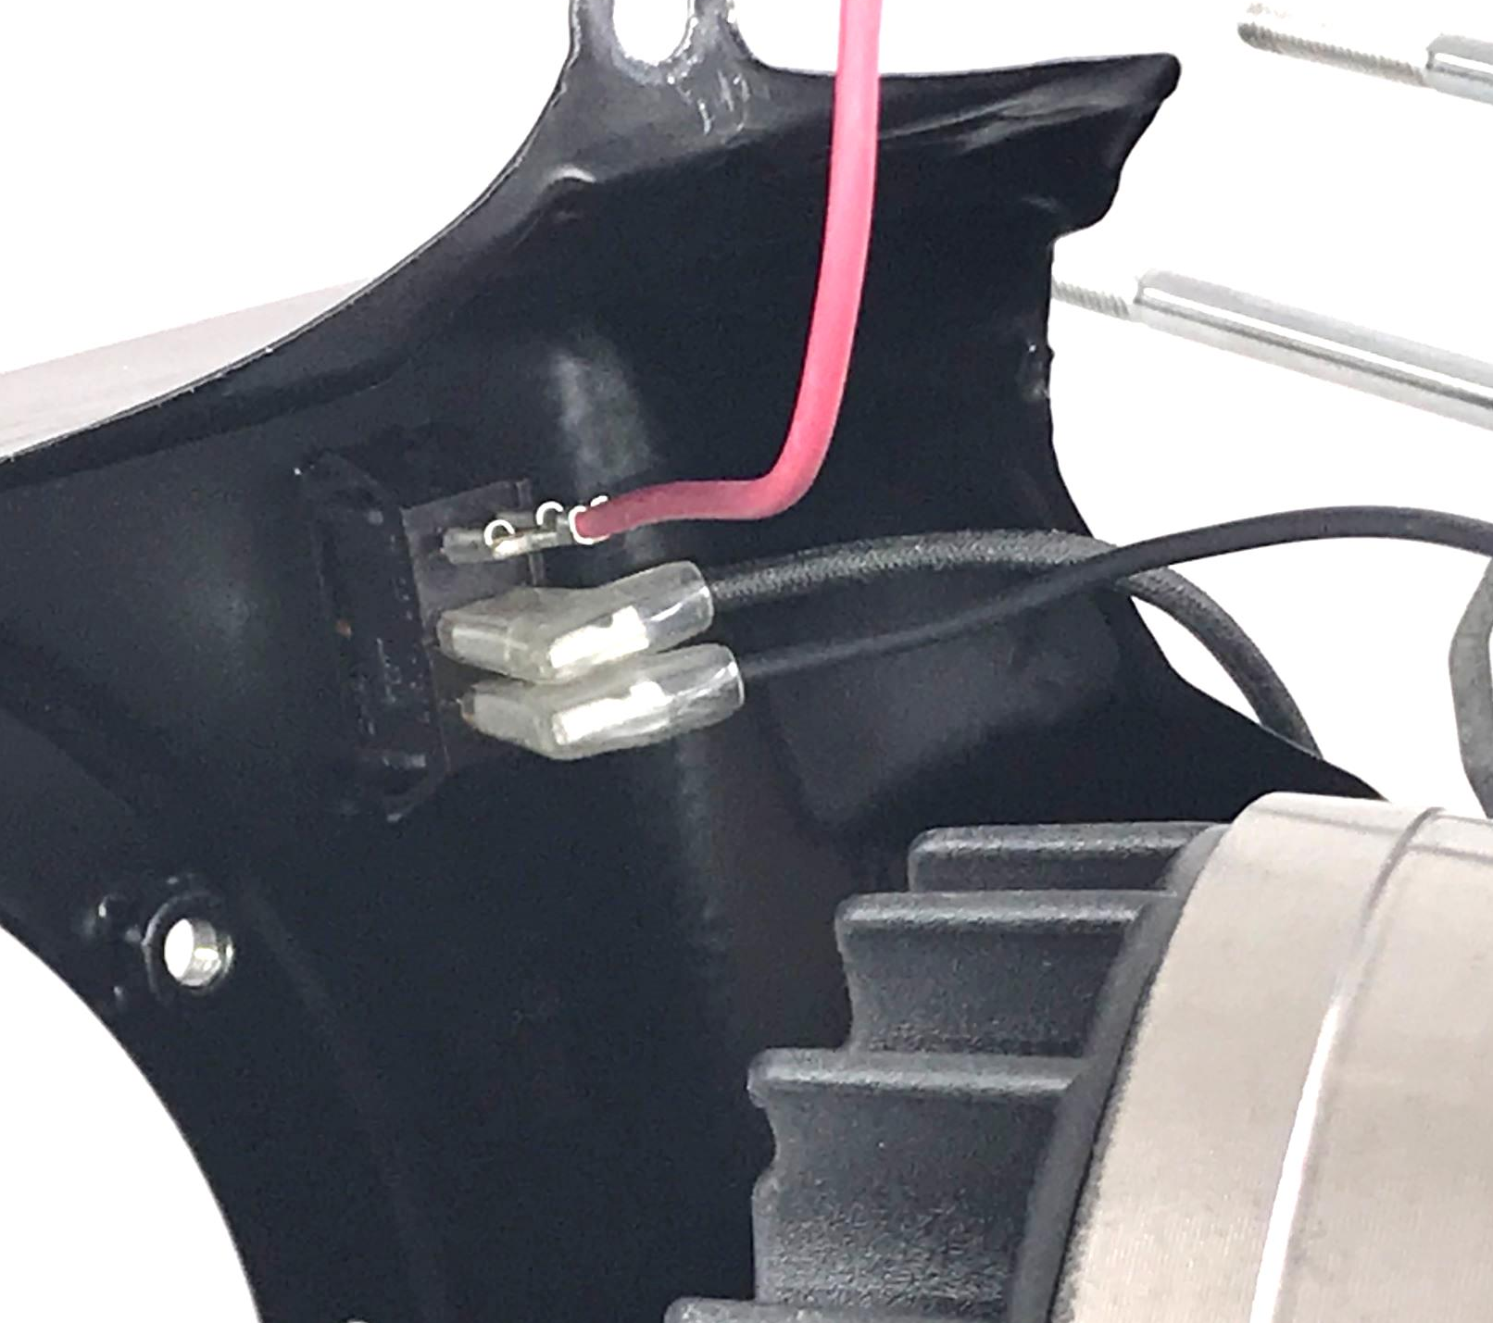
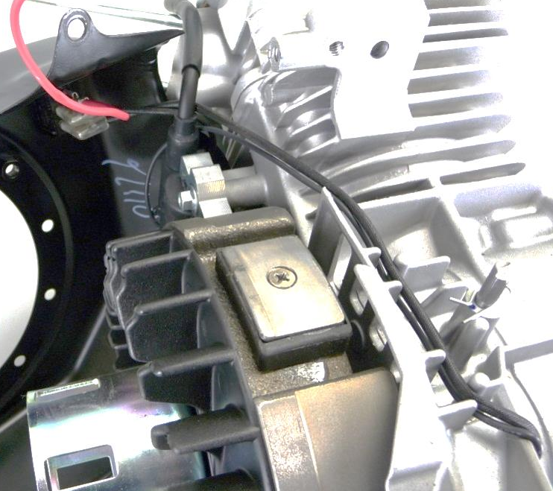
Disconnect Wiring from Switch
Note which wire are connected to which terminals on the switch
Note where each of the three wire are routed to
Notes:
Disconnect wiring from rocker switch installed in housing.
If there are three wires, mark which wires came from which terminal on the switch.
The switch is marked with a 1,2,3.
Note travel of wires across the top of the engine near the governor shaft as they need to be rerouted in the same orientation.

Slide 35
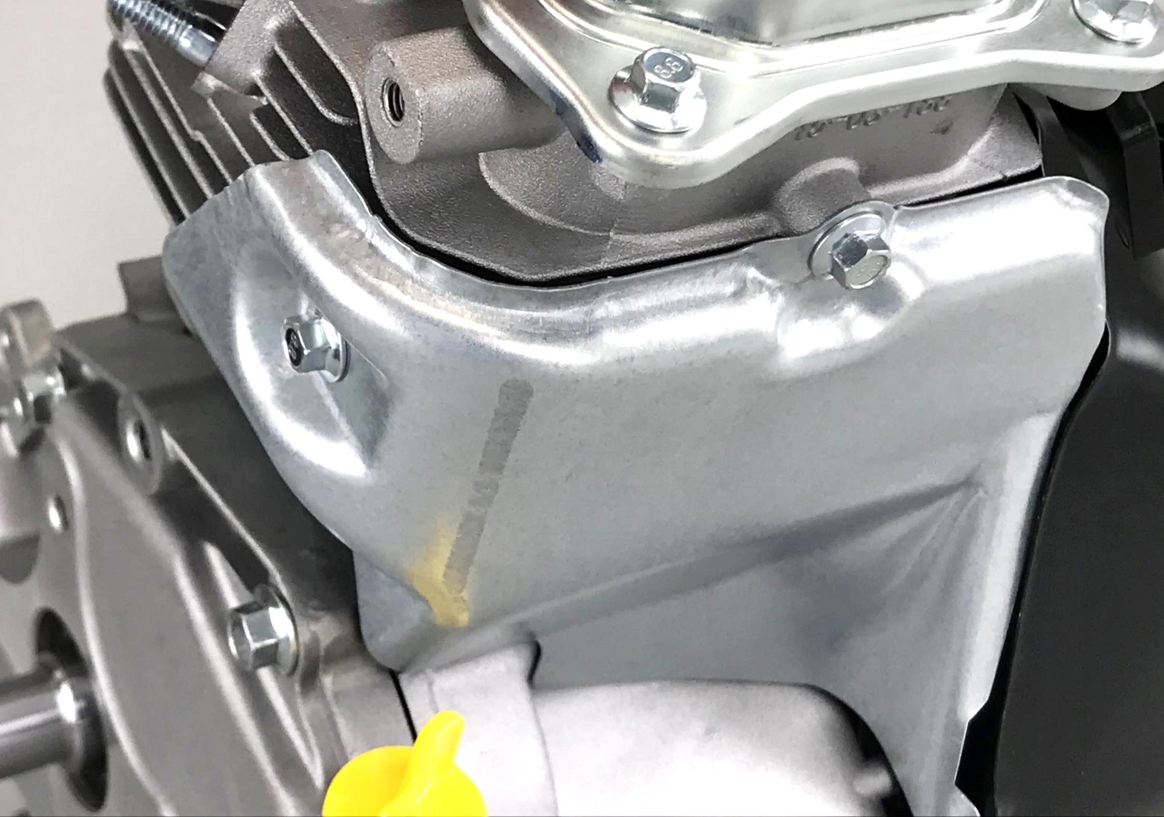
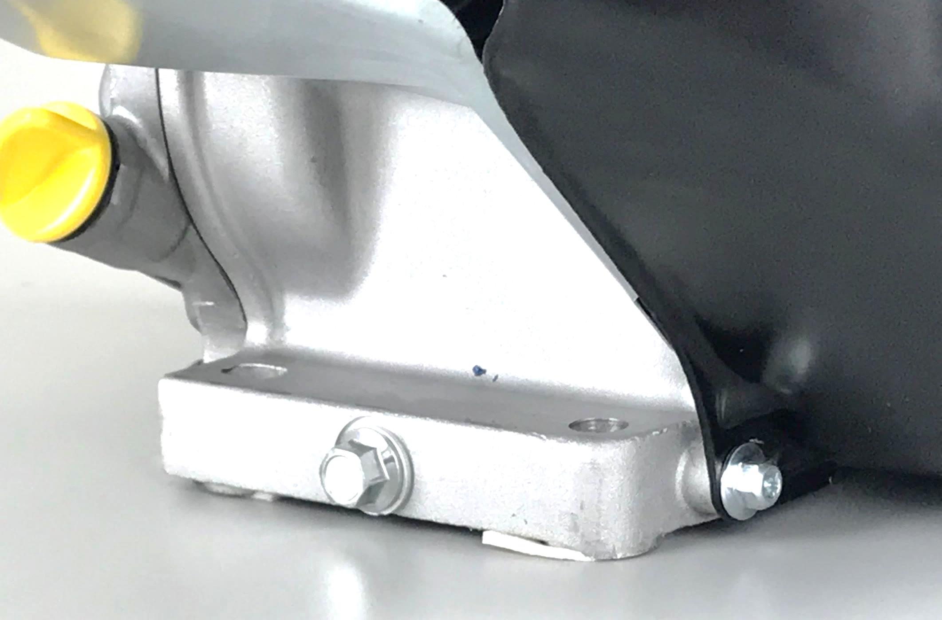
Remove Cylinder Air Guide
Use 8mm socket to remove three screws:
PTO side
Below valve cover
Lower left corner of blower housing
Notes:
Lower screw mount is placed between the blower housing and the cylinder.

Slide 36
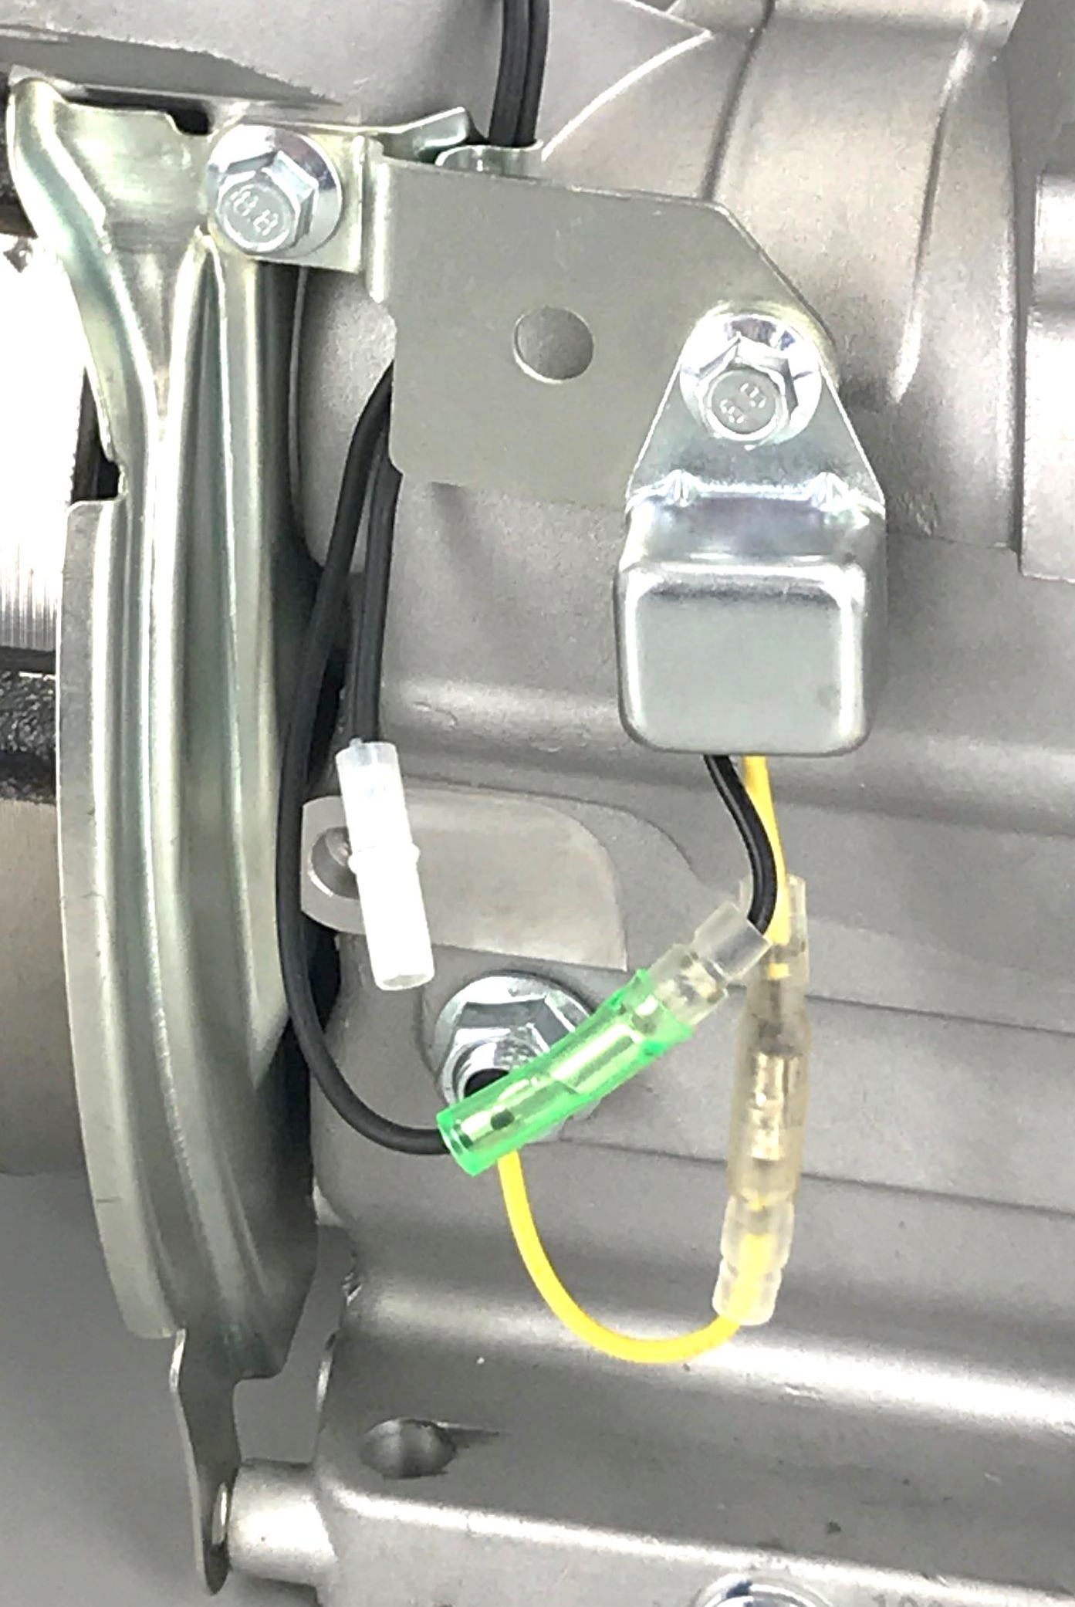
Remove Finger Guard
Use 8mm socket
Leave time delay sensor attached to finger guard
Disconnect yellow and black wires from time delay module
Notes:
Disconnect yellow and black wires from time delay module

Slide 37
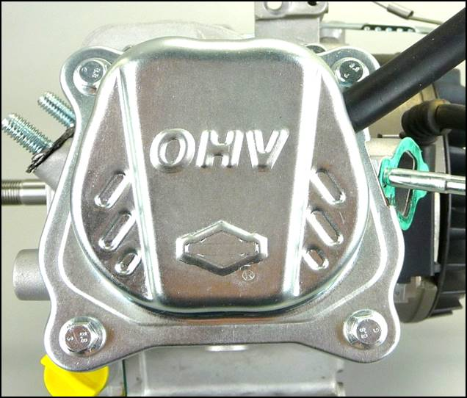
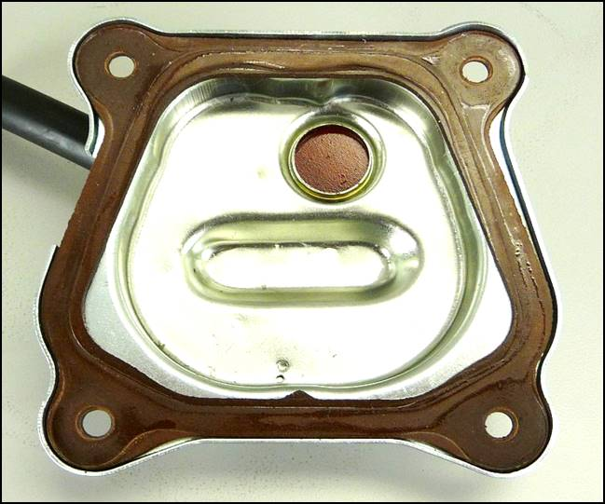
Remove Valve Cover
Use 8mm socket to remove four screws
Cover is also the breather
Notes:
Do not touch breather reed.

Slide 38
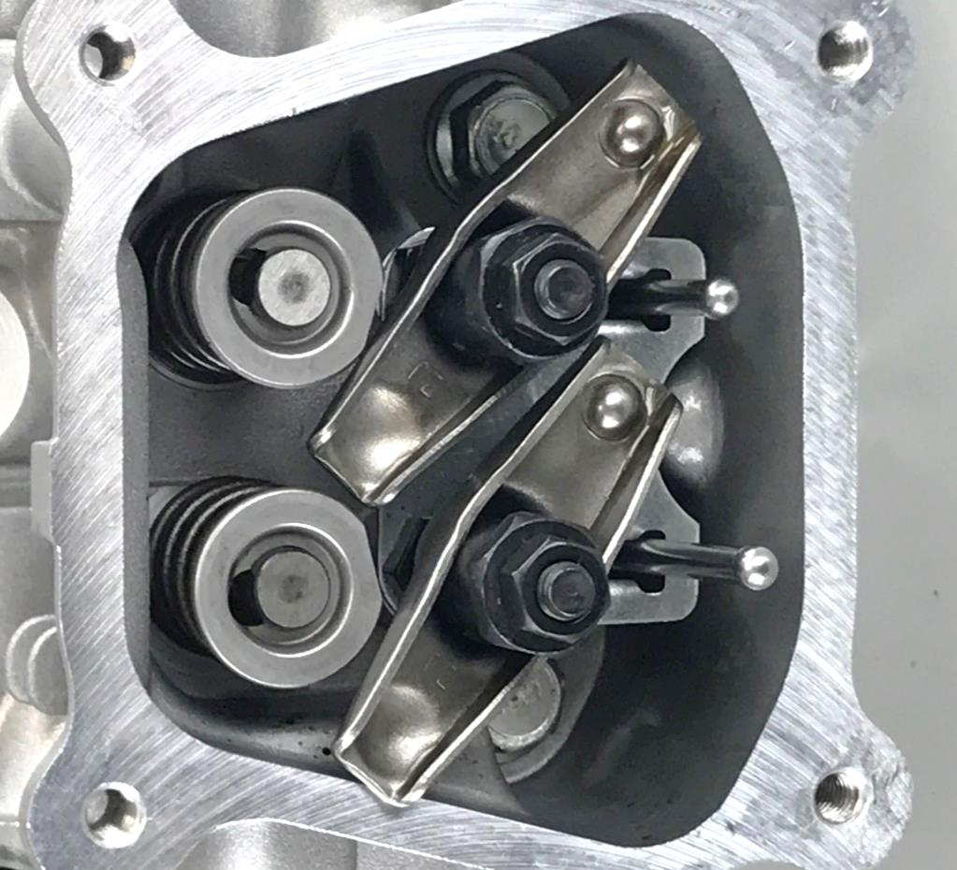
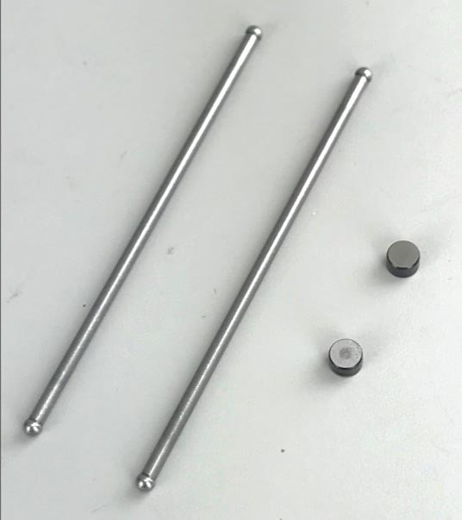
Remove Push Rods and End Caps
Position the piston to TDC on the compression stroke
Turn both rocker arms to the side
Remove push rods
Remove valve
stem end caps
Notes:
Remove push rods
Push rods are same length and same material.
Some engines use different materials for intake verses exhaust push rods.
Remove valve stem end caps, place in an area for safe keeping as these can be easily lost.

Slide 39
Remove Rocker Components
Caps
Pushrod Cup
Notes:
The valve stem caps are small and often not noticed.
They are frequently lost or not reinstalled.

Slide 40
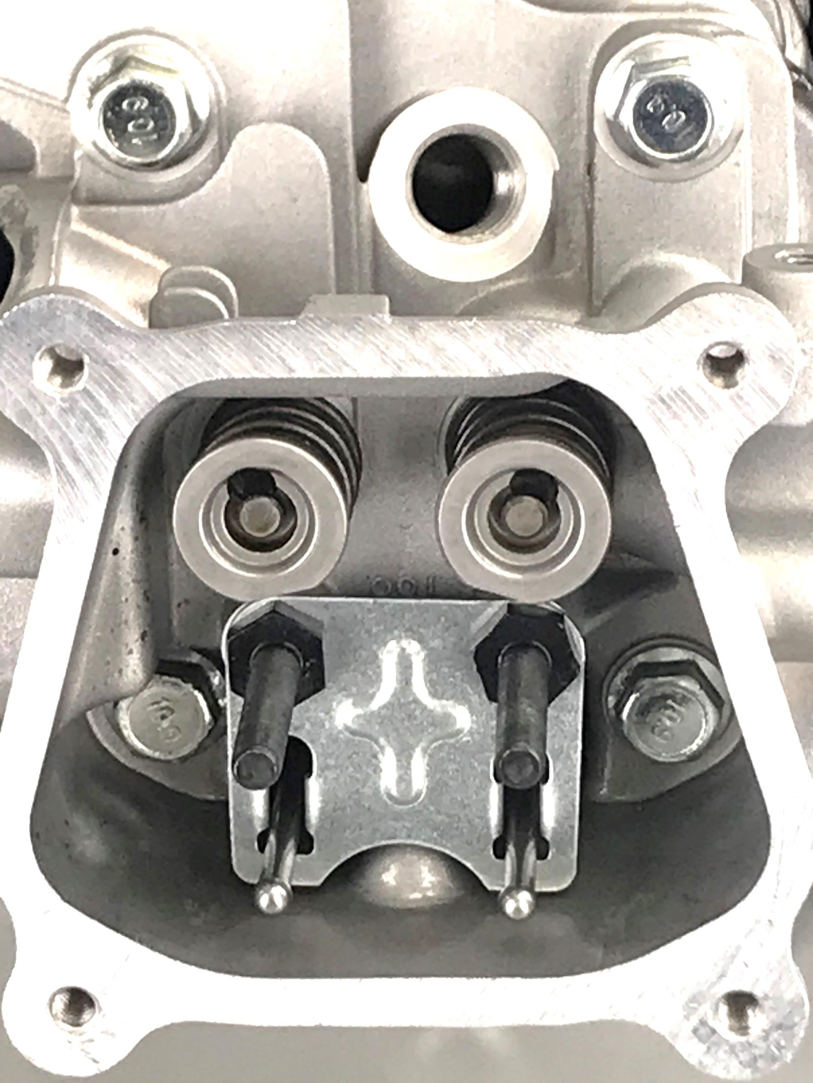
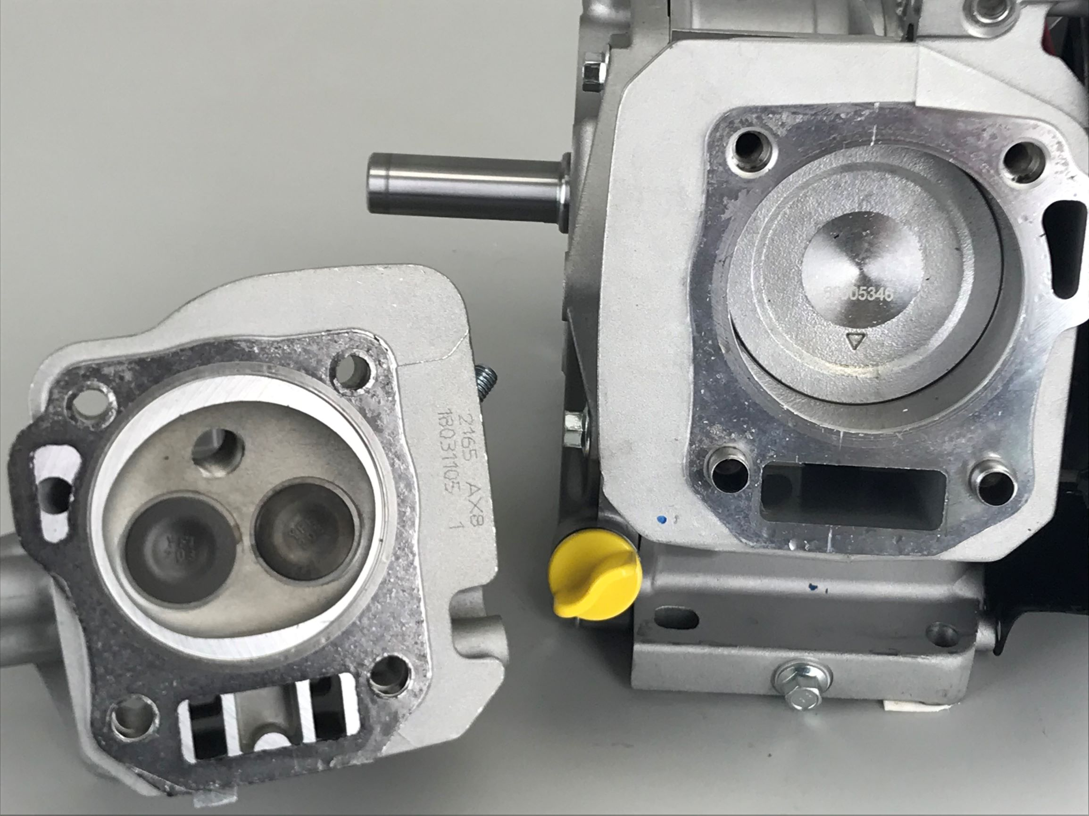
Remove Cylinder Head
Use 12mm socket – 4 screws
Cylinder head gasket maybe damaged during removal
Notes:
Note the 2 hollow alignment pins used to seat the head against the block.
Replace Cylinder Head Gasket is any damage is present.

Slide 41
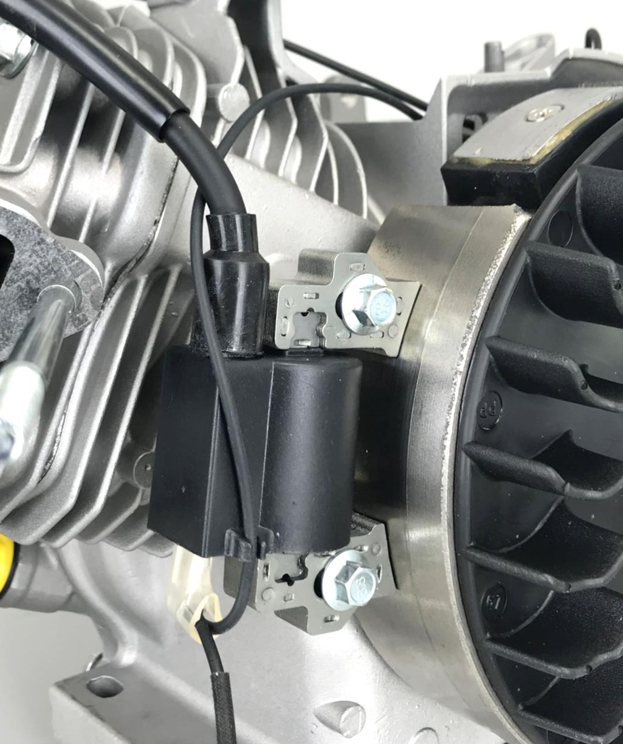
Remove Ignition Armature
Note orientation, High Tension lead on top
Use 8mm socket to remove two screws
Detach wire assembly
Notes:
Note that the ignition armature is installed with the ground wire tab facing down and the high tension lead facing up
Check the ignition armature to flywheel air gap clearance with a flat gauge.
The clearance should be approximately .010 in.
.

Slide 42
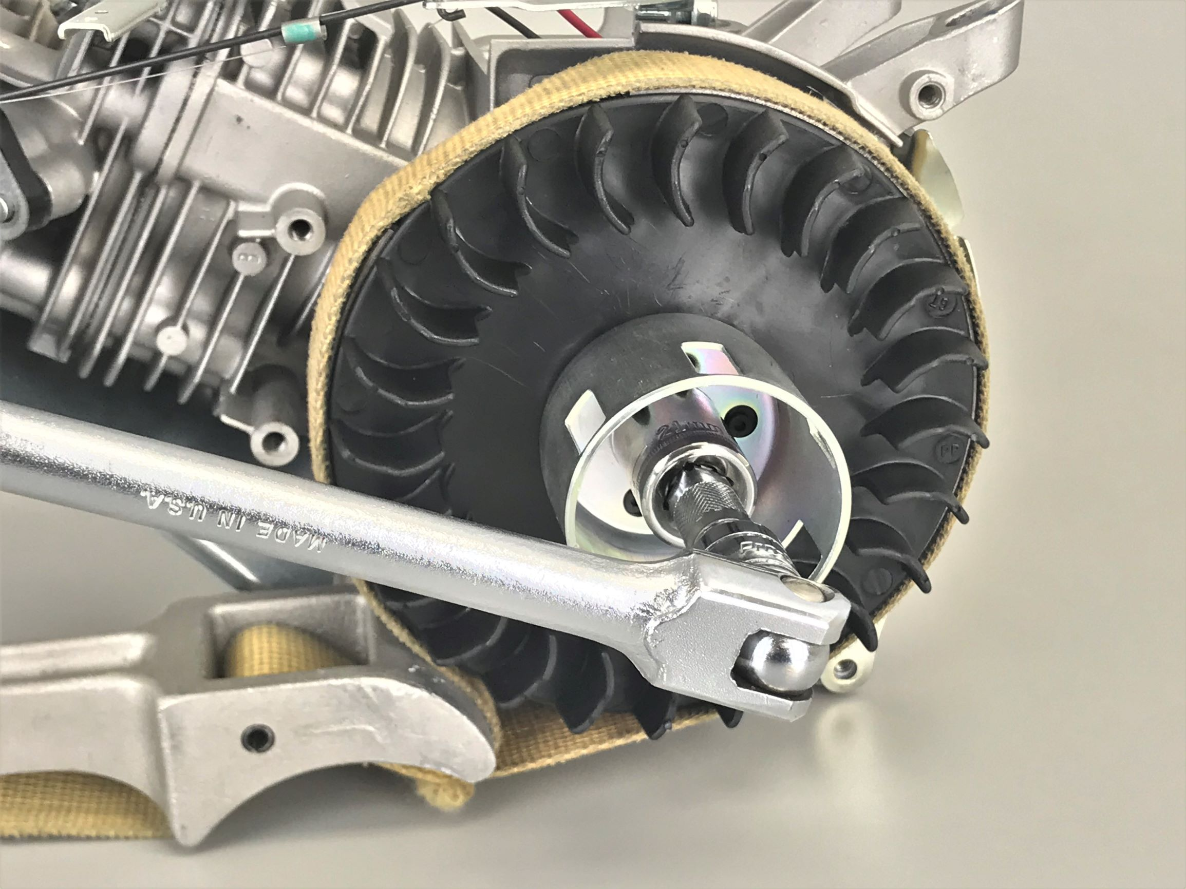
Remove Flywheel Nut
Wait for Instructor to demonstrate
Use 21mm deep socket, breaker bar and 19433 strap wrench
Notes:
Using a strap wrench, ½ in. breaker bar and 21 mm deep socket (or regular socket with a short extension), loosen the nut that secures the flywheel, fan and cup to the crankshaft.
The handle of strap wrench should lie on the bench on the cylinder side of the engine.
The strap should be wrapped clockwise around the flywheel with the concaved face of the wrench head facing down on the bench next to the flywheel.
The convex curved end of the wrench head should touch the flywheel, jamming the strap to keep the flywheel from turning.
Loosen the flywheel nut by turning it counter clockwise.
This will cause the strap to tighten around the flywheel so that the nut can be loosened.
For best practices, position the breaker bar in the 10:00 angle (as shown) and apply a downward force.
See video on the Power Portal on how to set up and used the strap wrench. http://www.thepowerportal.com/nA/English/BriggsStratton/TrainingResources/Iwanttoteach/ToolUse.htm
Flywheel contains:
Magnet to induce ignition coil
Cooling fins to circulate cooling air
It’s mass carries momentum to maintain engine rotation during exhaust, intake and compression stroke.
Has starter cup attached, that is used to transfer rotation from rewind to start engine.

Slide 43
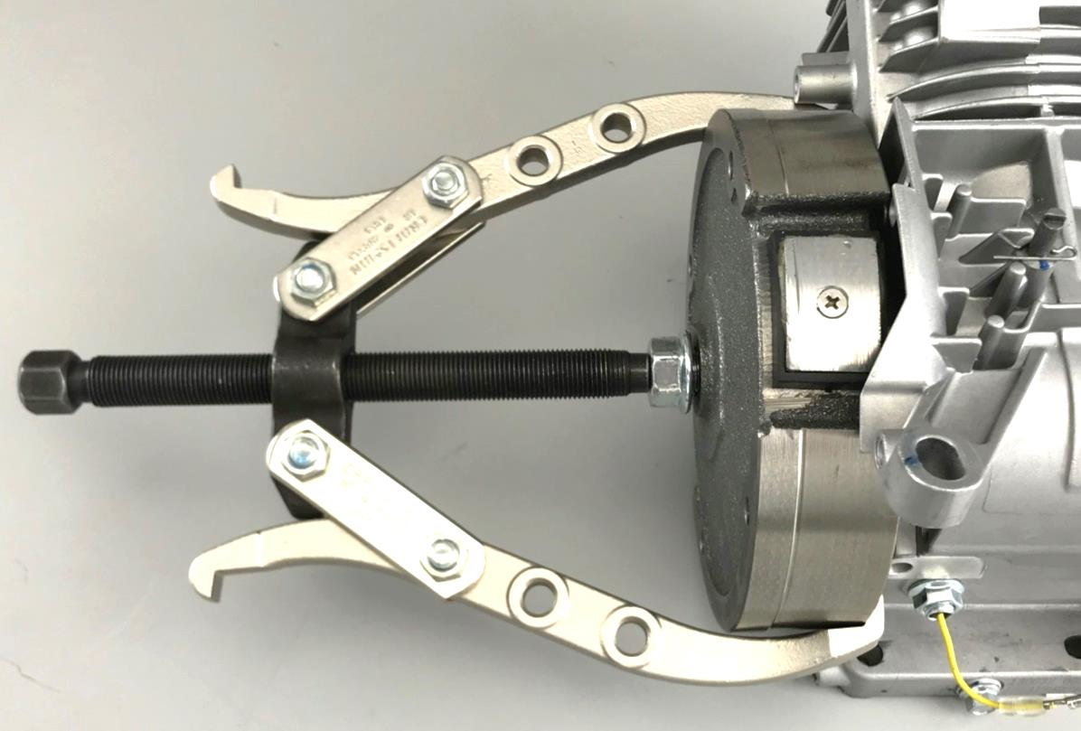
Remove Flywheel
Wait for Instructor to demonstrate
Use 8 inch wheel puller or 19203 Flywheel Puller
Replace nut on crankshaft threads leave ¼ in gap
Notes:
Replacing the nut loosely back onto the crankshaft will keep the flywheel in place after initial loosening.
Early engines did not have holes in the flywheel to attach the 19203 puller. In that case, an 8 or 9 inch gear puller is used as shown in the picture

Slide 44
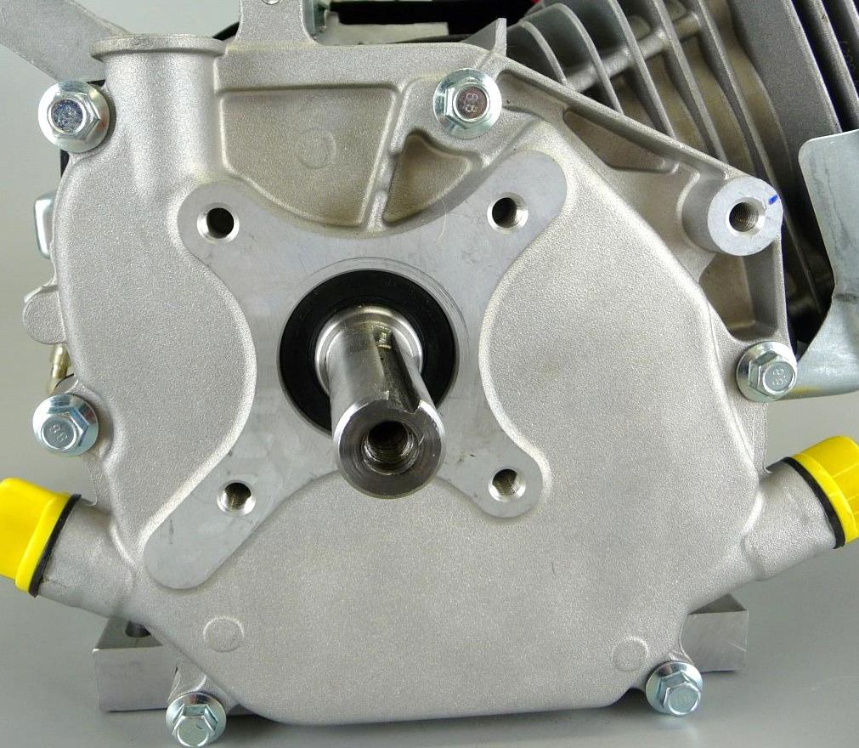
Remove Crankcase Cover
Use 10 mm socket
Case cover gasket will probably be damaged during removal
Do not pry off cover – It will come off by hand
Note: Don’t remove Cam Shaft!
Notes:
Remove crankcase cover
Contains surface for crankshaft to ride on
Contains two yellow caps for oil fill.

Slide 45
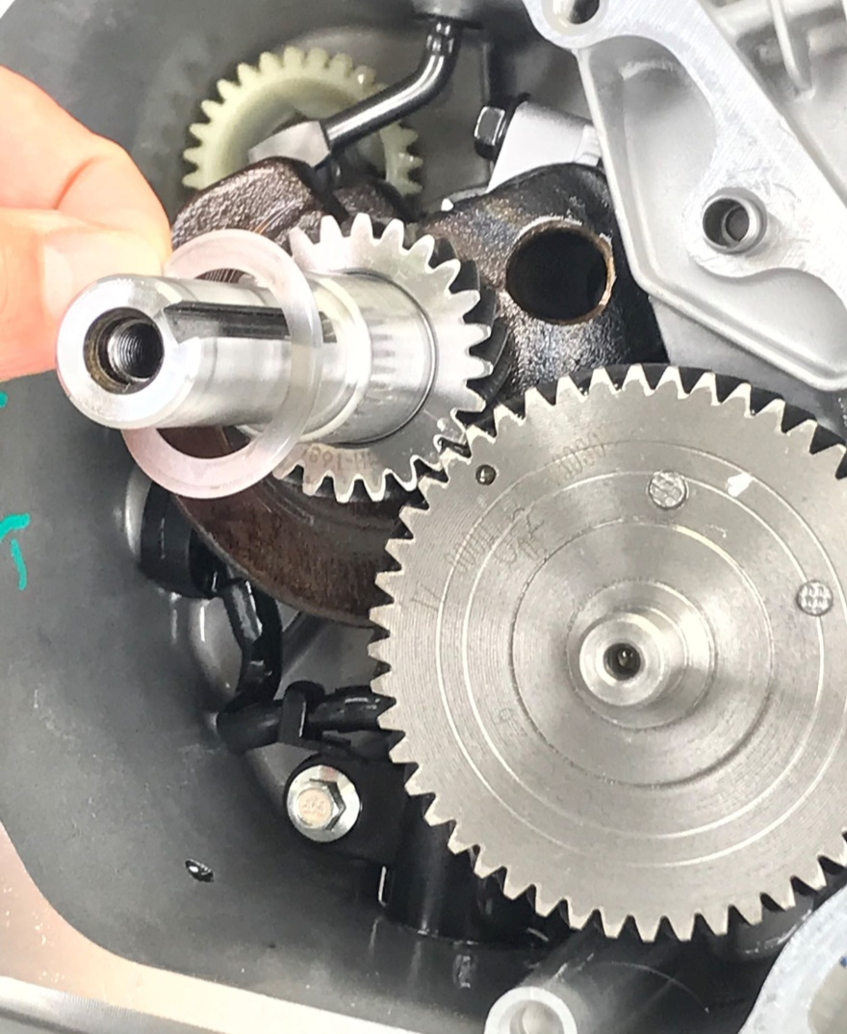
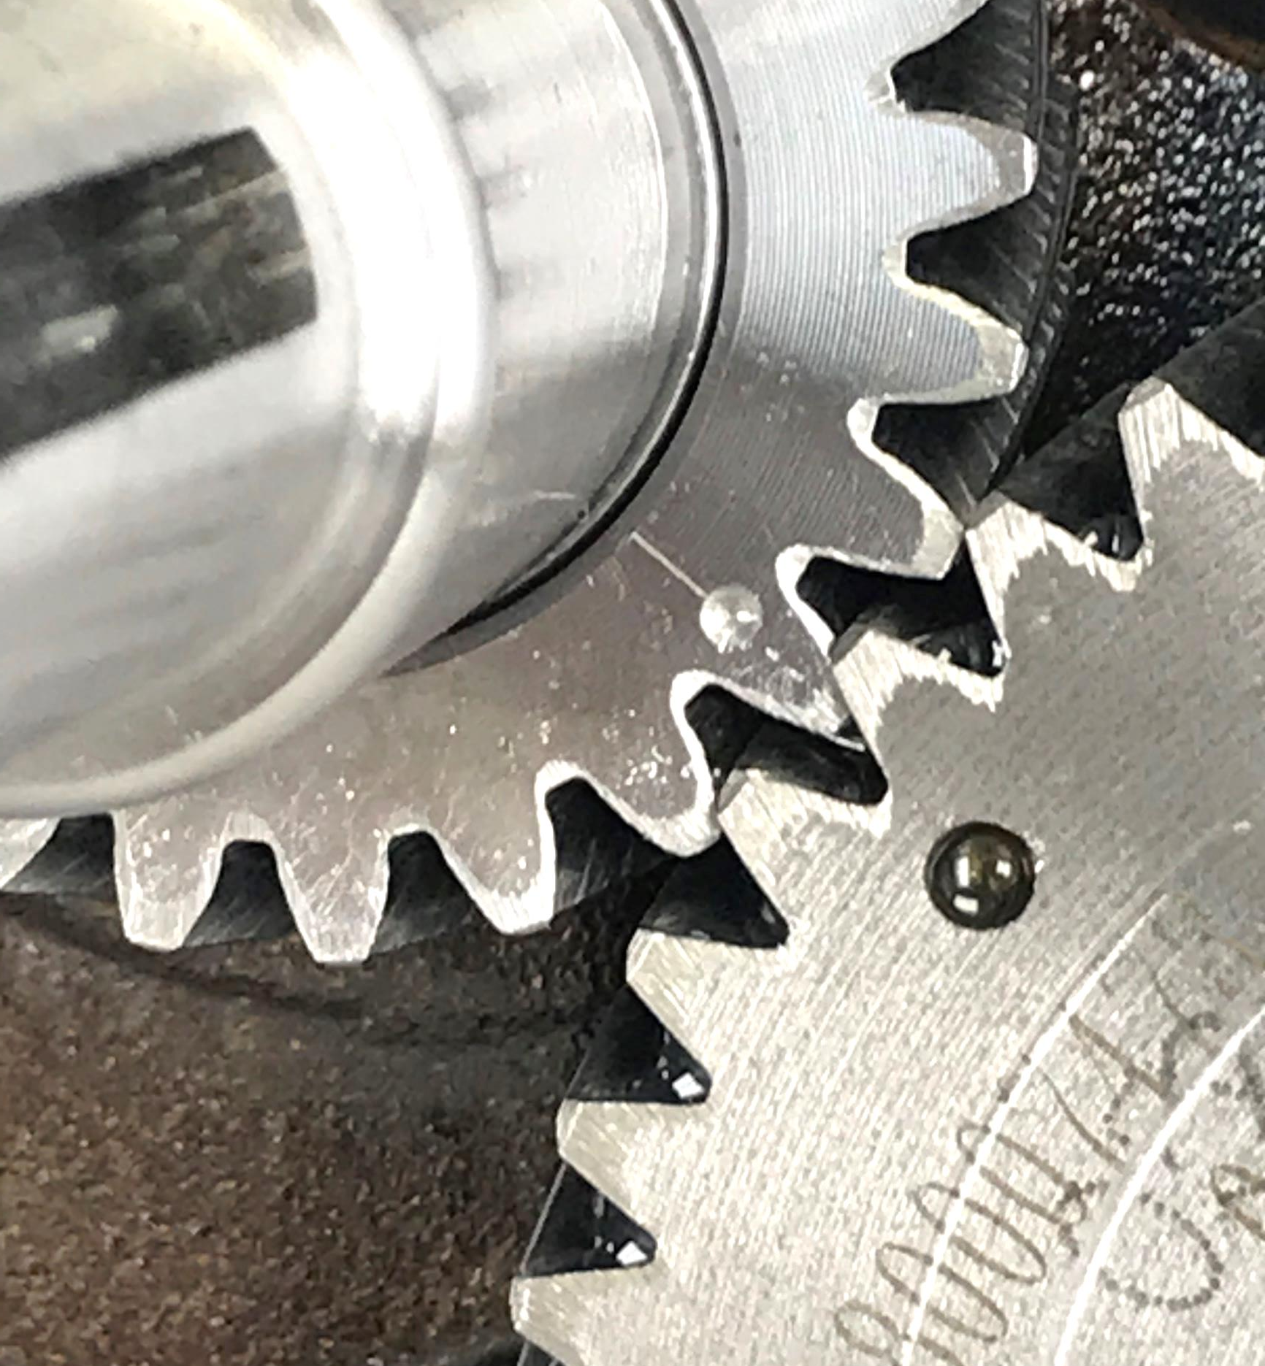
Inspect Camshaft Gear
Remove shim from crankshaft
Timing marks of cam gear and crankshaft gear should align
Notes:
Camshaft gear and crankshaft gear
Inspect for proper orientation of gear in relation to timing marks.

Slide 46
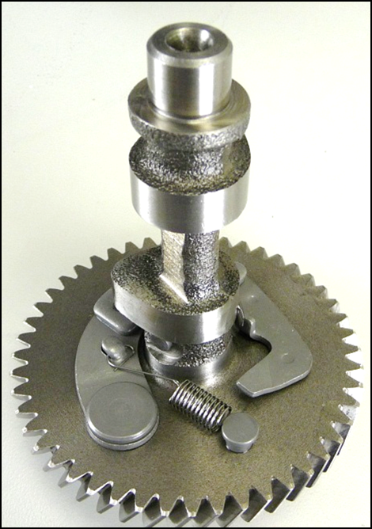
Remove Cam Gear
Remove camshaft by hand
Note compression release on cam
Notes:
Remove cam gear and tappets
Contains lobes that transfer motion to tappets and push rods for opening and closing of valves.
Height of lobes affect the duration of how long the valve is open.
Gear has a mark for proper orientation in relation to position of crankshaft
Has A compression release mechanism that slightly opens A valve for easy starting. Once engine has started, mechanism will move out of the way for full compression

Slide 47
Remove Tappets
Remove tappets by hand
Tappets ride on the lobe of the cam shaft and force the pushrods upward
Notes:
Remove cam gear and tappets
Contains lobes that transfer motion to tappets and push rods for opening and closing of valves.
Height of lobes affect the duration of how long the valve is open.
Gear has a mark for proper orientation in relation to position of crankshaft
Has A compression release mechanism that slightly opens A valve for easy starting. Once engine has started, mechanism will move out of the way for full compression

Slide 48
Remove Piston Connecting Rod Assembly
Use 10 mm socket
Piston and rod have alignment marks called “match marks”
Notes:
Remove Piston/Connecting Rod Assembly.
Creates Vacuum During Intake.
Causes Air Fuel Mixture To Compress.
Transfers Burn Of Fuel Mixture Into Linear Movement.
Forces Burnt Gases Out Of Cylinder.
Contains Piston Rings.
Seal Against Compression Leakage.
Movement Of Lubricating Oil.
Has A Marking For Proper Orientation.
Discuss Connecting Rod.
Attaches Piston To Crankshaft.
Has Machined Bearing Surface To Match Crankshaft Pin.

Slide 49
Remove Crankshaft
Slide out crankshaft by hand
Use caution not to scratch bearing surface in crankcase
Notes:
Remove crankshaft
Converts linear motion into rotary motion.
Attaches to a device for producing work, example: mower blade, belts, hydraulic pump, etc.
Supported at both ends in cylinder housing by bearings.
Contains an offset for connecting rod.
Offset affects the amount of piston travel in bore. (Displacement)
Contains gear.
Used to drive camshaft.
½ Diameter of cam gear for 2-1 ratio
Has timing mark for proper orientation

Slide 50
Discuss Crankcase
Wipe up any remaining oil in case
Clean all gasket surfaces with gasket scraper
Note governor gear and shaft and low oil sensor
Notes:
Discuss Cylinder Assembly
Structure For Engine
Contains Cooling Fins For Heat Transfer
Made From Aluminum
Some Units May Contain A Cast Iron Sleeve For Longer Wear
Crankshaft is supported on ball bearing or bushings.
Two locating pins ensure proper alignment of crankcase cover to cylinder.
Caution! Edges of crankcase at the cover gasket area are sharp!
Before proceeding to final assembly, complete training Torque Module and Lab

Slide 51
Reassembly
This is a step-by-step reassembly process.
It is not a race
Take your time when assembling the engine and listen for direction from the instructor
Do not work ahead
Fasteners will be torqued to the proper value located in the back of the 130G00 Repair Manual
Special procedures will be explained
Notes:
It is highly recommended to present the Training Torque module before applying torque during final assembly.
Torque used in this section will be the range listed in the 130G00 Repair Manual
For classroom training proposes and to avoid students from stripping screws/fasteners use the lower range of torque.
If the engine is going to be used in its intended application, use the mid-range torque.
Option: If engine is not going to be run in between each learning module and to avoid stripping threads, fasteners can be lightly hand tightening until final assembly.

Slide 52
Install Crankshaft
Install crankshaft by hand into cylinder block
Be careful not to damage bearing
Position crankpin at 7 o’clock
Notes:
Install Crankshaft In Cylinder Block
Use Caution Not To Scratch Bearing In Block
Position Crankpin Down To The Left To Allow Connecting Rod Room
Verify the crankshaft is fully inserted into cylinder bearing

Slide 53
Install Piston Assembly
Use 19070 ring compressor
Coat piston assembly and cylinder bore with oil
Check orientation marks
DO NOT HAMMER or force piston assembly into block
Notes:
Install Piston/Connecting Rod Assembly
Use A Ring Compressor
Lubricate Piston Assembly And Cylinder Wall With Oil
Do Not Hammer Piston Assembly Into Block. Should Be Able To Push In By Hand
Be Sure Orientation Marks Of Piston And Connecting Rod Face Magneto Side Of Case

Slide 54
Attach Rod to Crankshaft
Use 10 mm socket
Lubricate crankshaft journal with oil
Make sure match marks align
Rotate crankshaft and check for free movement
Notes:
If crankshaft is not fully seated, the connecting rod will not easily fit over journal.
Torque for 10mm screws is 110-140 lbs-in

Slide 55
Install Tappets
Place tappets in by hand
Tilting the engine will prevent tappet from sliding out and in the way of the camshaft
Notes:
Install tappets all the way into the cylinder to provide clearance when installing the camshaft

Slide 56
Install Camshaft Gear
Timing marks of cam gear and crankshaft gear should align
Replace shim on crankshaft
Notes:
Align camshaft gear and crankshaft gear
Have instructor inspect for proper orientation of gear in relation to timing marks.
Replace shim over PTO end of crankshaft and down on top of the crankshaft gear
Verify that camshaft is fully seated and meshed with crankshaft gear

Slide 57
Install Case Cover
Lubricate cover bearing
Use 10mm socket
Tighten down cover screws in the sequence shown
4
6
1
2
3
5
Notes:
Inspect and replace crankcase gasket if necessary.
Cover should easily slide on and seat against crankcase.
If it does not drop all the way down, rotate crankshaft back and forth to assist.
Never drive or force the cover on.
Tighten down cover screws in the sequence shown.
Torque Screw to 190-250 lbs-in during final assembly.

Slide 58
Install Dowel Pins and Head Gasket
Note two dowel pin locations and install
Place gasket over pins so the it lines up with cylinder
Notes:
Note the 2 hollow alignment pins used to seat the head against the block.
Replace Cylinder Head Gasket is any damage is present.

Slide 59
Install Cylinder Head and Pushrods
Use a 12mm socket
Use a “Step Torqueing” procedure
Tighten down cover screws in the sequence shown
Install push rods in slots
Insure that rod ends rest in recess of tappets
3
1
2
4
Notes:
Install Cylinder Head
Must Use A Step-Torque Sequence
During final assembly, torque fasteners in a star pattern
Step-Torque and sequence 75-150-210 lbs-in

Slide 60
Level Pushrods
Rotate engine until pushrods are level
Level
Not Level
Notes:
With both pushrods level, the piston will be at about TDC at the end of the compression stroke.
During full Dis & Re-Assembly, Tappets may be stuck in the up position in the cylinder not allowing the push rod to be leveled.
With the piston at ¼” past TDC on the compression stroke, a slight tap on the end of the push rod will free the tappet.

Slide 61
Install Rocker Components
Caps
Pushrod Cup
Notes:
The valve stem caps are small and often not noticed.
They are frequently lost or not installed.
If missing, you will notice the valve adjustment nut will be turned way in and the threaded stud will be sticking way above the rocker.
Thread the 14mm valve adjustment nut down the stud until it just touches the rocker.
Thread the 10mm valve adjustment lock nut down the stud until it is a few turns away from the adjustment nut.

Slide 62
Adjust Valve Lash
Piston needs to be at ¼ in. past TDC at beginning of power stroke
Intake valve .004-.006 inch
Exhaust valve .006-.008 inch
Notes:
Adjust Valve Lash
Instruct How To Find Top Dead Center
Move Piston To ¼” Past TDC of the compression stroke or another way to look at it is ¼ “ into the power stroke.
How to do it:
If the pushrods were adjusted level, look into the spark plug hole and the piston should be just about at the top of its travel.
Insert a popsicle stick or wooden pencil into the plug hole and touch the top of the piston.
Slowly turn the crankshaft clockwise as viewed from the flywheel side and watch the pencil.
Allow it to rise to the TDC position after which it will begin to drop as the piston travels from TDC to BDC.
Let it travel downwards ¼ inch and stop.
The clearances can now be adjusted.
Note: This procedure is used on all Briggs & Stratton engines, ensures that compression release will not effect clearance.
Adjust Valve Clearance:
Intake Valve .004-.006”
Exhaust Valve .006-.008”
A “Step” feeler gauge (shown) eases this procedure.
Torque 10mm lock nut to 60-80 lbs-in during final assembly.

Slide 63
Install Valve Cover
3
1
Check gasket, replace if necessary
Use 8mm socket
Tighten down four cover screws in the sequence shown
2
4
Notes:
Install Valve Cover
Torque fasteners in a star pattern
Torque to 70-90 lbs-in during final assembly

Slide 64
Install Flywheel, Key, Starter Cup, Fan and Nut
Align flywheel and crankshaft keyways
Slide flywheel, fan and cup onto crankshaft
Use strap wrench
Use 21 mm deep socket
Notes:
Install flywheel, key, fan, starter cup and nut
Check if fan and cup are correctly aligned and seated to the flywheel
Use strap wrench with handle facing non-cylinder end laying on table
Torque flywheel nut
Rotate flywheel & crankshaft to insure free movement
At final assembly, torque to 65 lbs-ft.

Slide 65
Setting Ignition Armature Air Gap
Wait for Instructor to demonstrate
Orientate armature with high tension lead on top
Use 8mm socket
Use a .010 in. flat gage or CE5121 gage for gap clearance
Notes:
Check Armature for proper orientation, with the ground wire tab facing down and the high tension lead facing up
Check the ignition armature to flywheel air gap clearance with a flat gauge.
The clearance should be approximately .010 in.
Torque for 8mm screws is 80-110 lbs-in

Slide 66
Install Finger Guard
Use 8mm socket
Connect yellow to yellow wire on time delay module
Connect black wire to black on time delay module
Notes:
Disconnect yellow and black wires from time delay module
The other black wire with a white connector is for another ignition ground point.
This could be a OPC control, remote switch, etc.

Slide 67
Install Cylinder Air Guide
Use 8mm socket to secure two screws:
PTO side
Below valve cover
*Lower screw will be added when blower housing is assembled
Notes:
Install Cylinder Air Guide
Torque to 30-50 lbs-in during final assembly
Torque Blower Housing screw to 60-110 lbs-in

Slide 68
Connect Wiring to Switch
Check that wires are connected correctly to the switch terminals
Route wires accordingly
Notes:
Reconnect wiring to rocker switch installed in housing.
The switch is marked with a 1,2,3.
Note travel of wires across the top of the engine near the governor shaft as they need to be rerouted in the same orientation.

Slide 69
Install Blower Housing
Carefully place blower housing onto engine
Check that switch wires are not pinched
Use 8mm socket to secure four screws
Notes:
Using an 8mm socket, install the 4 screws that secure the blower housing to the engine.
Ensure wires are not pinched
Torque for 8mm screws is 60-110 lbs-in

Slide 70
Install Rewind Starter
Use 8mm socket to secure three screws
Notes:
This step can be optional.
Rewind and Blower Housing can be removed/replaced as one component.
Torque for 8mm screws is 25-35 lbs-in

Slide 71
Connect Governor Spring
Turn bracket over and hook governor spring to tab in orientation shown
Notes:
Orientation needs to be correct before proceeding.

Slide 72
Install Speed Control Bracket
Use 8mm socket secure two screws
Note Throttle Control Level may need to be reposition to access the upper screw
Note routing of RED ground wire
Notes:
Check that RED wire is between screw and control bracket
Torque to 80-110 lbs-in during final assembly

Slide 73
Align Governor Shaft
Check that the straight leg of clip is in the properly seated in the slot.
Notes:
Confirm that retaining clip is seated correctly in the governor shaft slot.

Slide 74
Install Governor Lever
Place the governor arm over the shaft
The slot at the end of the lever should be parallel
DO NOT tighten nut
Notes:
If the slot is not parallel or looks as if any damage or attempted straightening has occurred.
Replace governor lever

Slide 75
Attach Governor Springs and Link to Governor Lever
Install governor spring
Install link and link spring
Check your drawing to verify correct hole locations

Slide 76
Install Gaskets and Spacer
Note orientation of each gasket and carburetor spacer
Insert spark plug wire into integral holder on spacer
Spacer Gasket Carburetor Spacer Carburetor Gasket
Notes:
Make sure gaskets are installed and properly oriented.
Snap High Tension Lead (spark plug wire) into holder on carburetor spacer.

Slide 77
Install Carburetor
Slide carburetor along studs until the governor link can be installed
Press the governor link into the throttle shaft
Carefully reattach the link spring into the correct hole
Notes:
Take care to prevent damage to the spring. Make sure gaskets are in place

Slide 78
Temporarily Install Air Cleaner Base
Install gasket and air cleaner base
Install nuts to hold carburetor in place during static governor adjustment
Notes:
Temporary hand tighten nuts
Air cleaner base and carburetor must be installed before a static governor adjustment can be made.

Slide 79
Perform Static Governor Adjustment
Determine which direction to rotate the governor shaft:
Place the throttle lever to fast speed
Manually move the throttle plate from close to wide open and observe the movement of governor lever on governor shaft
If movement of lever is clockwise,
rotate shaft full clockwise
If lever rotates counterclockwise,
rotate shaft full counter clockwise
Notes:
Before proceeding, check to ensure that the governor shaft’s groove and cotter pin are correctly engaged.
Perform Static Governor Adjustment
Move throttle to fast speed
As Throttle Goes To Wide Open, Watch Movement Of Governor Lever On Governor Shaft.
If Movement Of Lever Is Clockwise, Rotate Shaft Full Clockwise.
If Lever Rotates Counterclockwise, Rotate Shaft Full Counter Clockwise.
Governor Shaft Will Only Rotate About A 1/16th Turn.
Torque nut to 50-60 lbs-in. upon final assembly

Slide 80
Perform Static Governor Adjustment
Turn and hold governor shaft with pliers in the same direction
Tighten nut with 10mm wrench
Notes:
Before proceeding, check to ensure that the governor shaft’s groove and cotter pin are correctly engaged.
Perform Static Governor Adjustment
Move throttle to fast speed
As Throttle Goes To Wide Open, Watch Movement Of Governor Lever On Governor Shaft.
If Movement Of Lever Is Clockwise, Rotate Shaft Full Clockwise.
If Lever Rotates Counterclockwise, Rotate Shaft Full Counter Clockwise.
Governor Shaft Will Only Rotate About A 1/16th Turn.
Torque nut to 50-60 lbs-in. upon final assembly

Slide 81
Reassembly Fuel Tank
Use 8mm socket for screw just above spark plug
Use 12mm socket for two nuts above low oil module
Notes:
First align hole for 8mm screw and secure in place before tightening the two nuts.
Check that Red wire is not being pinched between the fuel tank and cylinder.
Torque Screw to 75-95 lbs-in during final assembly
Torque Nuts to 90-110 lbs-in during final assembly

Slide 82
Reconnect Fuel Line
Remove air cleaner base
Push fuel line onto hose barb
Remove hose clamp tool
Use needle nose pliers to pinch and slide hose clamp over the carburetor hose barb
Notes:
Use caution as some fuel is bound to dribble from the line, carb or tank.
Fuel hose line is routed under the throttle lever.

Slide 83
Install Spark Plug
Use 5/8 in. spark plug socket
Check Spark Plug Gap (0.030 in)
To ensure no damage is done to the spark plug, avoid applying any side load to the wrench
Notes:
Torque to 140-200 lbs-in during final assembly
Spark Plug Gap = 0.030 in.

Slide 84
Install Muffler
Replace muffler gasket if necessary
Place muffler flange over studs
Install lock washers
Use 13mm socket to fasten nuts
Notes:
Inspect muffler gasket, replace if worn out
Place Muffler over studs
Next place lock washer on studs
Torque Nuts to 80-110 lbs-in during final assembly

Slide 85
Install Air Cleaner Backing Plate/Base
Check if gasket is installed correctly
Then using a 8mm socket to attach the top screw
Next use 10mm socket for two flange nuts
Notes:
Control levers may need to be adjusted in order for the A/C base to slide on over the carburetor studs easier
Reconnect breather hose by sliding it over boss on backside of base.
Torque for 8mm screws is 40-60 lbs-in
Torque for 10mm nuts is 30-50 lbs-in

Slide 86
Install Air Cleaner Backing Plate/Base
Re-connect the breather hose to the air cleaner base
Notes:
Breather tube allow the air that is compressed in the crankcase during the down stroke of the piston to be recirculated back into the carburetor.
Air contains oil and fuel vapors, which are re-burned.
Crankcase must operate in a vacuum to prevent oil from being pressurized

Slide 87
Install Filter and Air Cleaner Cover
First install rubber gasket over mounting boss on base
Slide filters over stud, and secure tightly with wing nut
Insert cover over stud and hand tighten knob
Notes:
Never use compressed air to clean a paper cartridge.
Air could make a hole in the paper.
Tap cartridge gently on a hard surface to clean.
If very dirty, or soaked with gas or oil, cartridge must be replaced.
Some units may have a foam pre-filter.
Pre-filter promotes longer life of paper filter
Pre-filter can be washed with hot water and dish soap.
Ring out, and squeeze in paper towel to dry.
Do not oil pre-cleaner.
Wing Nut and Knob are hand tighten

Slide 88
Install Trim Panel
Engage tab on left side of trim panel with A/C base
Install three, 8mm screws
Install throttle lever knob
Notes:
Control levers may need to be moved to aid Trim Panel installation
Torque Screws to 20-40 lbs-in during final assembly

Slide 89
Success!
Do you have any extra parts?
Do you have any questions?
Notes:
Discuss any issues the students had throughout the lab.
Proceed to next lesson.

