Slide 1
Agronomy Insects

Slide 2
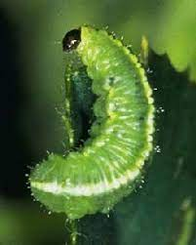
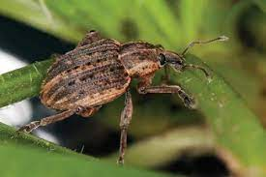
(11) Alfalfa Weevil (adult/larva)

Slide 3
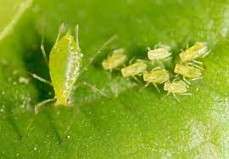
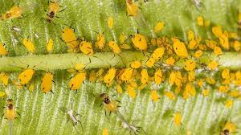
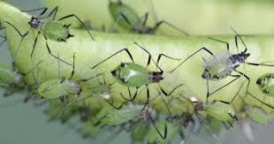
(12) Aphid

Slide 4
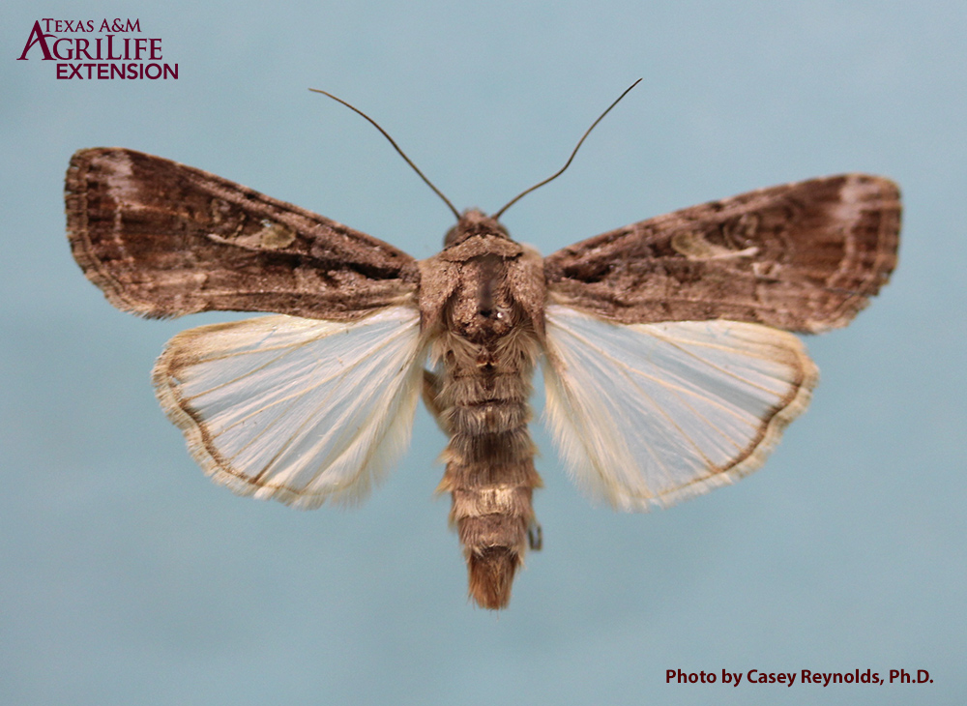
(13) Armyworm Adult (not on 2021 event)

Slide 5
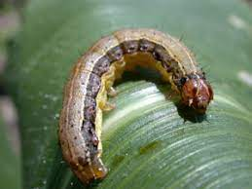
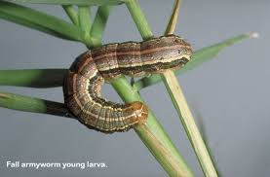
(14) Armyworm Larva

Slide 6
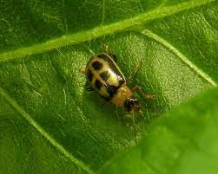
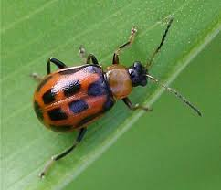
(15) Bean Leaf Beetle

Slide 7
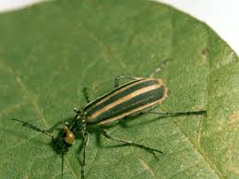
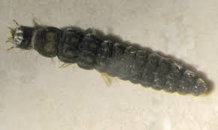
(16) Blister Beetle

Slide 8
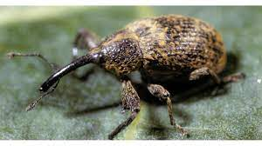
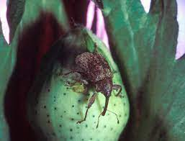
(17) Boll Weevil

Slide 9
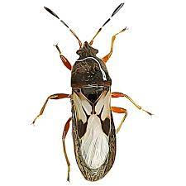
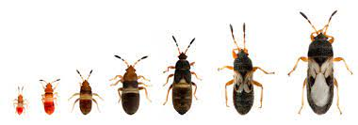
(18) Chinch Bug

Slide 10
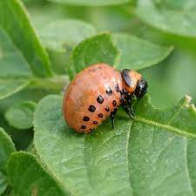
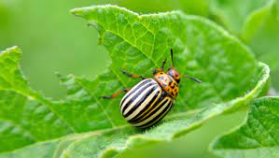
(19) Colorado Potato Beetle

Slide 11
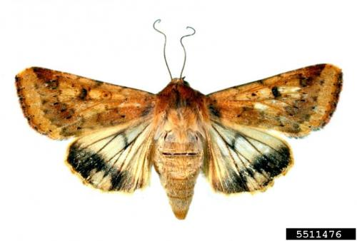
(20) Corn Earworm Adult (not on 2021 event)

Slide 12
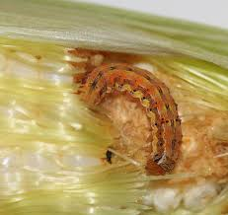
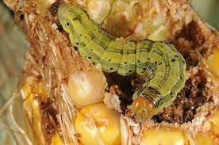
(21) Corn Earworm Larva

Slide 13
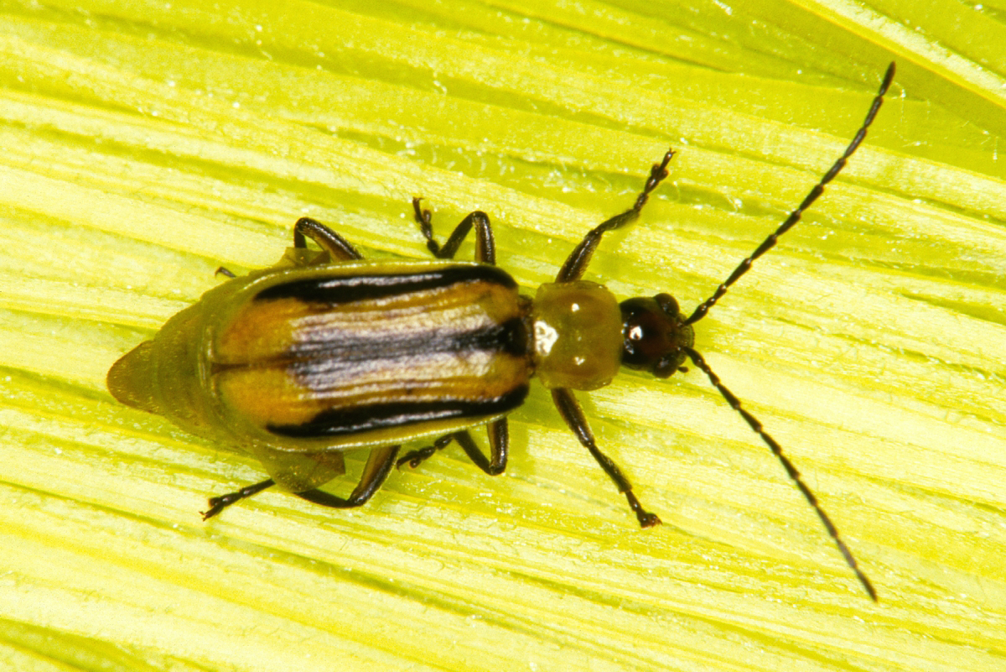
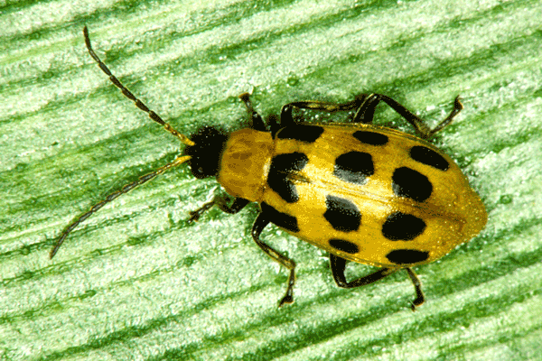
(22) Corn Rootworm Adult

Slide 14
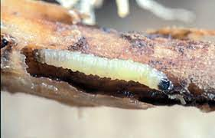
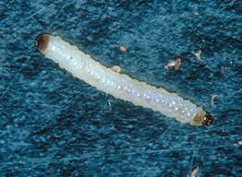
(23) Corn Rootworm Larva

Slide 15
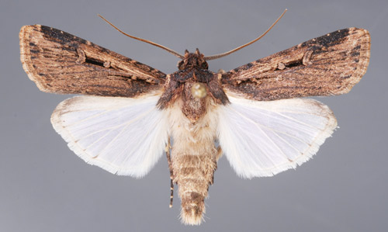
(24) Cutworm Adult (not on 2021 event)

Slide 16
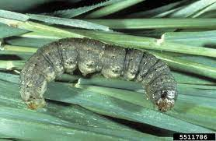
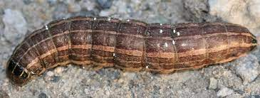
(25) Cutworm Larva

Slide 17
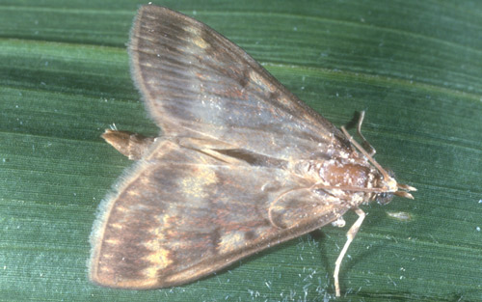
(26) European Corn Borer Adult (not on 2021 event)

Slide 18
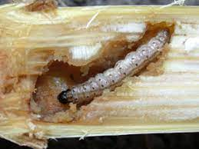
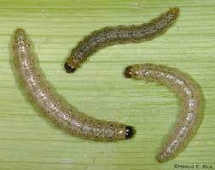
(27) European Corn Borer Larva

Slide 19
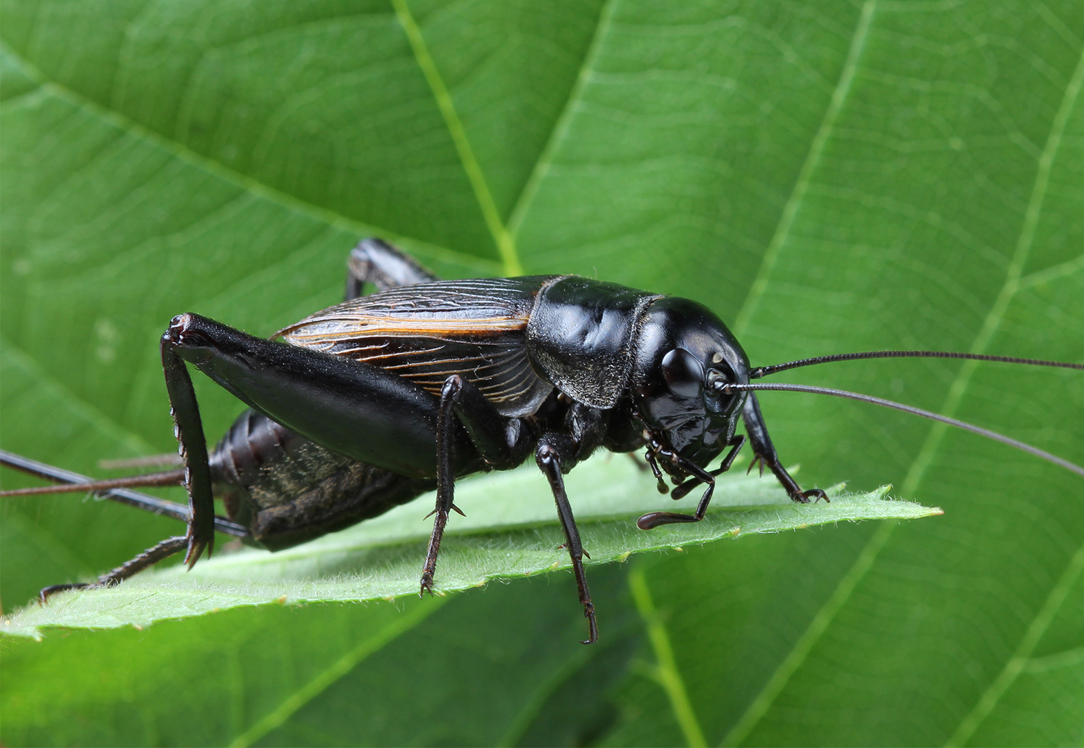
(28) Field Cricket

Slide 20
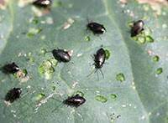
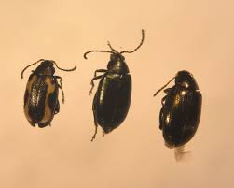
(29) Flea Beetle

Slide 21
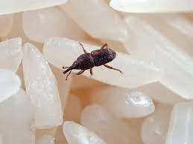
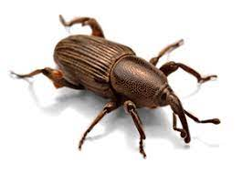
(30) Grain Weevil

Slide 22
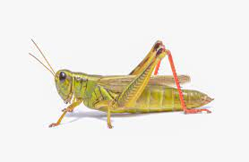
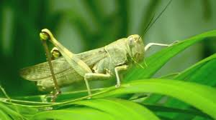
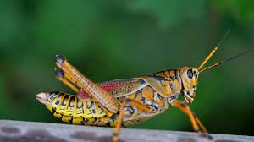
(31) Grasshopper

Slide 23
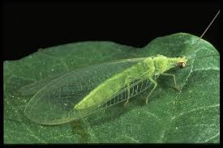
(32) Green Lacewing

Slide 24
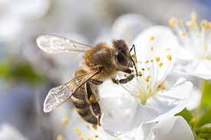
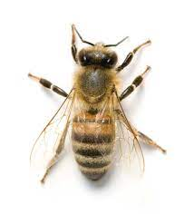
(33) Honeybee

Slide 25
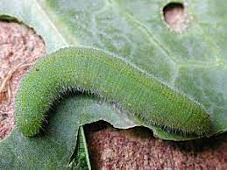
(34) Imported Cabbageworm

Slide 26
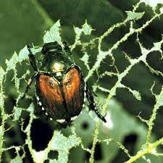
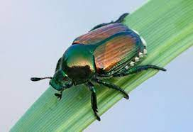
(35) Japanese Beetle

Slide 27
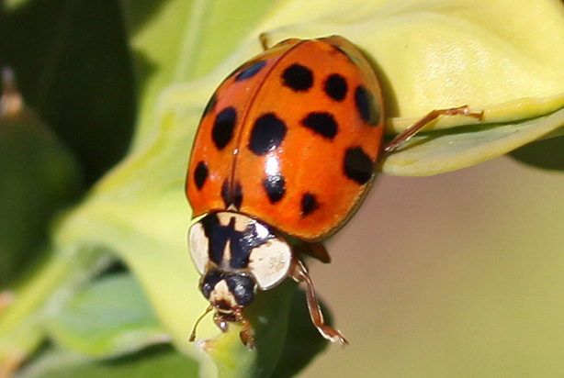
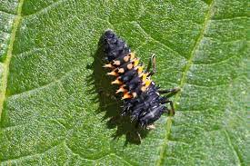
(36) Lady Beetle Adult or Larva

Slide 28
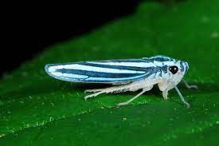
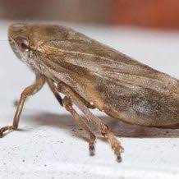
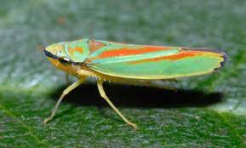
(37) Leafhopper

Slide 29
(38) Mexican Bean Beetle Adult or Larva

Slide 30
(39) Salt Marsh Caterpillar

Slide 31
(40) Spidermite

Slide 32
(41) Spittlebug

Slide 33
(42) Squash Bug

Slide 34
(43) Stinkbug

Slide 35
(44) Striped Cucumber Beetle

Slide 36
(45) Tarnished Plant Bug

Slide 37
(46) Thrips

Slide 38
(47) Tobacco/Tomato Hornworm

Slide 39
(48) Whitefly

Slide 40
(49) Wireworm

