Slide 1
Agronomy Soils Guide

Slide 2
Soils Practicum
An easy 100 points!
Made up of 3 parts
Soils Textures (3 samples, 5 points each)
Soils Structures (3 samples, 5 points each)
Questions from Soil Resource Report (14 questions, 5 points each)

Slide 3
Soil Textures

Slide 4
Soil Textures
Now that you know the textures, you need to understand what fine, medium, and coarse are.
In this contest, you will have 3 samples of soil to evaluate. These soil samples will be dry. You are provided with a water squirt bottle to moisten the soil. This is what each sample will feel like.
Fine: This will get really sticky and can form into a ball easily. Slick!
Medium: This will just feel like mud. Forms into a ball but not very strong.
Coarse: Straight up beach sand. Forms into a ball them crumbles. Gritty!

Slide 5
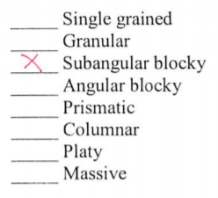
Soil Structures
There are eight soil structures to choose from in this contest.

Slide 8
*Subangular blocky will have rounded edges
*Angular blocky has sharp points on the edges

Slide 9
*Prismatic has flat sides and will be flat on the ends.
*Columnar will have round edges and will be round on the ends like a hot dog.

Slide 12
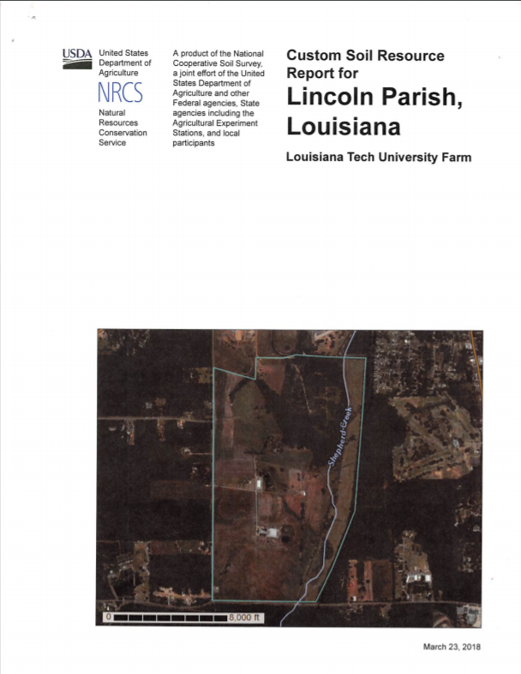
Questions
14 multiple choice questions that
you answer with a provided
Custom Soil Resource Report like this.

Slide 13
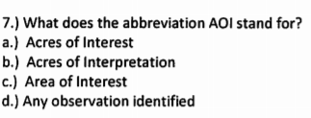
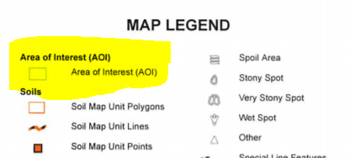
Example Question 1

Slide 14
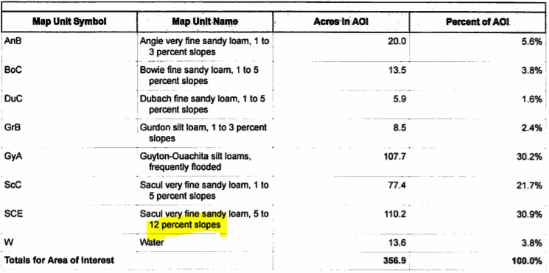
Example Question 2

Slide 15
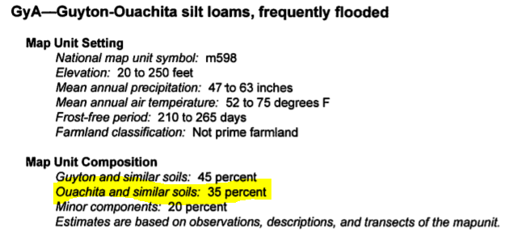
Example Question 3

