Slide 1
Agronomy Plant ID

Slide 2
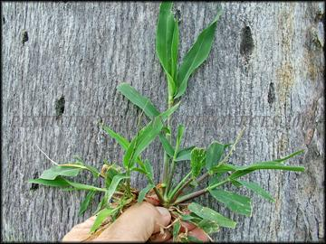
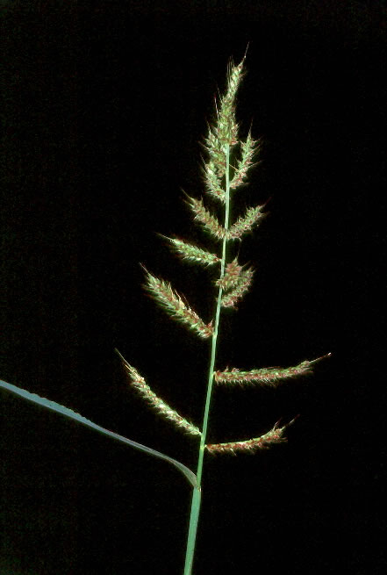
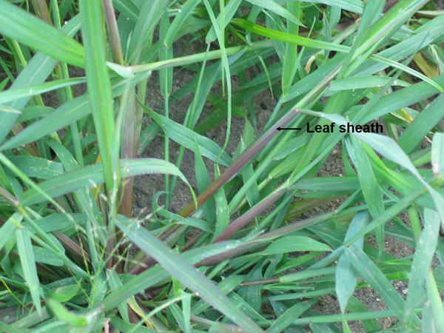
(100) barnyardgrass

Slide 3
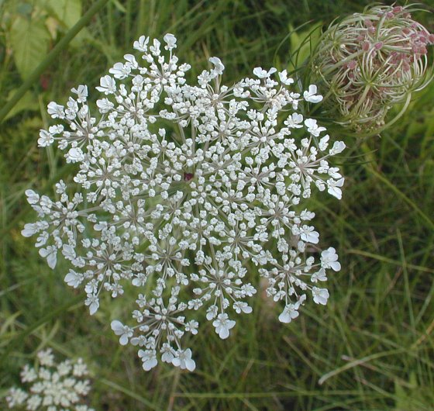
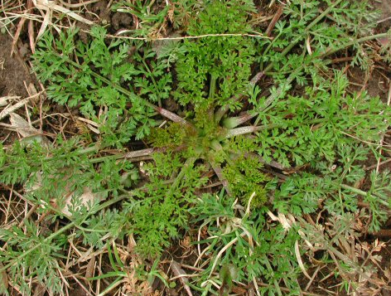
(101) carrot, wild

Slide 4
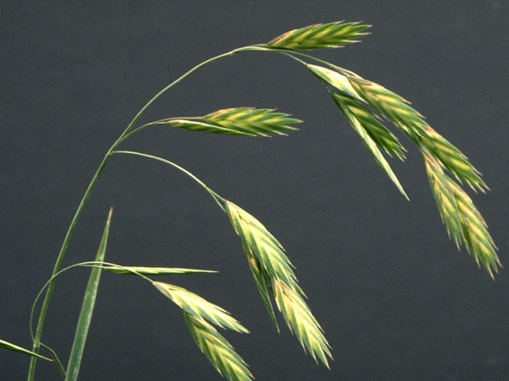
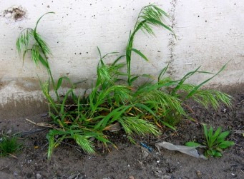
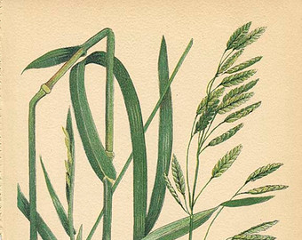
(102) Cheat

Slide 5
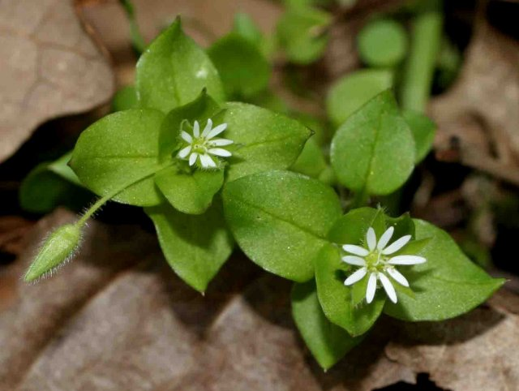
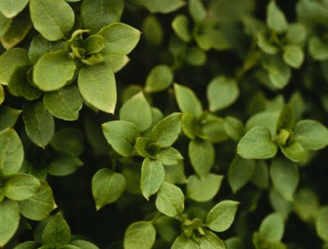
(103) Chickweed,Common

Slide 6
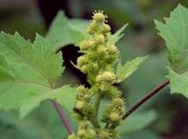
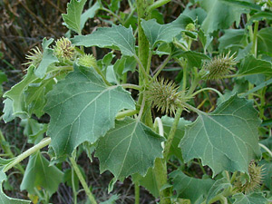
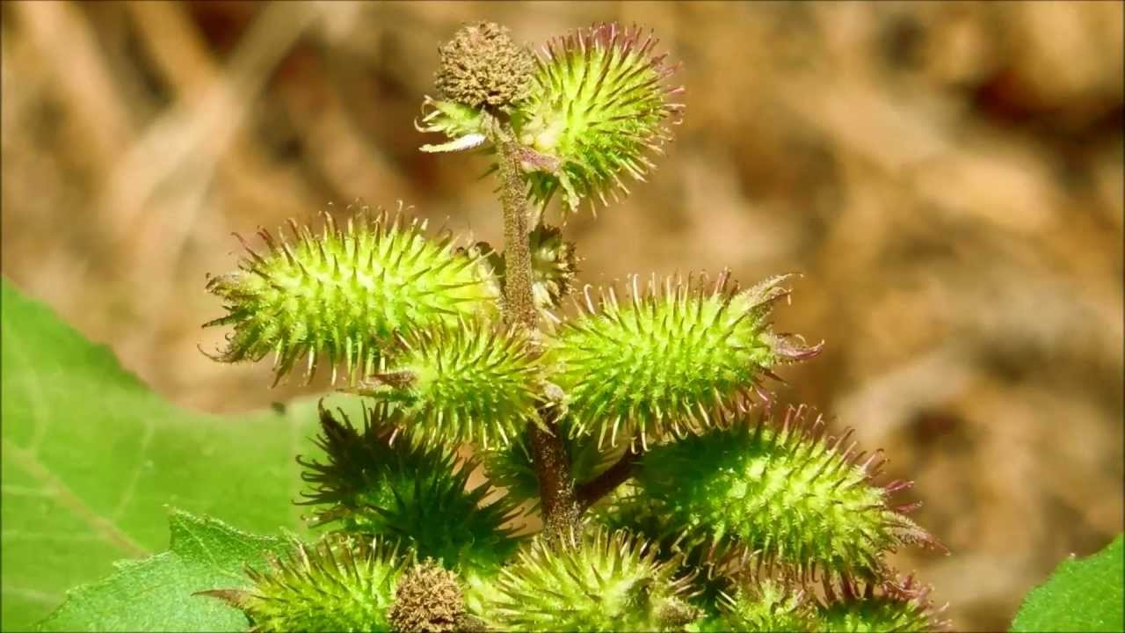
(104) Cocklebur, Common

Slide 7
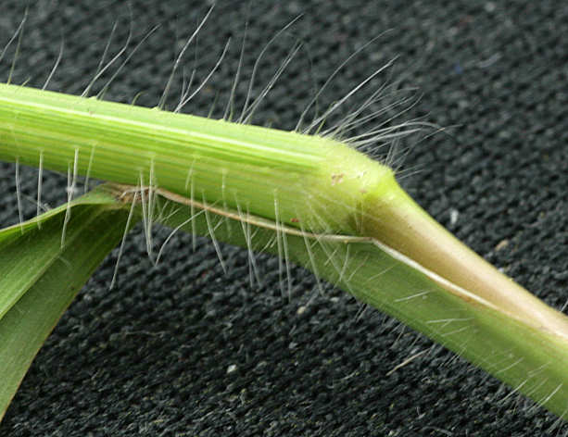
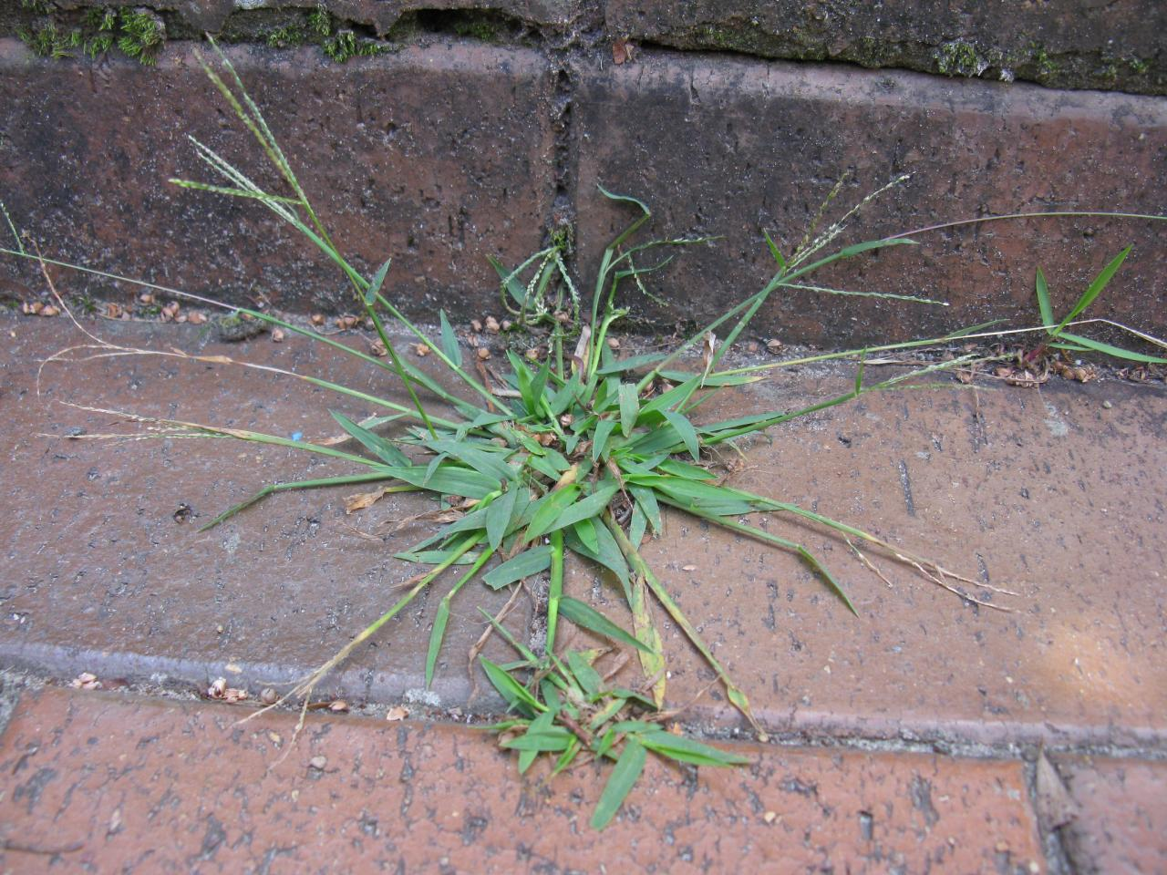
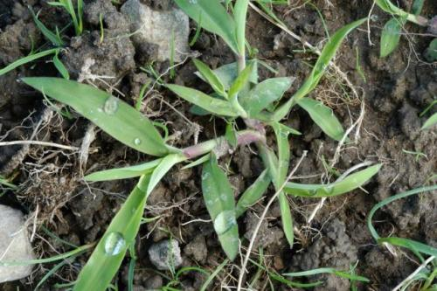
(105) Crabgrass, large

Slide 8
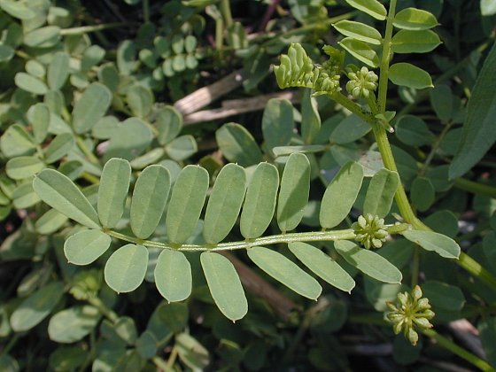
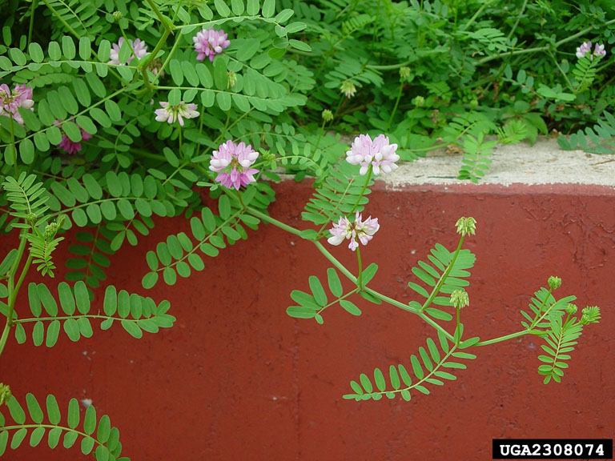
(106) Crown Vetch, trailing

Slide 9
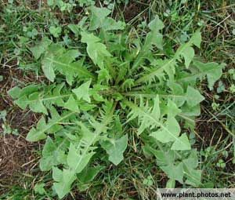
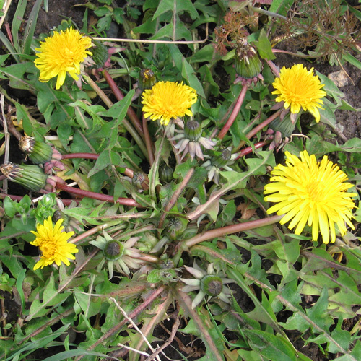
(107) Dandelion

Slide 10
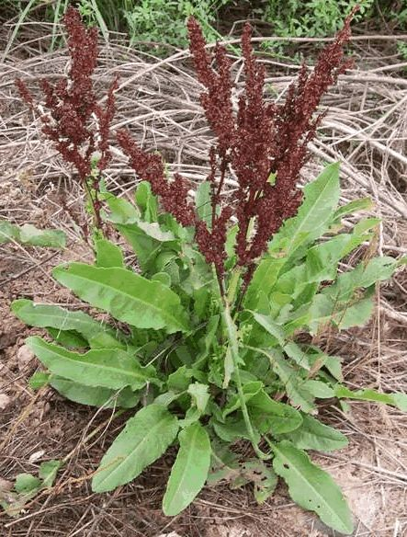
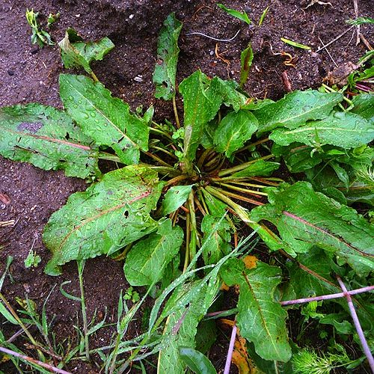
(108) Dock, Curly

Slide 11
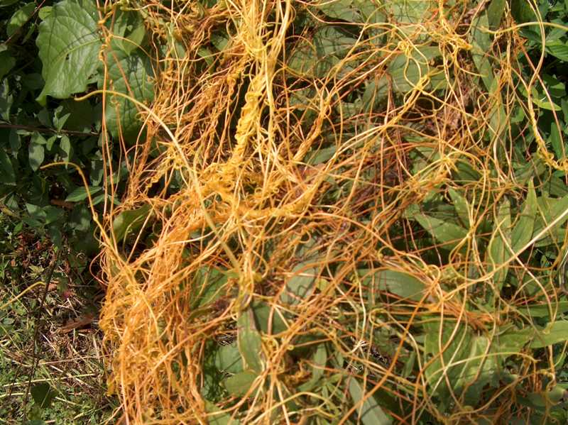
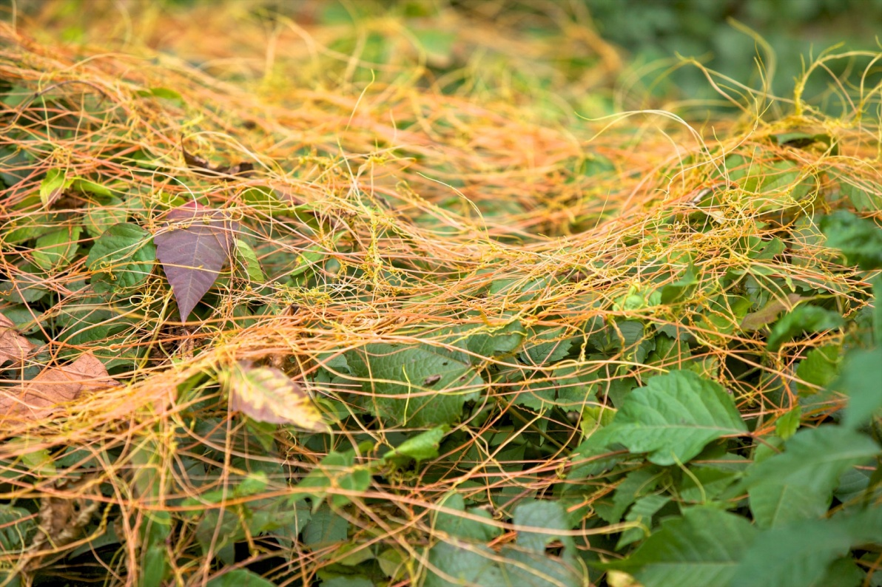
(109) Dodder

Slide 12
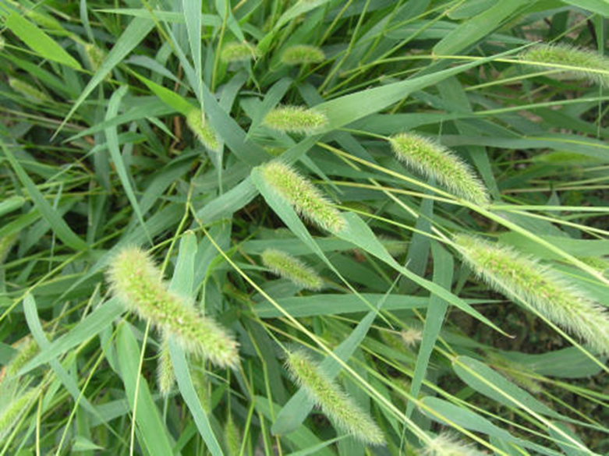
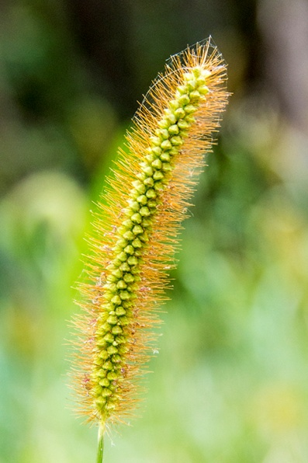
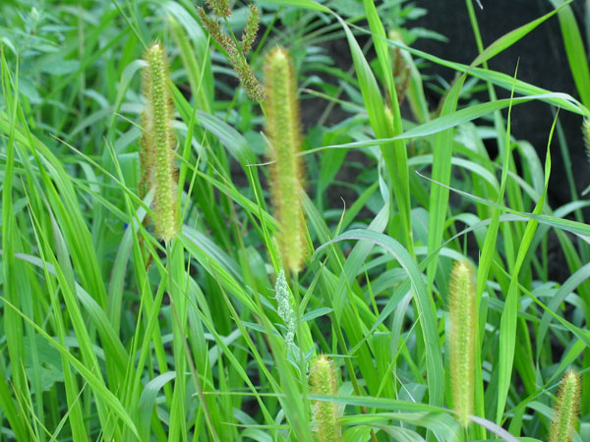
(110) Foxtail

Slide 13
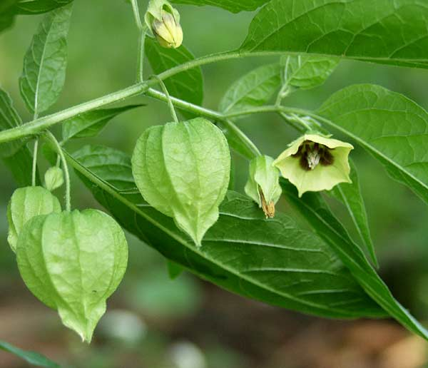
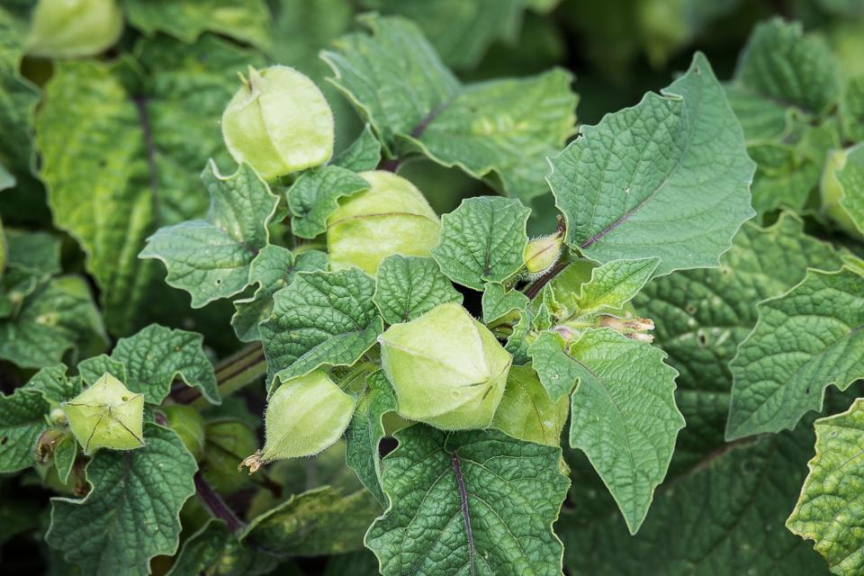
(111) Groundcherry

Slide 14
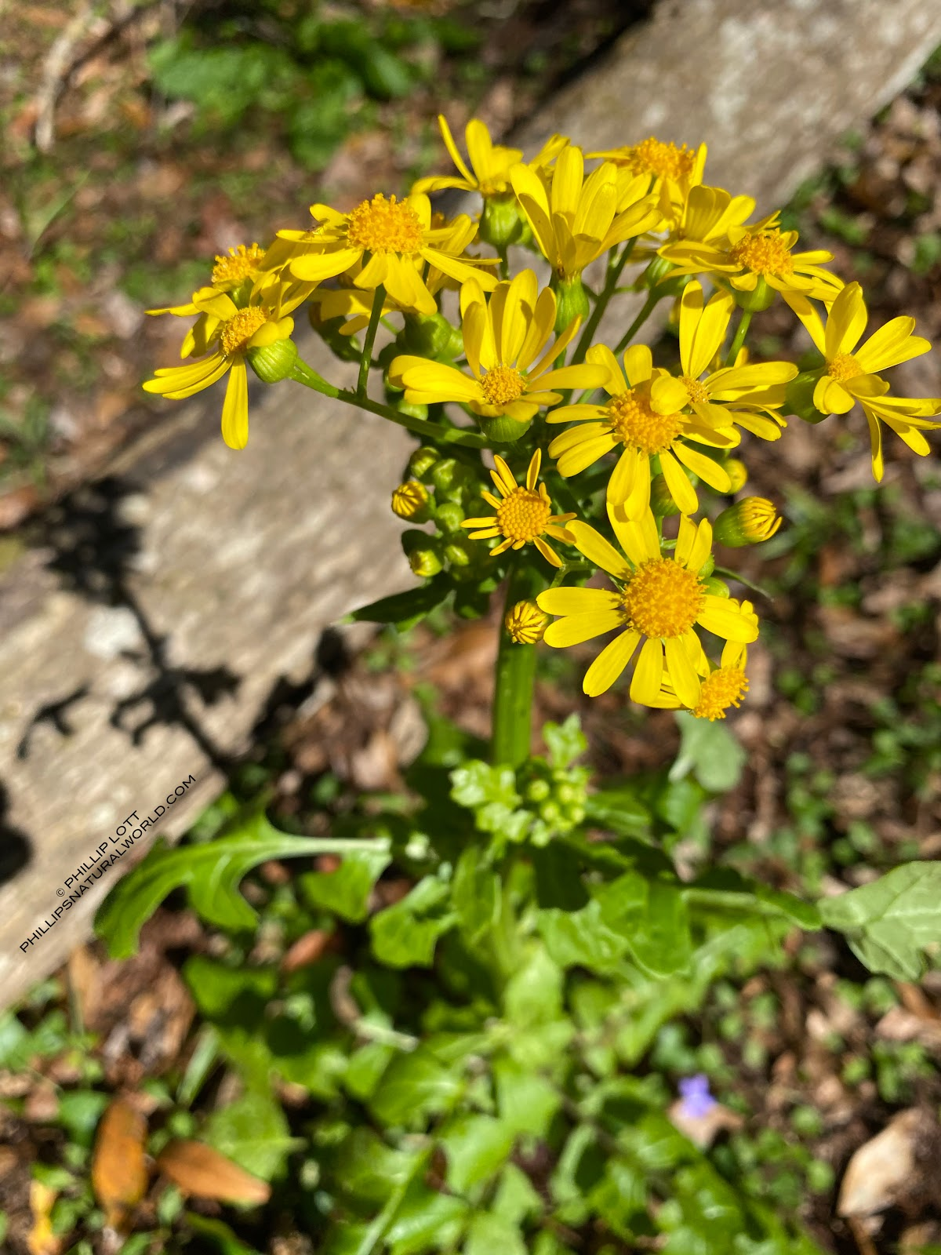
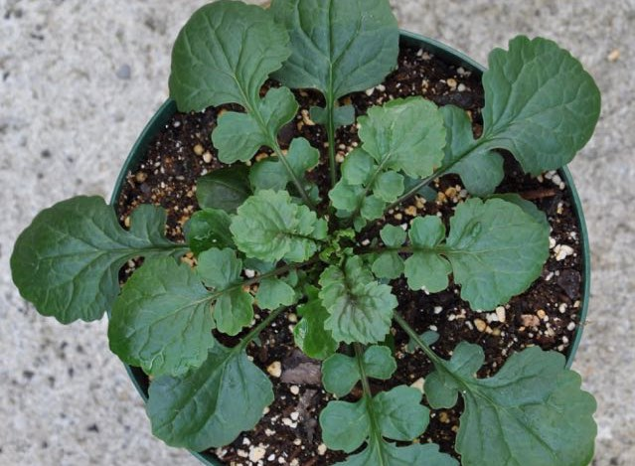
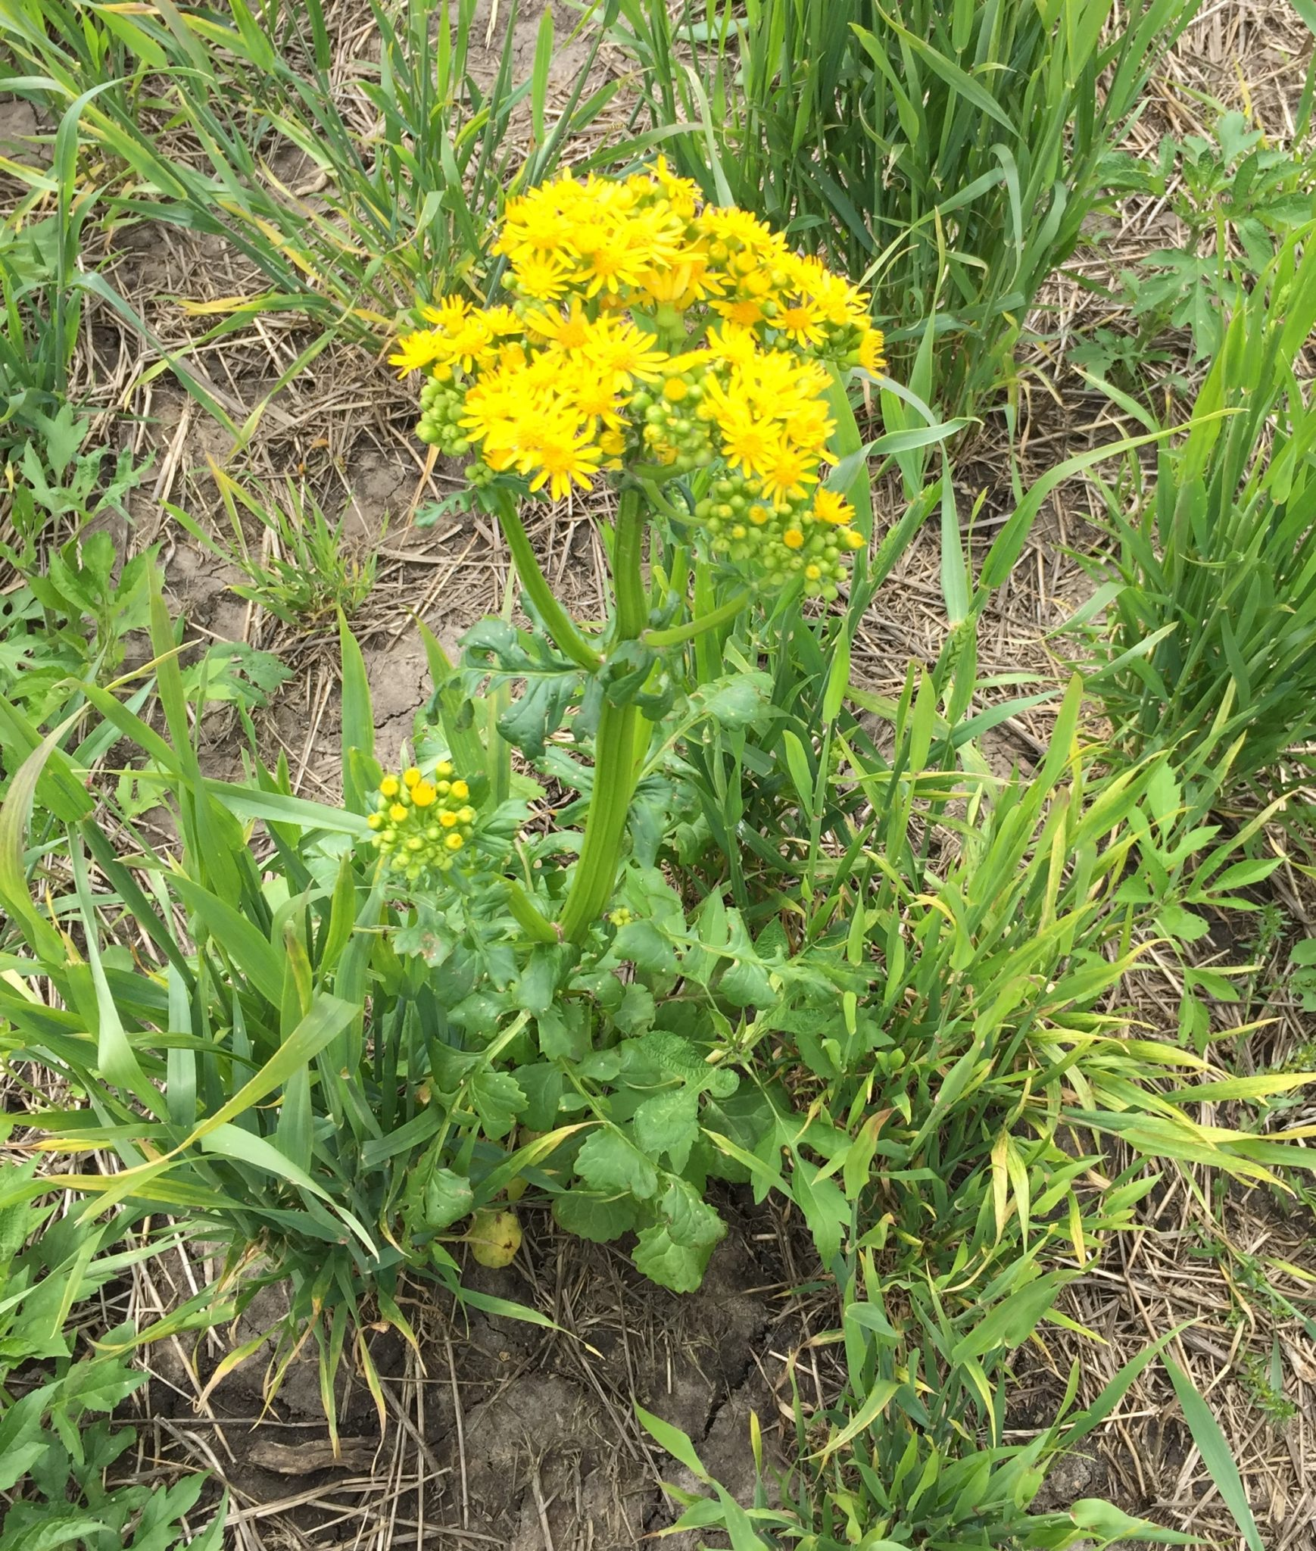
(112) Grounsel, Cressleaf

Slide 15
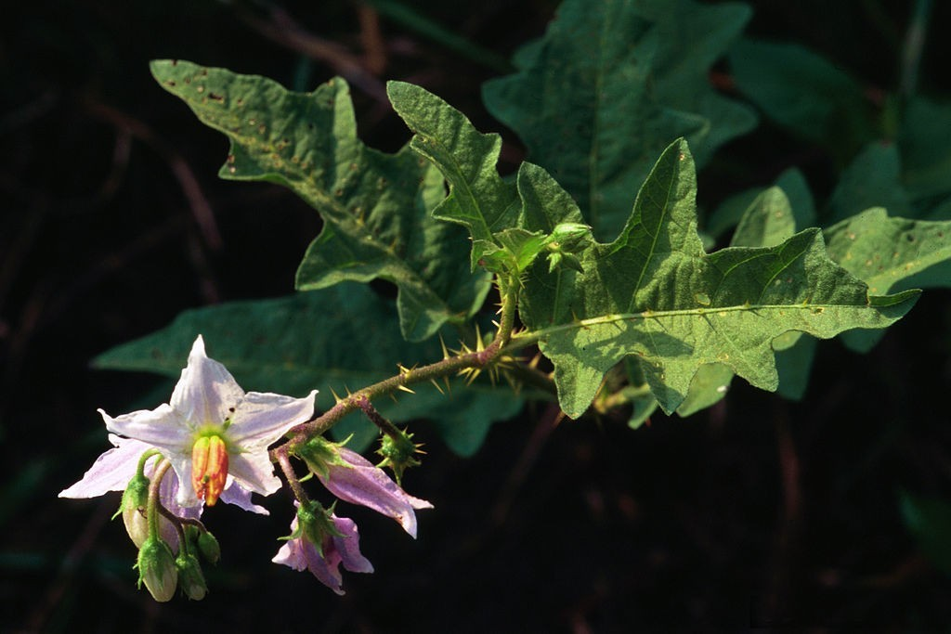
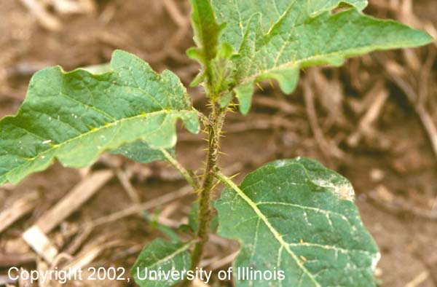
(113) Horsenettle

Slide 16
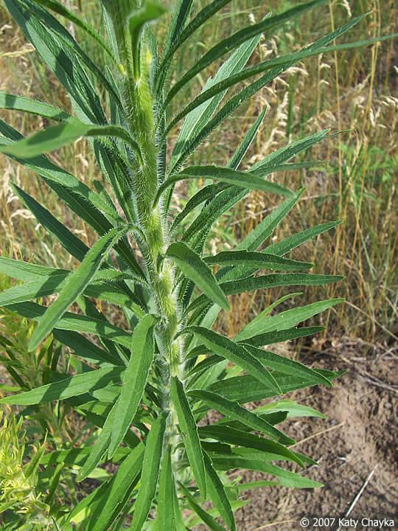
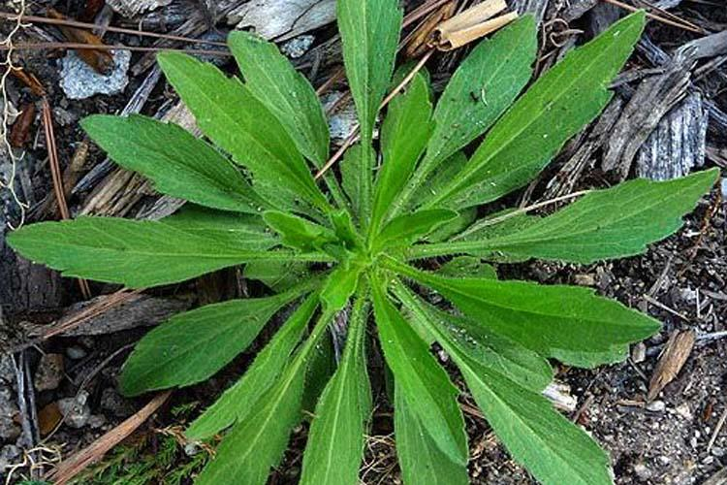
(114) Horseweed (Marestail)

Slide 17
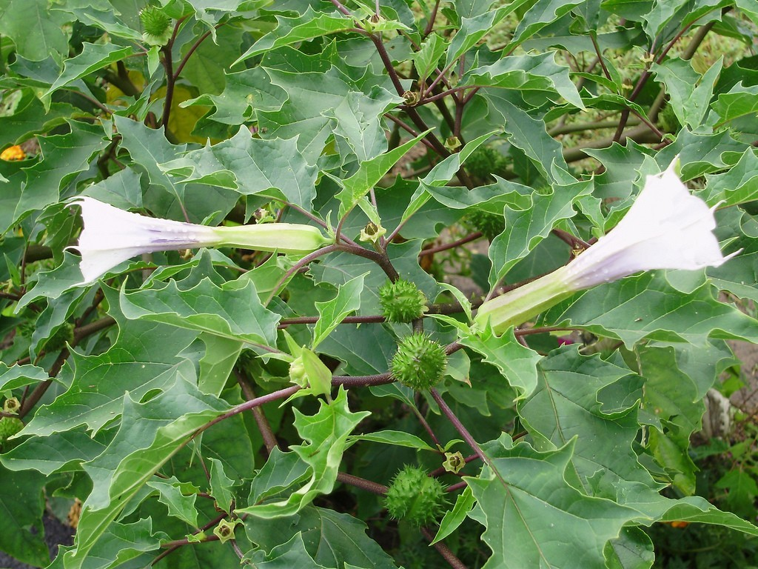
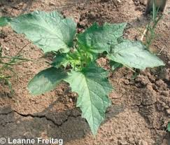
(115) Jimsonweed

Slide 18
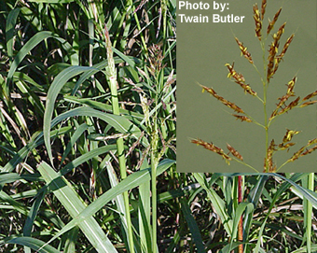
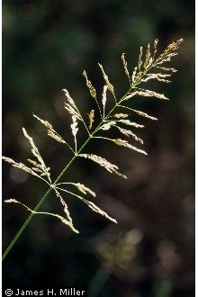
(116) Johnsongrass

Slide 19
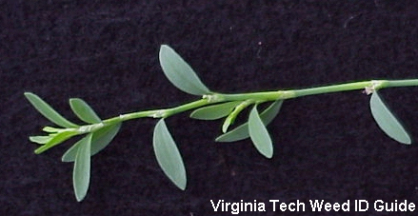
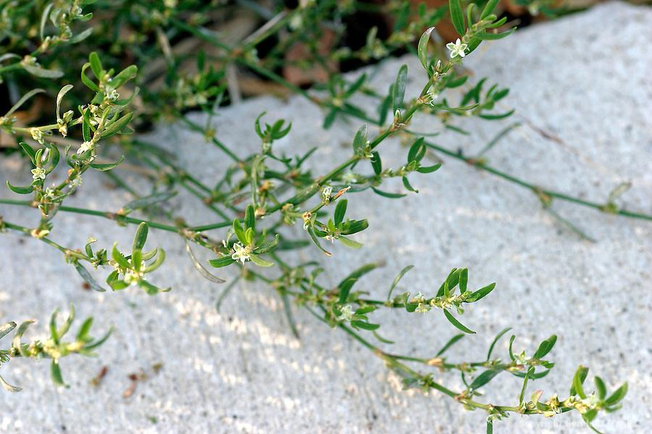
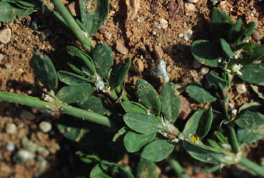
(117) Knotweed, Prostrate

Slide 20
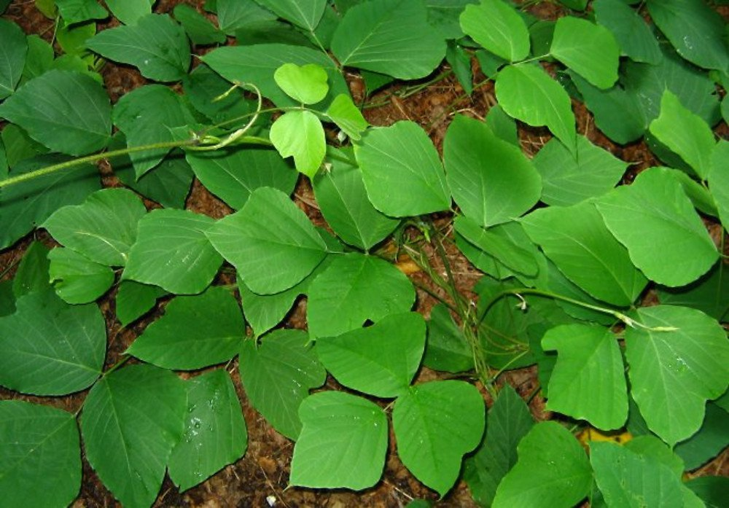
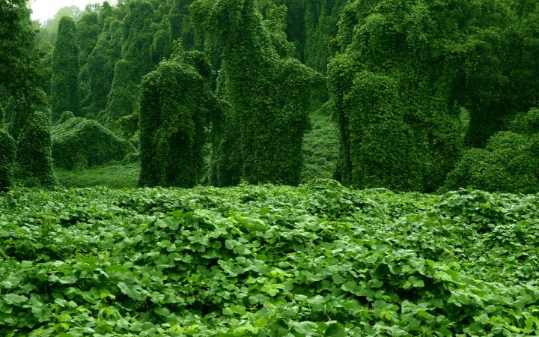
(118) Kudzu

Slide 21
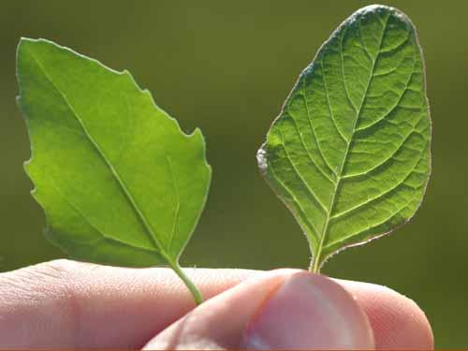
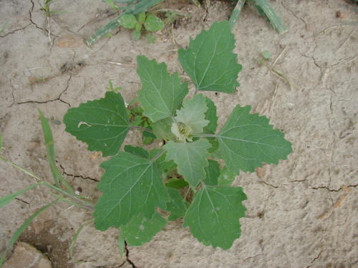
(119) Lambsquarters, Common

Slide 22
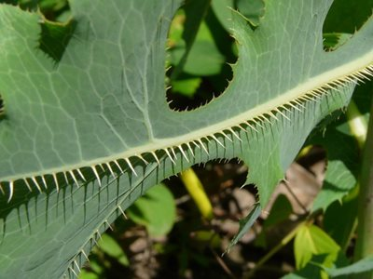
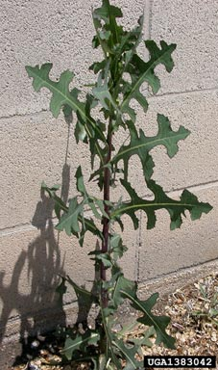
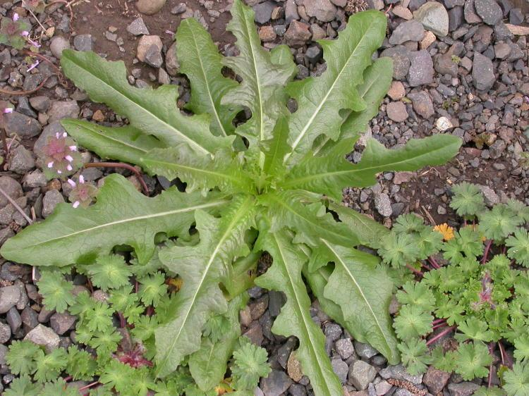
(120) Lettuce, Prickly

Slide 23
(121) Milkweed, Common

Slide 24
(122) Morningglory

Slide 25
(123) Mustard, Wild

Slide 26
(124) Nightshade, Black

Slide 27
(125) Nightshade, Silverleaf

Slide 28
(126) Nutsedge

Slide 29
(127) Onion/Garlic, Wild

Slide 30
(128) Pigweed, (redroot/Palmer/waterhemp)

Slide 31
(129) Plantain, Broadleaf

Slide 32
(130) Plantain, Buckhorn

Slide 33
(131) Purslane, Common

Slide 34
(132) Ragweed, Common

Slide 35
(133) Ragweed, Giant

Slide 36
(134) Sandbur, Field

Slide 37
(135) Shepard’s-purse

Slide 38
(136) Sicklepod

Slide 39
(137) Smartweed

Slide 40
(138) Sowthistle

Slide 41
(139) Spurge, Prostrate

Slide 42
(140) Thistle, Bull /Canada

Slide 43
(141) Velvetleaf

Slide 44
(200) Alfalfa

Slide 45
(201) Bermudagrass

Slide 46
(202) Broccoli

Slide 47
(203) Cantaloupe

Slide 48
(204) Carrot

Slide 49
(205) Cauliflower

Slide 50
(206) Cereal Rye

Slide 51
(207) Chili Pepper

Slide 52
(208) Corn

Slide 53
(209) Cotton

Slide 54
(210) Cucumber

Slide 55
(211) Lettuce

Slide 56
(212) Oats

Slide 57
(213) Onion

Slide 58
(214) Peas

Slide 59
(215) Peanut

Slide 60
(216) Potato

Slide 61
(217) Red Clover

Slide 62
(219) Rice

Slide 63
(220) Sorghum

Slide 64
(221) Soybean

Slide 65
(222) Squash

Slide 66
(223) Strawberry

Slide 67
(224) Sugarcane

Slide 68
(225) Sunflower

Slide 69
(226) Sweet Potato

Slide 70
(227) Sweetclover

Slide 71
(228) Tall Fescue

Slide 72
(229) Tomato

Slide 73
(230) Watermelon

Slide 74
(231) Wheat

Slide 75
(232) White Clover

