Slide 1
Agronomy Disorders
Agronomy CDE

Slide 2
Causal Categories

Slide 3
Biological
Any kind of plant disease or insect (basically an invading pathogen).
Bacteria
Fungus
Insect
Nematodes
Virus

Slide 4
Cultural
Anything that PEOPLE cause.
Chemical
Compaction
Heat (Could also be considered Environmental)
Mechanical
(Moisture: if picture shows or explains irrigation)
Nutritional

Slide 5
Environmental
Any damage caused by weather conditions or nature.
Drought
Frost Damage
Hail
Moisture: Environmental is the standard category.
Sun Scald
Wind Damage
Heat

Slide 6
Parts of Plant Damaged

Slide 7
Reproductive Parts
Any part that plays a role in plant sexual reproduction.
Seeds
Fruits (which will/do contain seeds)
Flowers
Note that potatoes, sugarcane billets, or any other asexually propagated plant parts are NOT considered Reproductive Parts. These should be considered Vegetative Parts.

Slide 8
Vegetative Parts
Any parts that do not play a role in reproduction or transport nutrients and water.
Basically just leaves and petioles (part that attaches leaves to stems).

Slide 9
Vascular Bundles
Any part that primarily transports nutrients and water.
Stems
Vines
Roots

Slide 10
More than one area
Any combination of the previous parts described.
Take a picture of a disorder at face value. In other words, take into account only the parts shown (don’t try to make a disorder affect other parts in your mind).

Slide 11
Agents

Slide 12
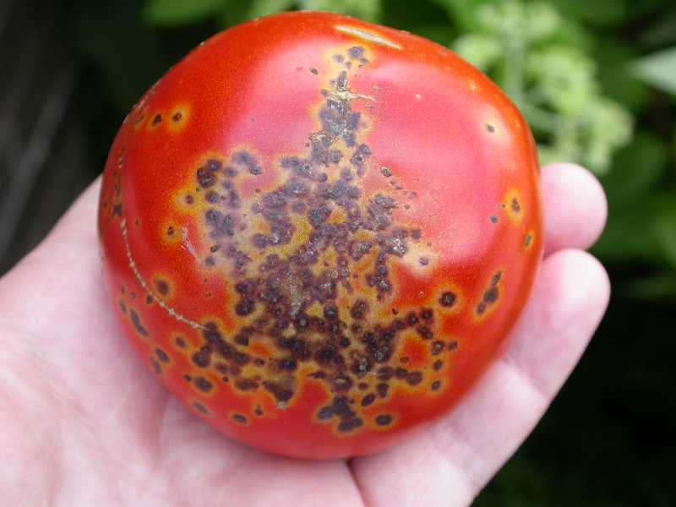
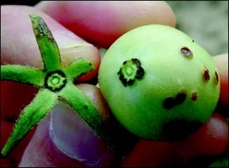
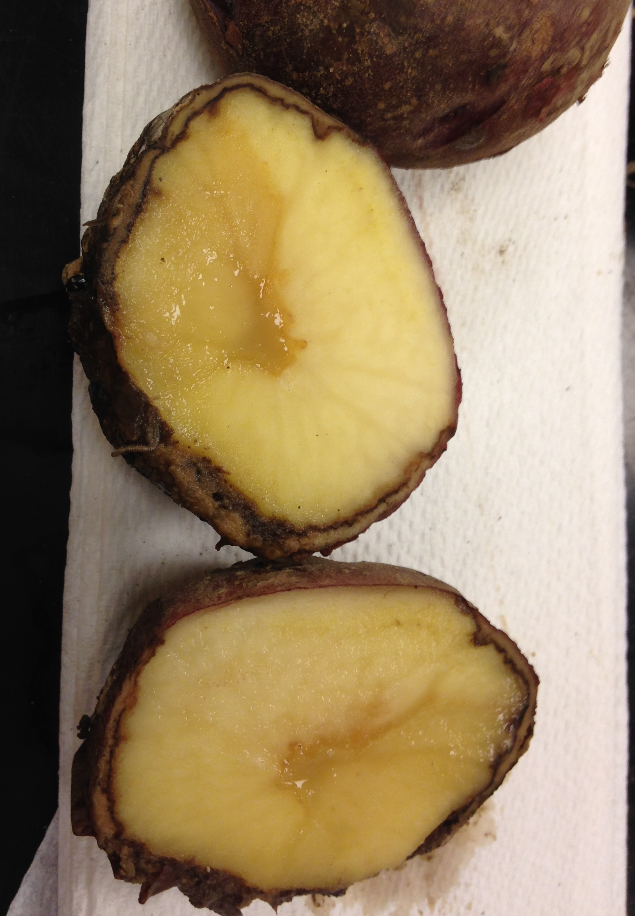
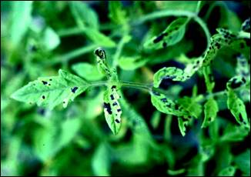
Bacteria
Black spots/blotches or rotting fruits. Often appear greasy/water soaked.
Rots that being inside a fruit and work their way toward the outside. Are generally slimy/smelly

Slide 13
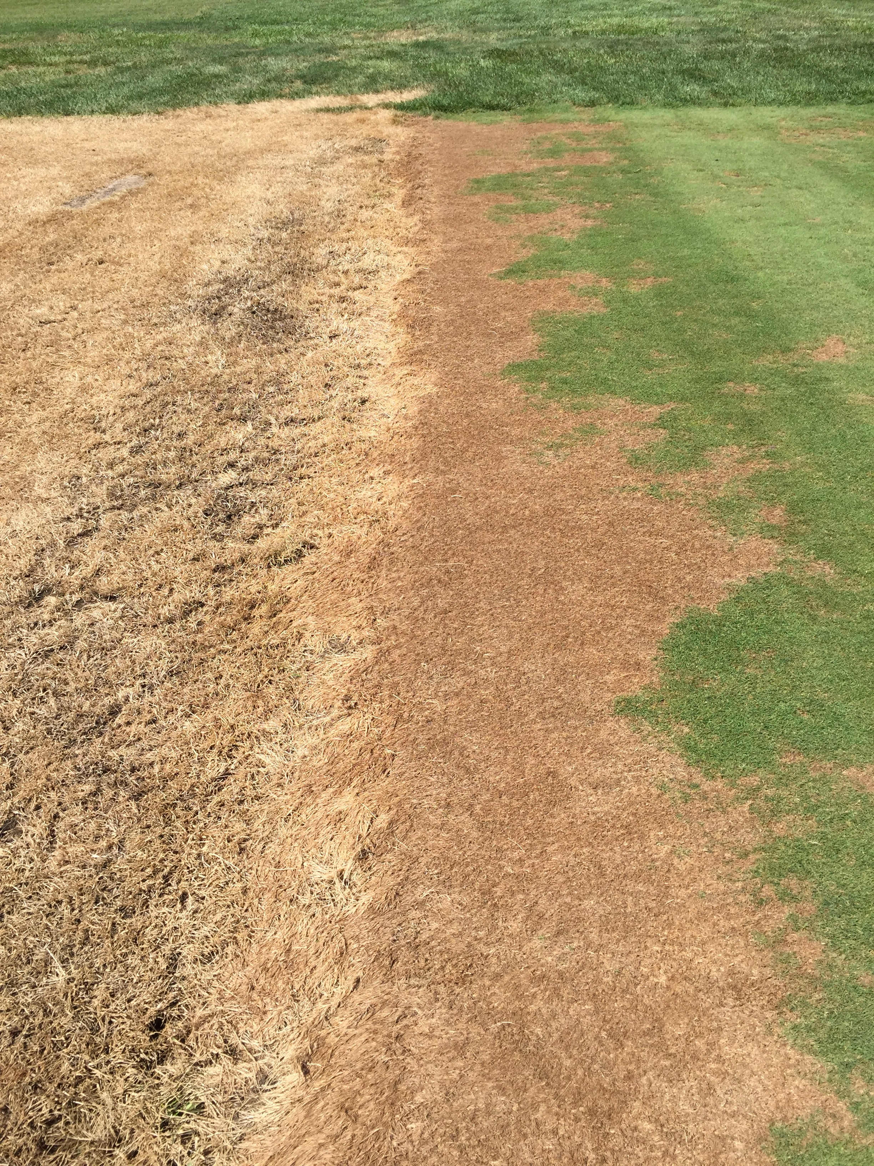
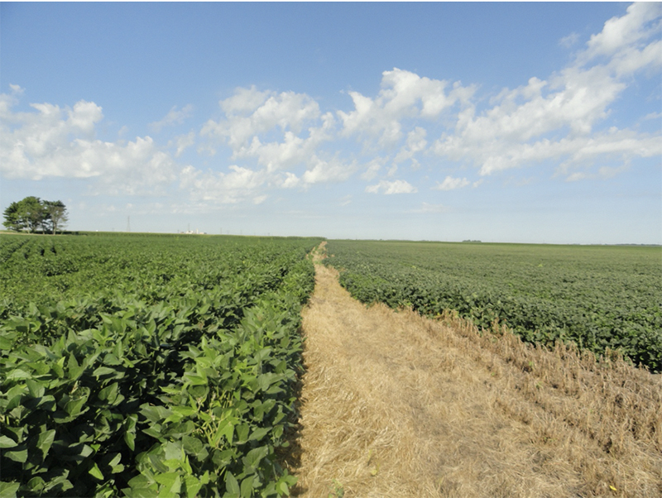
Chemical
Can present in many ways depending on the chemical applied and the plant affected.
Can also be a field view of herbicide drift, sprayer contamination, or pesticide volatilization.
LEFT: Sprayer tank contamination
RIGHT: Herbicide drift

Slide 14
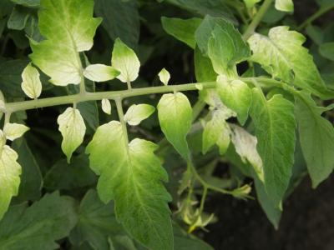
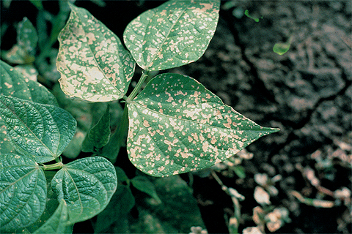
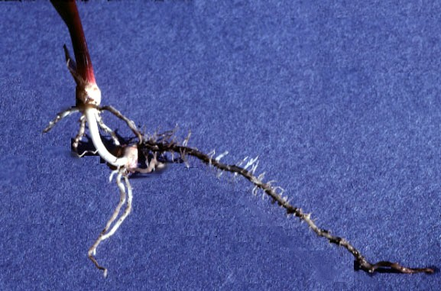
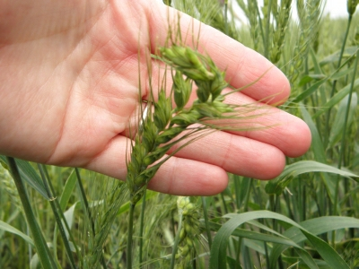
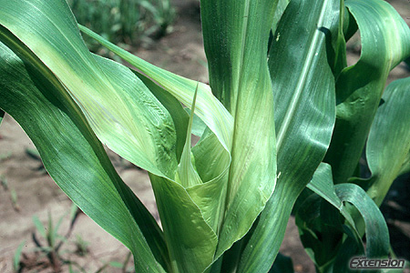
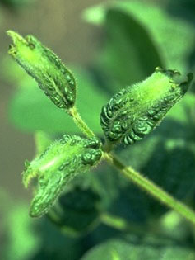
Chemical
Twisting, cupping, bleaching, chlorosis of leaves that are not a nutritional pattern, dead spots on older leaves that are not spreading, and clubbed/bottlebrushed roots are typical herbicide damages
Pigment Inhibitor Damage Cell Membrane Disrupter (Group 14 or 22) Treflan (Group 3) carryover causing
to Tomato Paraquat Drift on Soybean bottlebrushed roots in corn.
ALS herbicide (Group 2) causing twisting/stunting of wheat seedhead.
Glyphosate (Group 9) drift in corn causing chlorosis of leaf tissue.
Growth regulator herbicides (Group 4) such as 2,4-D or dicamba cause leaf strapping and cupping (right) and/or the stems to twist and grow back toward the ground (left).

Slide 15
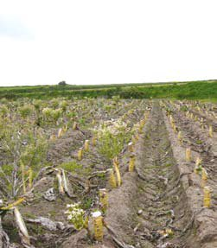
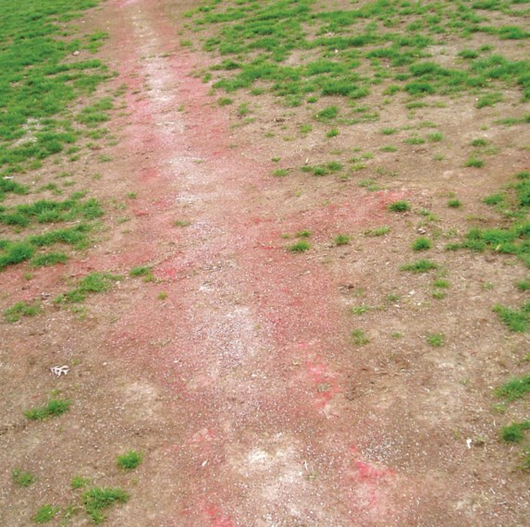
Compaction
Smushed plants or soil (usually caused by traffic).

Slide 16
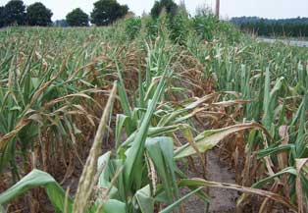
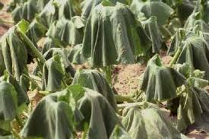
Drought
Crispy or wilted plants.

Slide 17
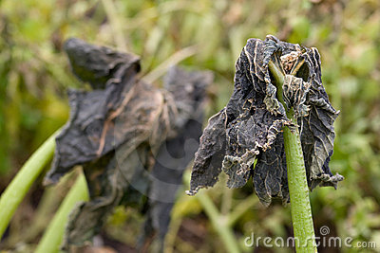
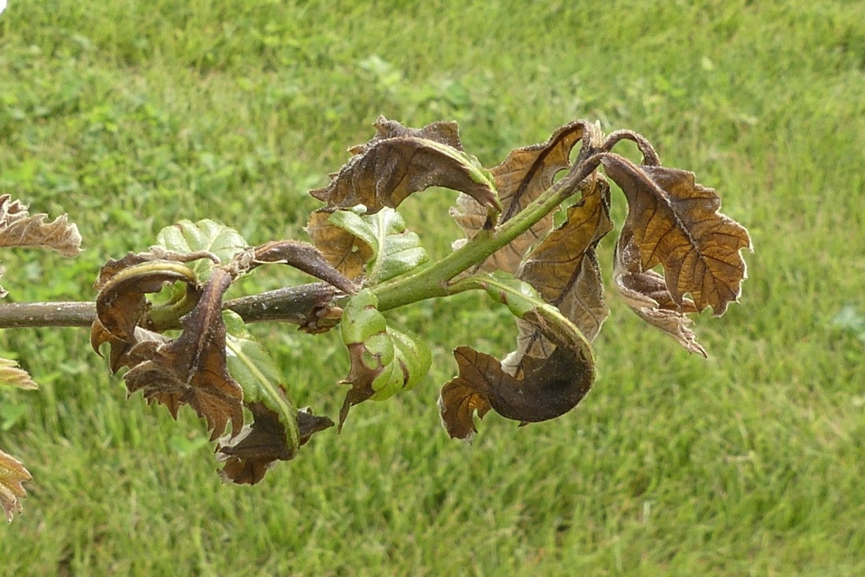
Frost Damage
Wilting with black/dark coloring (necrosis).
Can have a “gooey” appearance when fresh.

Slide 18
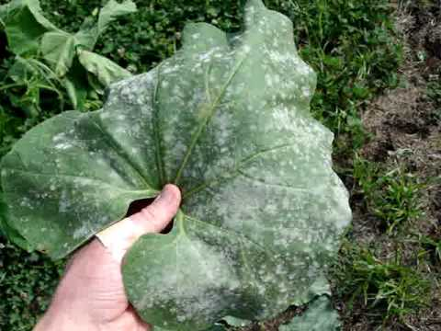
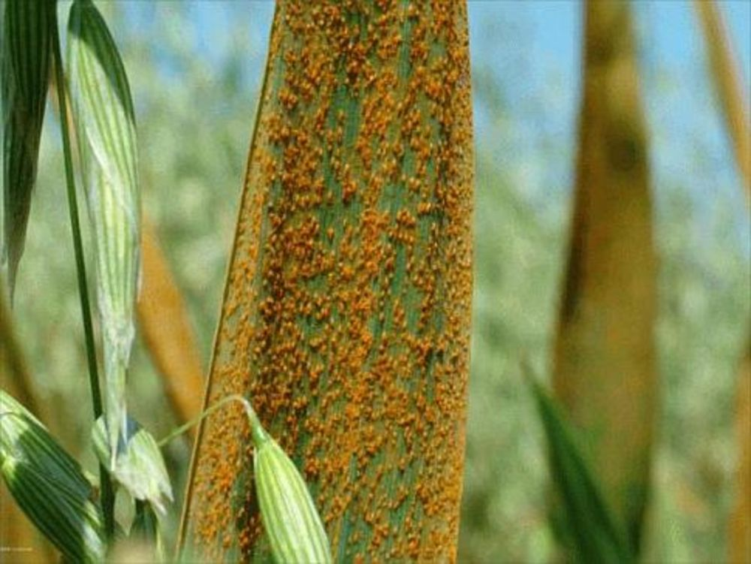
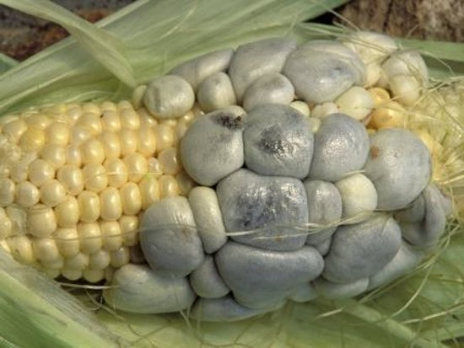
Fungus
The most common biological problem.
Can range from mold, mildew, rusts, galls, and scabs.

Slide 19
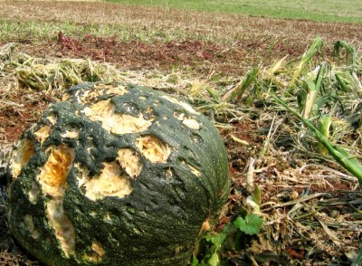
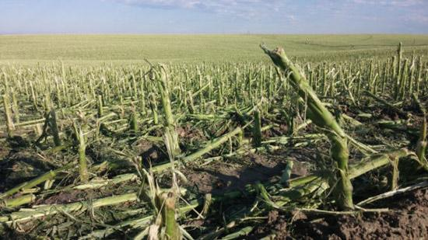
Hail
Beat up crops, laying in many directions.

Slide 20
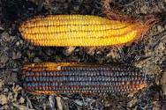
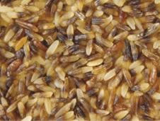
Heat
Burned crop fruits (grains).
Caused from staying in grain dryer too long.

Slide 21
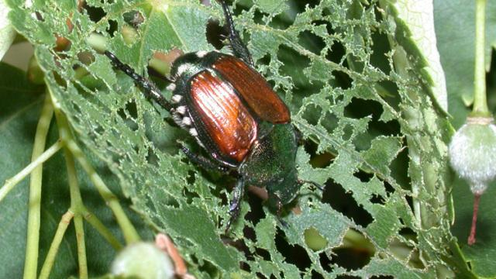
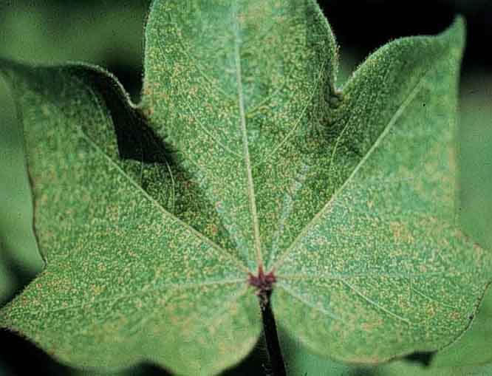
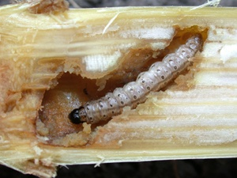
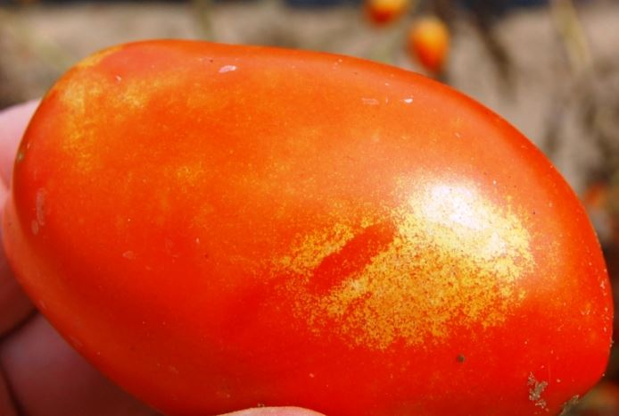
Insect
Will have holes and tunnels in leaves, stems, or fruits if caused by beetles, worms, or weevils
Will show stipling of leaf tissue or yellowing of fruits if caused by an insect with a piercing/sucking mouth part.

Slide 22
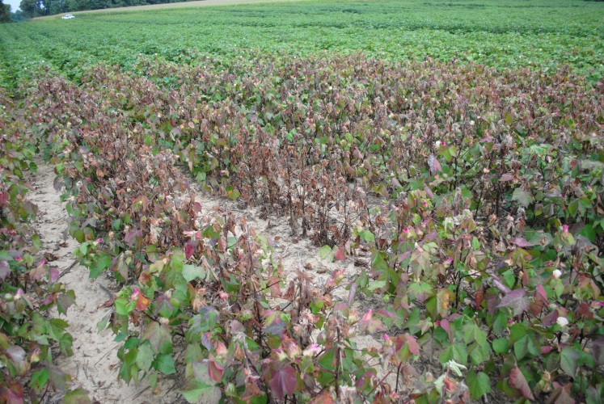
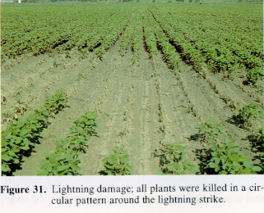
Lightning
A “dead zone” in a crop field.

Slide 23
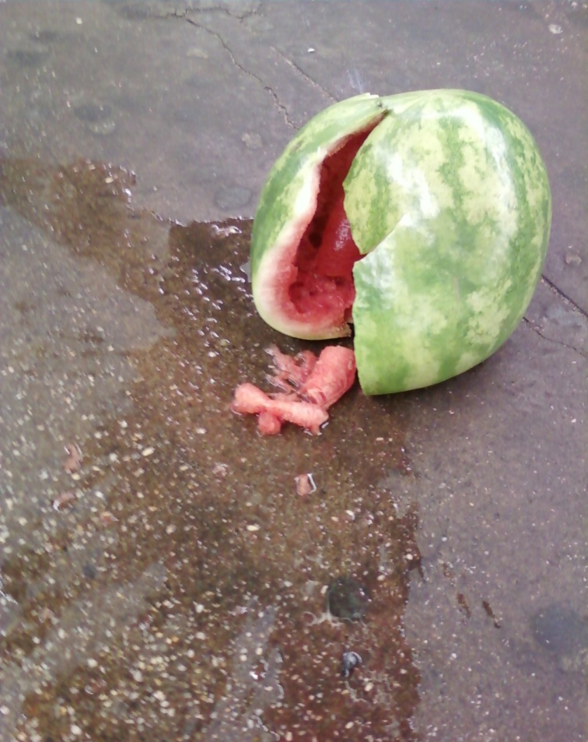
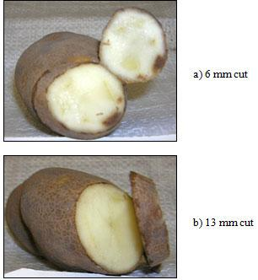
Mechanical
Caused by machinery or human error (usually during or after harvesting).

Slide 24
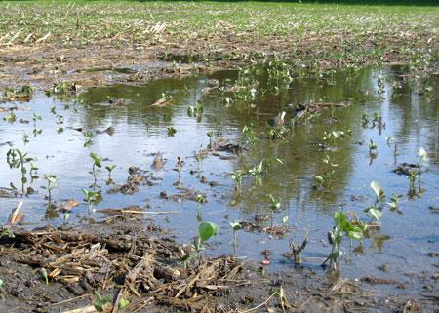
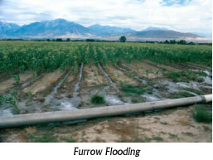
Moisture
Caused by the environment or people if irrigation is used.
Excess watering, rill/gully erosion, and split fruits are common examples.

Slide 25
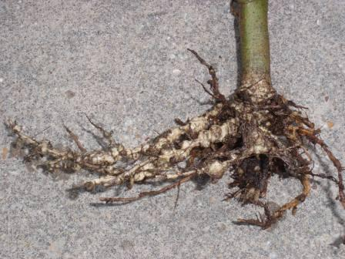
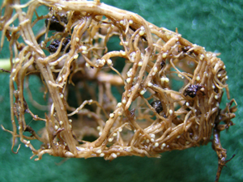
Nematodes
Large nodes or extreme distortion on roots.

Slide 26
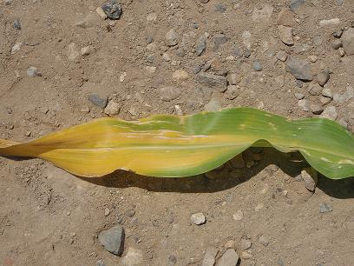
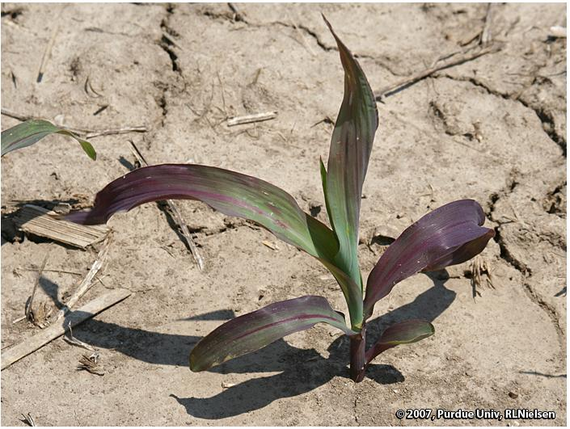
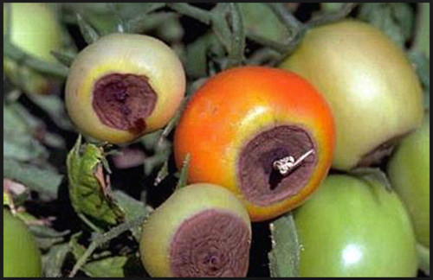
Nutritional
Characterized by colors (yellow and deep purple).
Nitrogen: chlorosis from leaf tip to the base. Oldest leaves first to be affected.
Phosphorous: purpling of leaf tissue
Potassium: chlorosis of leaf margins.
Most micronutrients: interveinal chlorosis
Exception: Calcium deficient tomatoes; have an undeveloped blossom end.

Slide 27
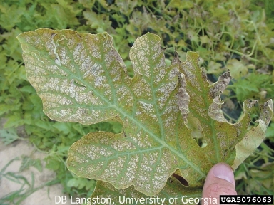
Pollution
Very rare, typically only shown as ozone pollution to watermelon.

Slide 28
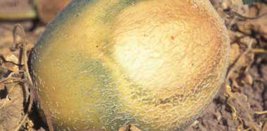
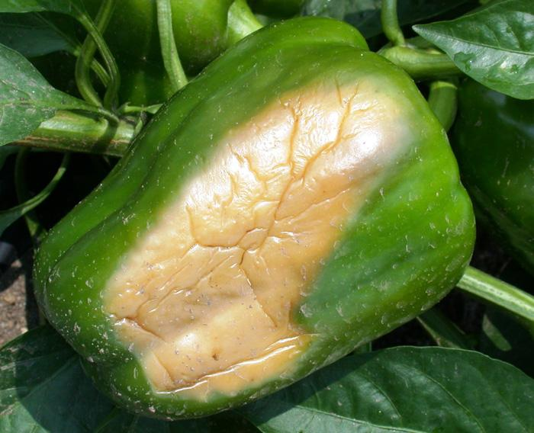
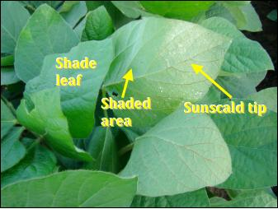
Sunscald
Usually either a white discoloration on fruit or leaves.

Slide 29
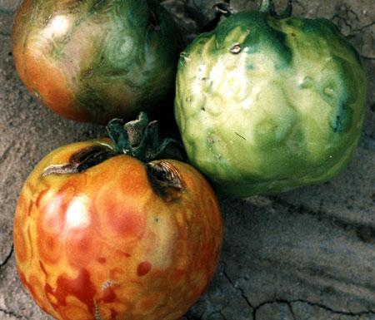
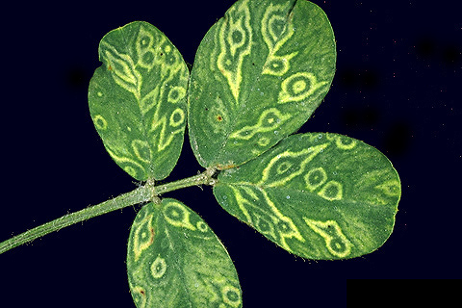
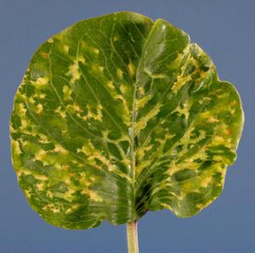
Virus
Appears as “circles” and “stained glass”.
Other viral diseases cause deformities of plant tissue that are not easily explained by other agents.
Viral infections are not as common as other plant disorders.

Slide 30
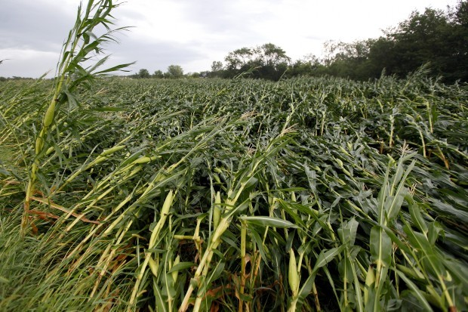
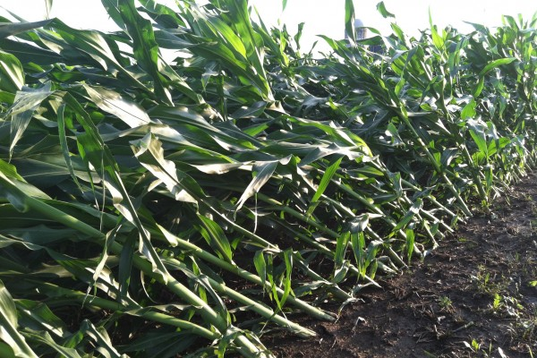
Wind Damage
Crops laying over in the same direction.

