Slide 1
Forestry Tree ID

Slide 2
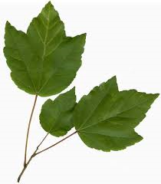
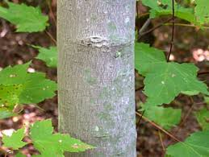
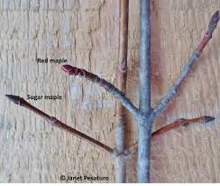
Red Maple (Acer rubrum)

Slide 3
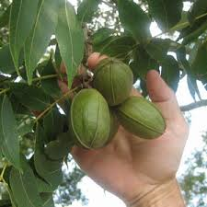
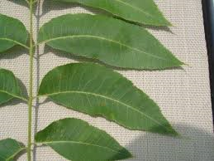
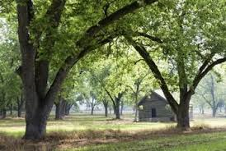
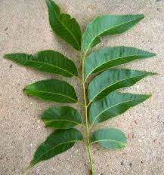
Pecan (Carya illinoensis)

Slide 4
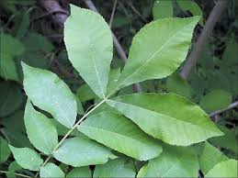
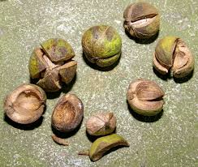
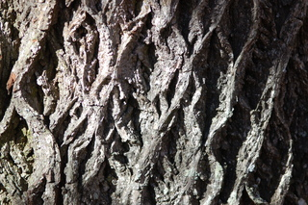
Hickory (Carya spp.)

Slide 5
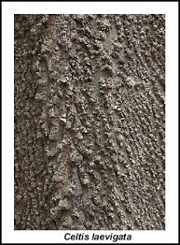
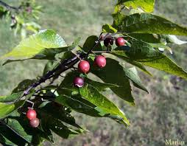
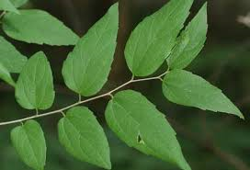
Sugarberry (Celtis laevigata)

Slide 6
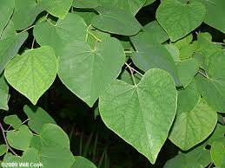
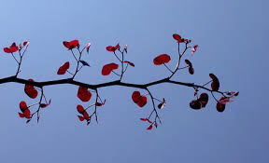
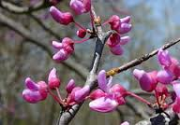
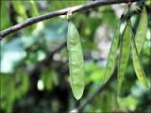
Eastern Redbud (Cercis canadensis)

Slide 7
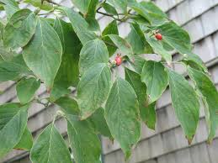
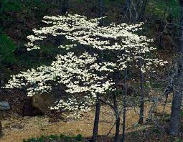
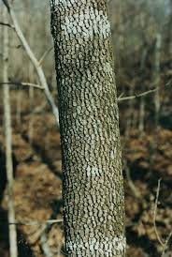
Flowering Dogwood (Cornus florida)

Slide 8
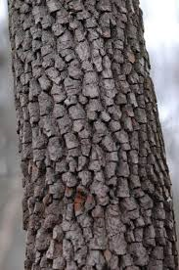
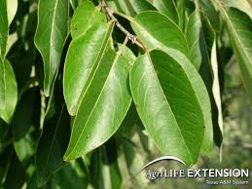
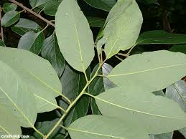
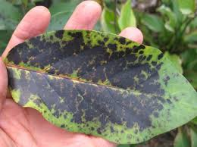
Common Persimmon (Diospyros virginiana)

Slide 9
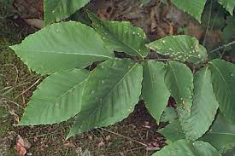
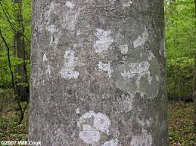
American Beech (Fagus grandifolia)

Slide 10
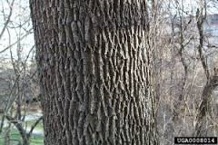
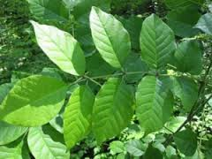
Ash (Fraxinus spp.)

Slide 11
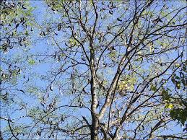
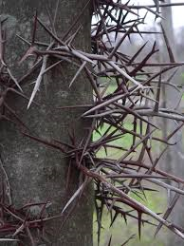
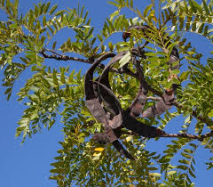
Honeylocust (Glenditsia triacanthos)

Slide 12
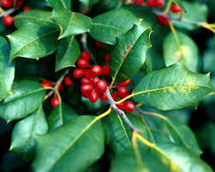
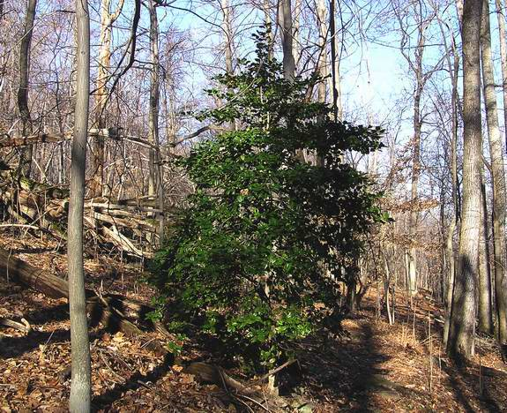
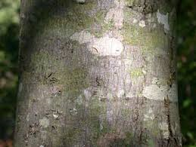
American Holly (Ilex opaca)

Slide 13
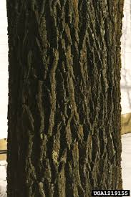
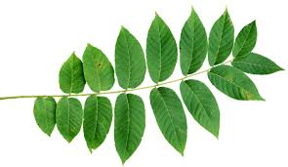
Black Walnut (Juglans nigra)

Slide 14
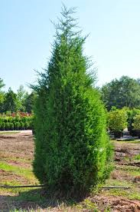
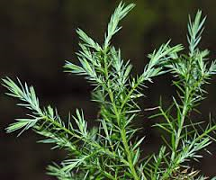
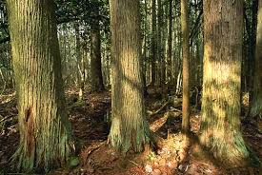
Eastern Redcedar (Juniperus virginiana)

Slide 15
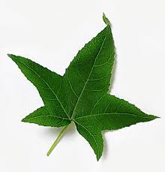
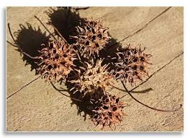
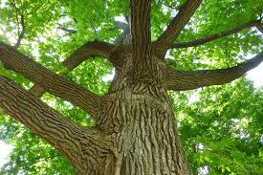
Sweetgum (Liquidambar styraciaflua)

Slide 16
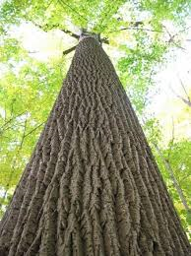
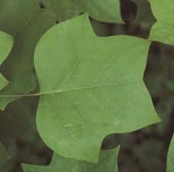
Yellow Poplar (Liriodendron tulipifera)

Slide 17
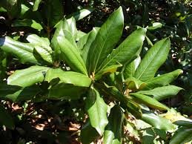
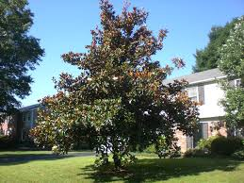
Southern Magnolia (Magnolia grandiflora)

Slide 18
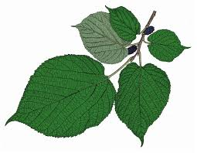
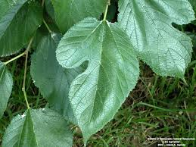
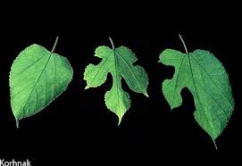
Red Mulberry (Morus rubra)

Slide 19
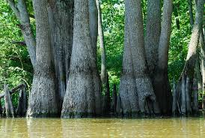


Water Tupelo (Nyssa aquatica)

Slide 20




Blackgum (Nyssa sylvatica)

Slide 21



Shortleaf Pine (Pinus echinata)

Slide 22



Slash Pine (Pinus elliottii)

Slide 23


Spruce Pine (Pinus glabra)

Slide 24



Longleaf Pine (Pinus palustris)

Slide 25



Loblolly Pine (Pinus taeda)

Slide 26



American Sycamore (Platanus occidentalis)

Slide 27


Eastern Cottonwood (Populus deltoides)

Slide 28



Black Cherry (Prunus serotina)

Slide 29


White Oak (Quercus alba)

Slide 30



Southern Red Oak (Quercus falcata)

Slide 31


Overcup Oak (Quercus lyrata)

Slide 32


Blackjack Oak (Quercus marilandica)

Slide 33


Cow Oak (Quercus michauxii)

Slide 34



Water Oak (Quercus nigra)

Slide 35


Cherrybark Oak (Quercus pagoda)

Slide 36



Willow Oak (Quercus phellos)

Slide 37


Shumard Oak (Quercus shumardii)

Slide 38


Post Oak (Quercus stellata)

Slide 39

Nuttall Oak (Quercus texana)

Slide 40



Live Oak (Quercus virginiana)

Slide 41


Blacklocust (Robinia pseudoacacia)

Slide 42



Black Willow (Salix nigra)

Slide 43


Sassafras (Sassafras albidum)

Slide 44



Baldcypress (Taxodium distichum)

Slide 45

Tallow Tree (Triadica sebifera)

Slide 46


Winged Elm (Ulmus alata)

Slide 47


American Elm (Ulmus americana)

