Slide 1
Wood Products ID
Louisiana FFA

Slide 2
Species

Slide 3
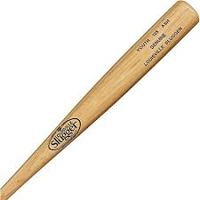
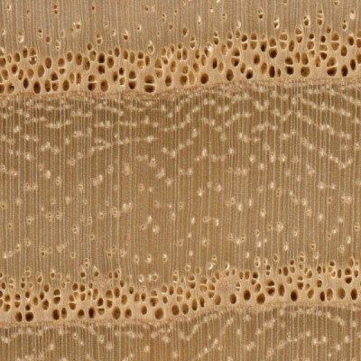
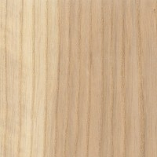
Ash (Fraxinus sp.)
Furniture, stair treads, turned objects, flooring, musical instruments, baseball bats

Slide 4
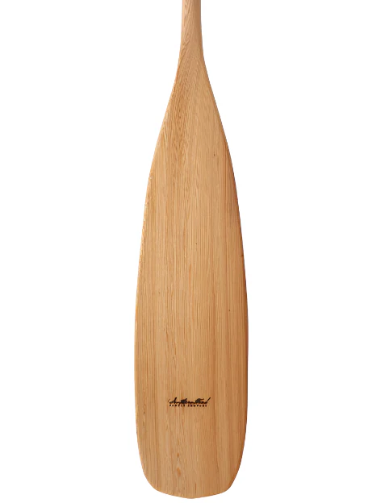
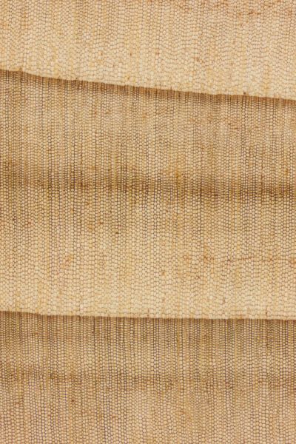
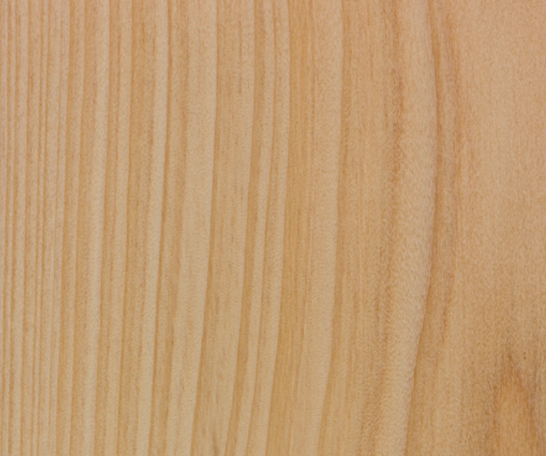
Bald Cypress (Taxodium distichum)
Paneling, moulding, outdoor furniture, exterior trim, boat paddles

Slide 5
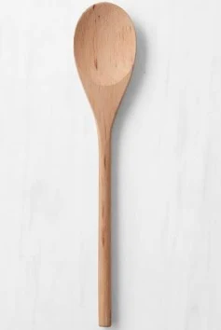
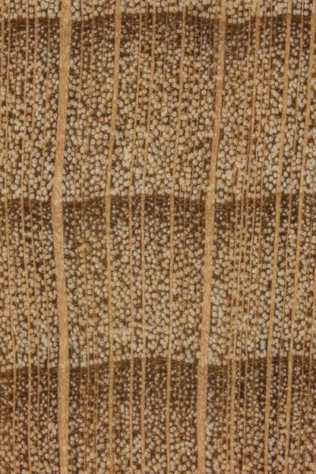
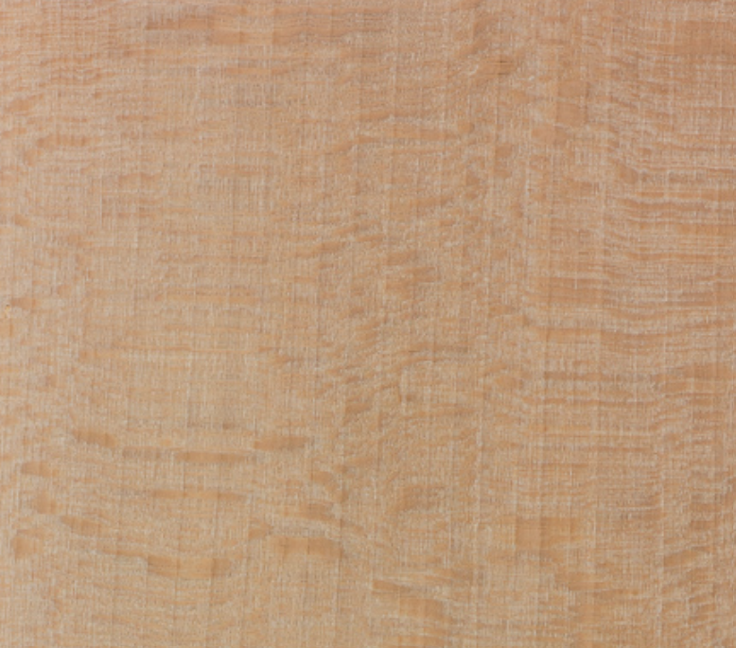
Beech, American (Fagus americana)
Veneer, flooring, crates, musical instruments, wooden utensils

Slide 6
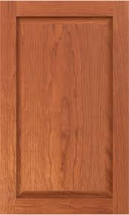
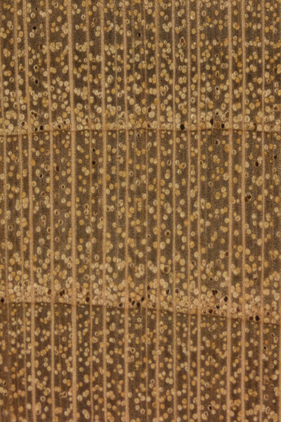
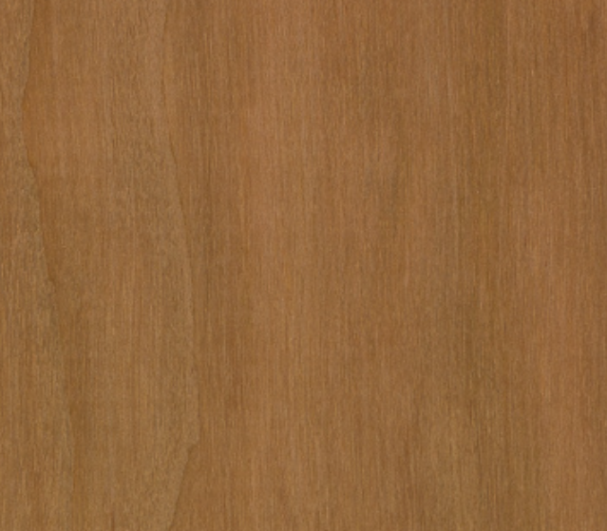
Cherry, Black (Prunus serotina)
High end furniture, finish carpentry, cabinets

Slide 7
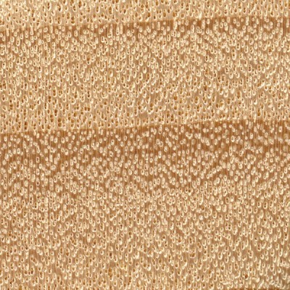
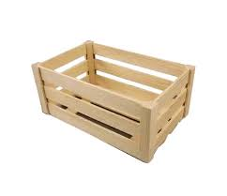
Cottonwood, Eastern (Populus deltoides)
Furniture, millwork, wooden toys, utensils, crates

Slide 8
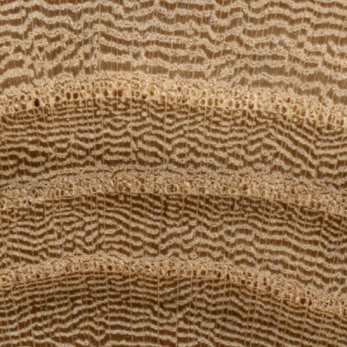
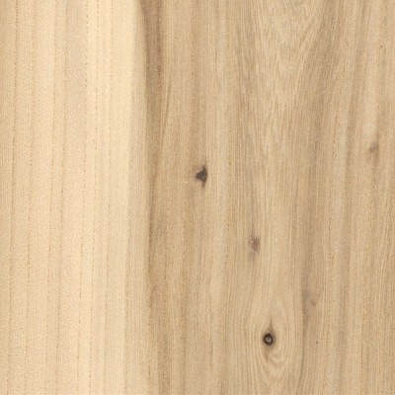
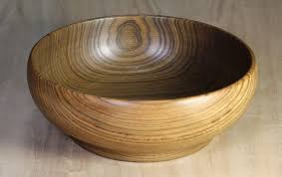
Elm (Ulmus sp.)
Furniture, hockey sticks, turned bowls

Slide 9
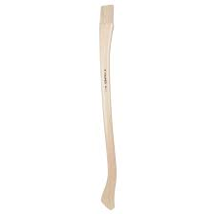
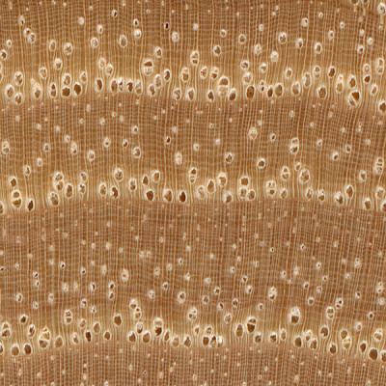
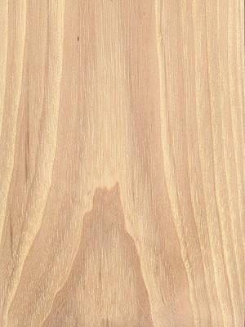
Hickory (Carya sp.)
Furniture, flooring, tool handles, shafts, bows, skis

Slide 10
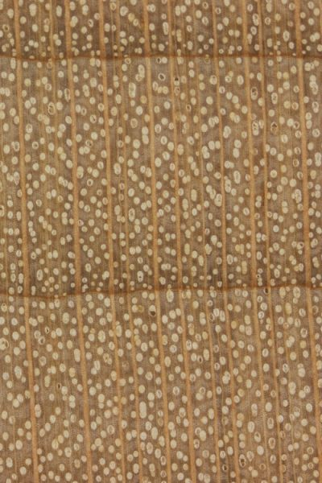
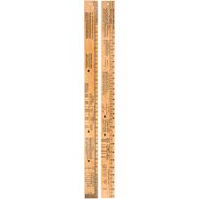
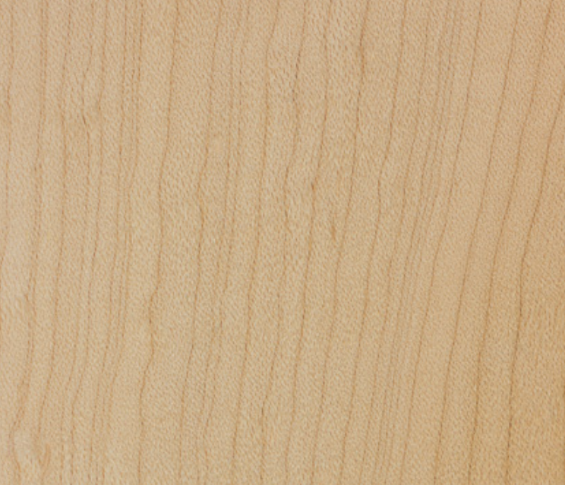
Maple (Acer sp.)
Gym flooring, butcher blocks, bowling pins, biltmore sticks

Slide 11
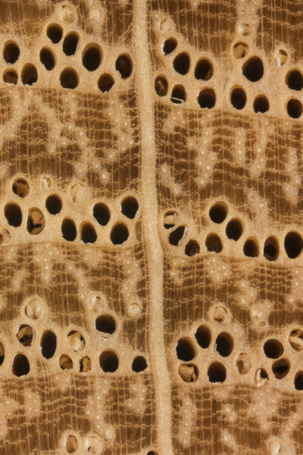
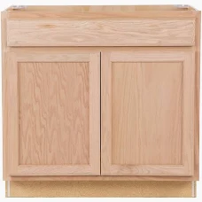
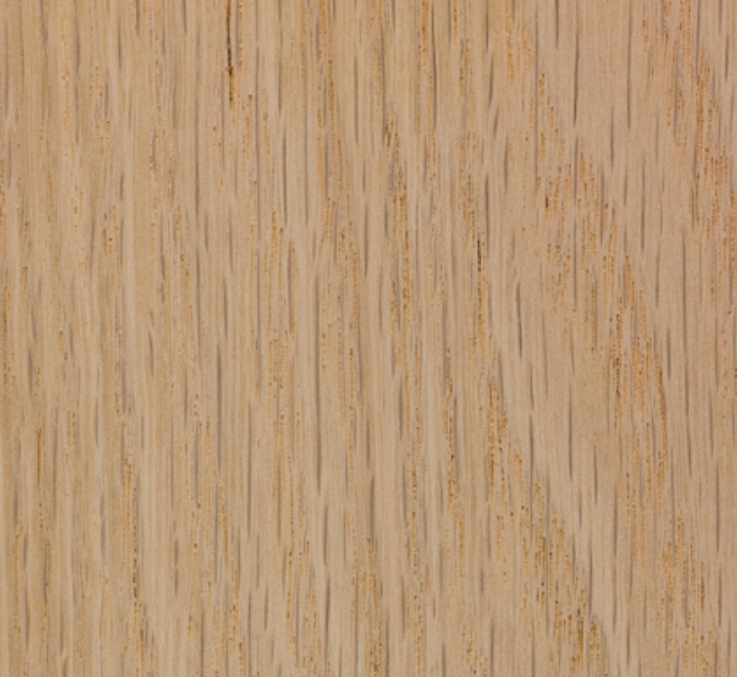
Oak, Red (Quercus rubra)
Furniture, flooring, cabinetry

Slide 12
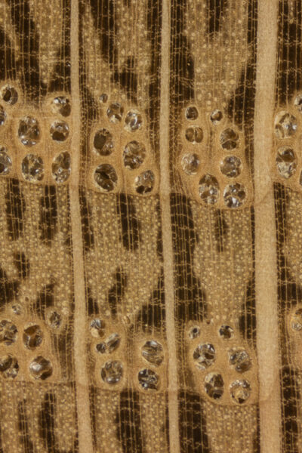
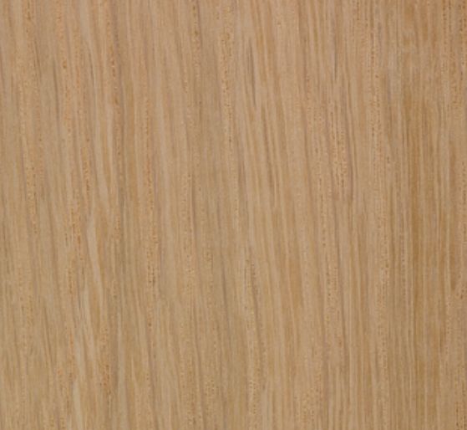
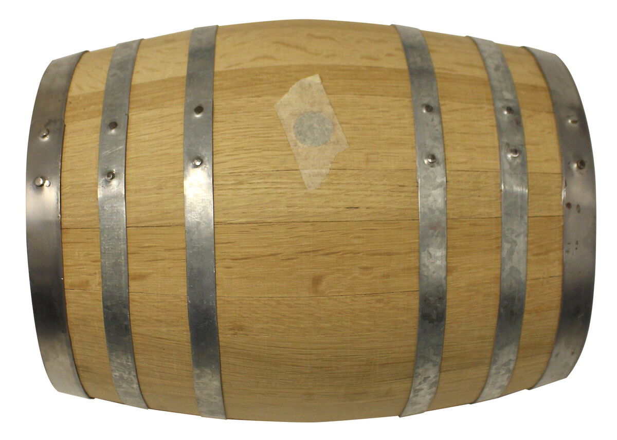
Oak, White (Quercus alba)
Railroad ties, flooring, outdoor furniture, wooden barrels

Slide 13
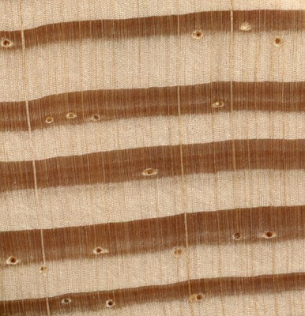
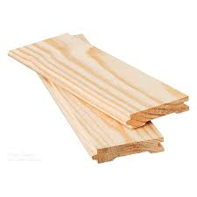
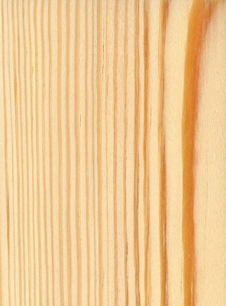
Pine, Southern Yellow (Pinus sp.)
Dimensional lumber, plywood, OSB, treating

Slide 14
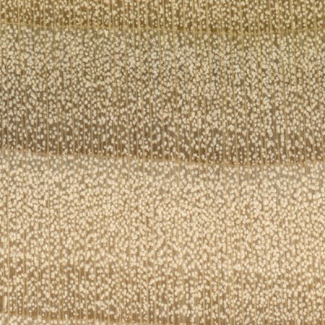
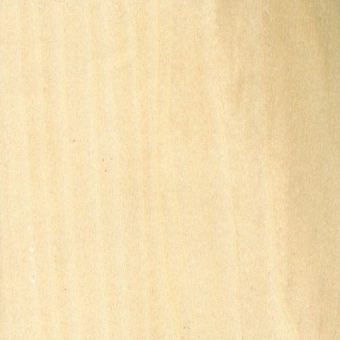
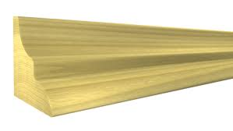
Poplar, Yellow (Liriodendron tulipifera)
Furniture, wooden toys, moulding

Slide 15
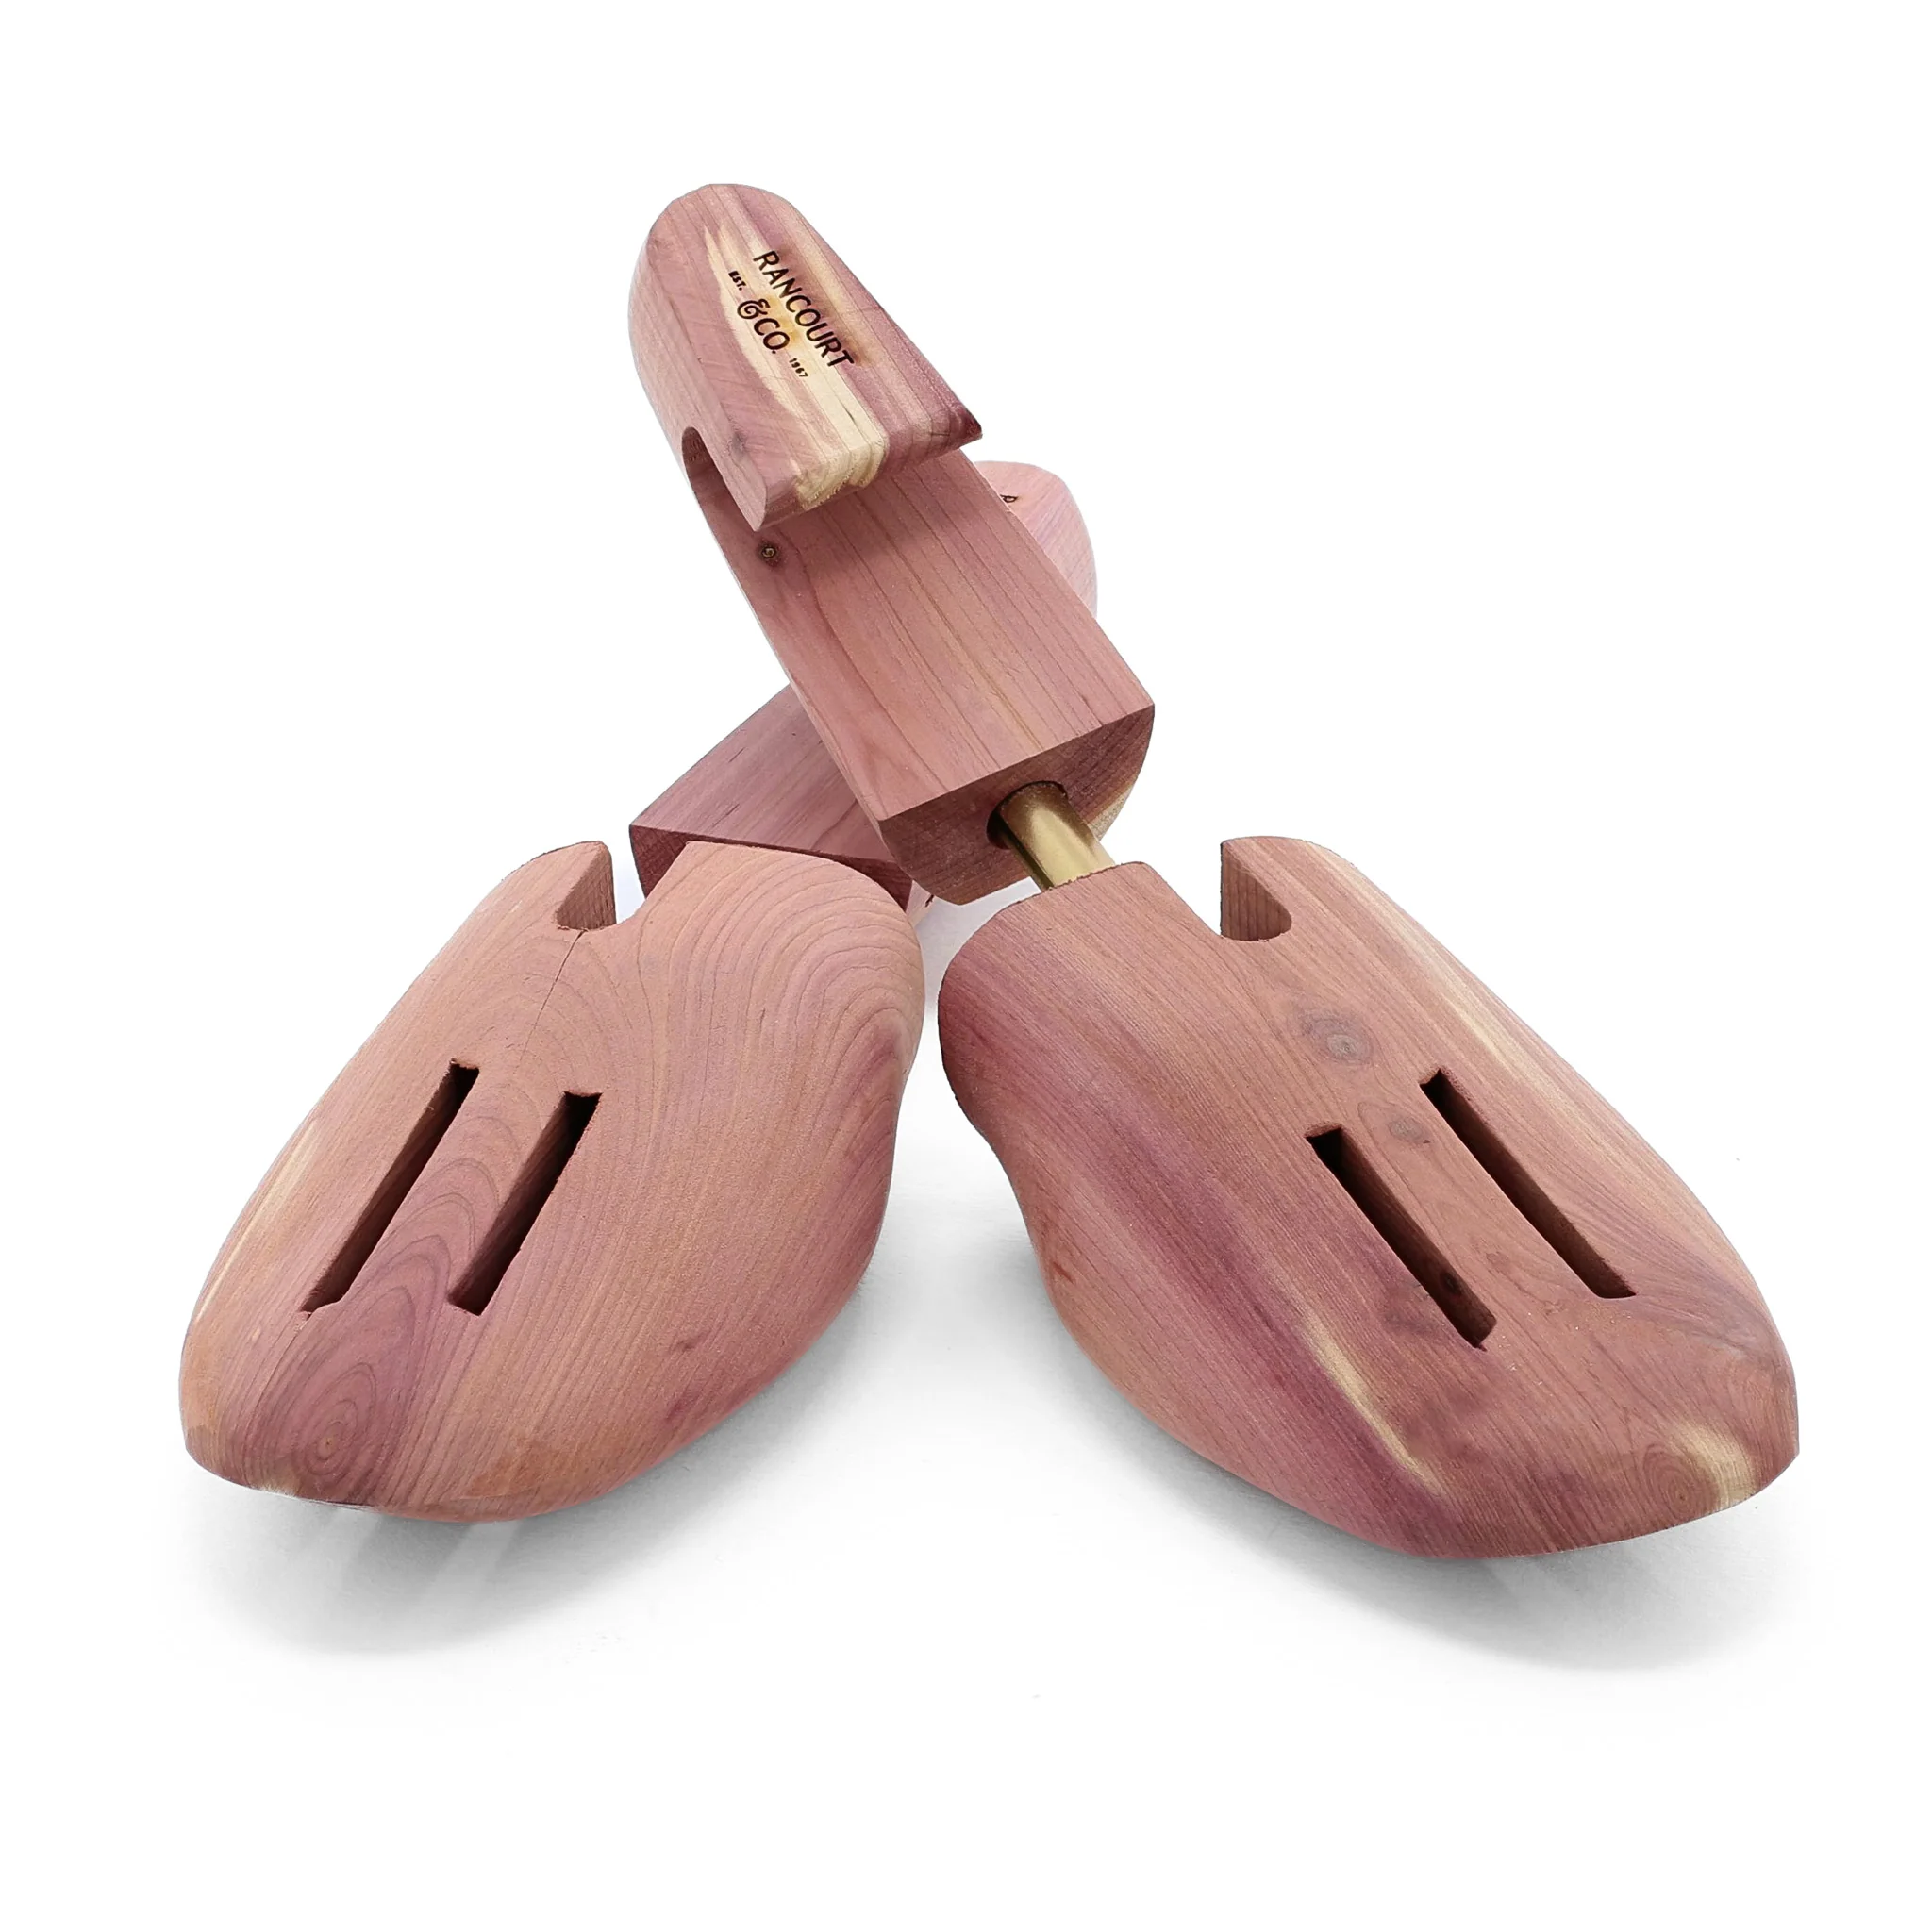
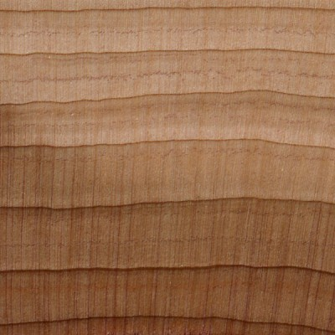
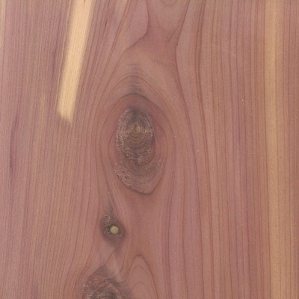
Red Cedar, Eastern (Juniperus virginiana)
Furniture, closet linings, aromatics, shoe trees

Slide 16
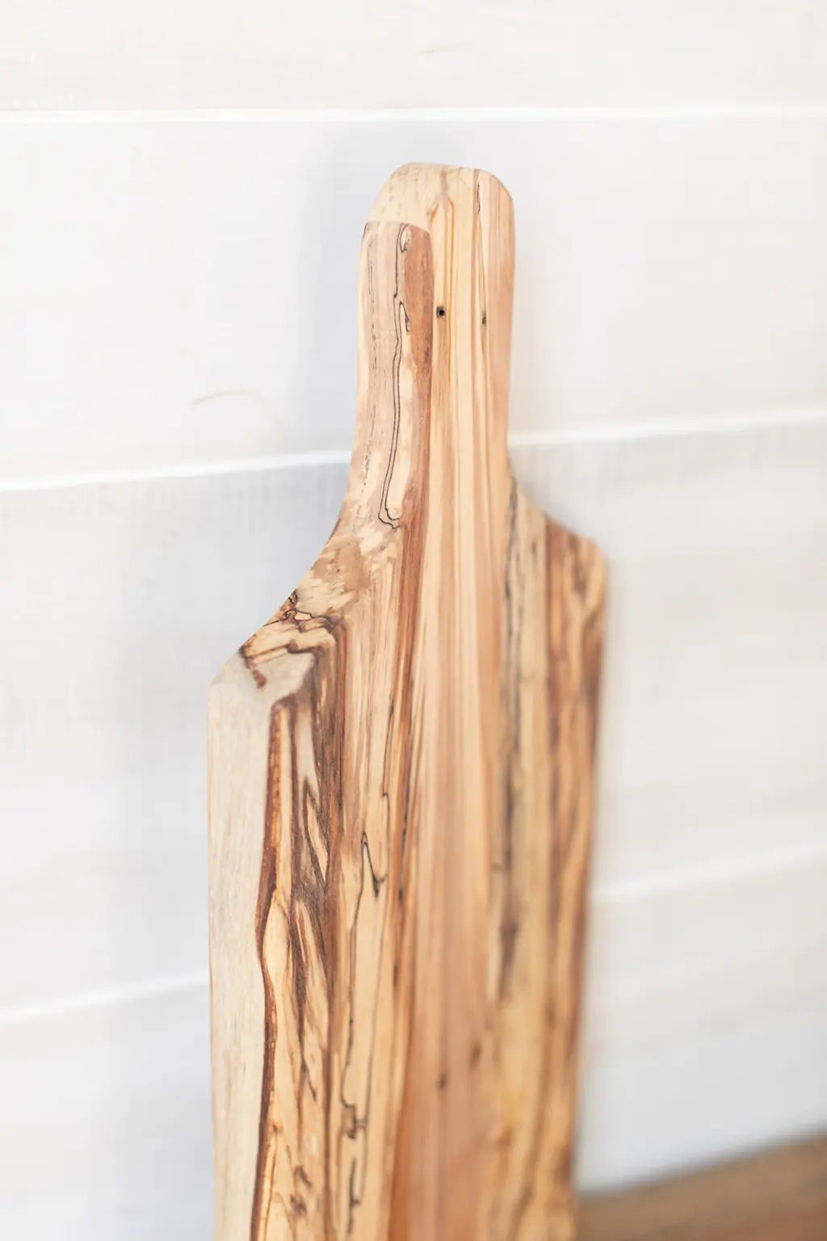
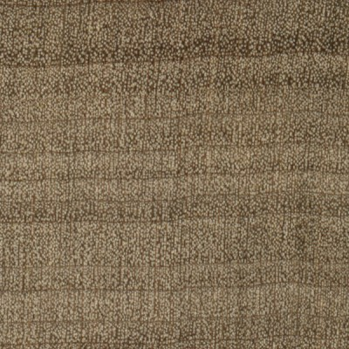
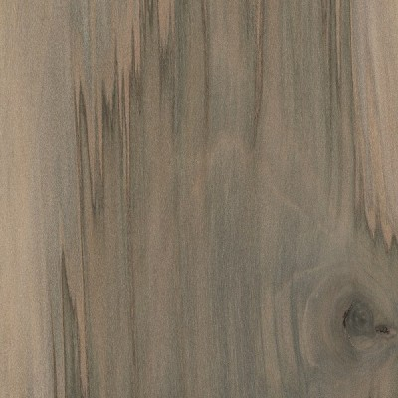
Sweetgum (Liquidambar styraciflua)
Veneer, furniture, railroad ties, crates, cutting/charcuterie boards

Slide 17
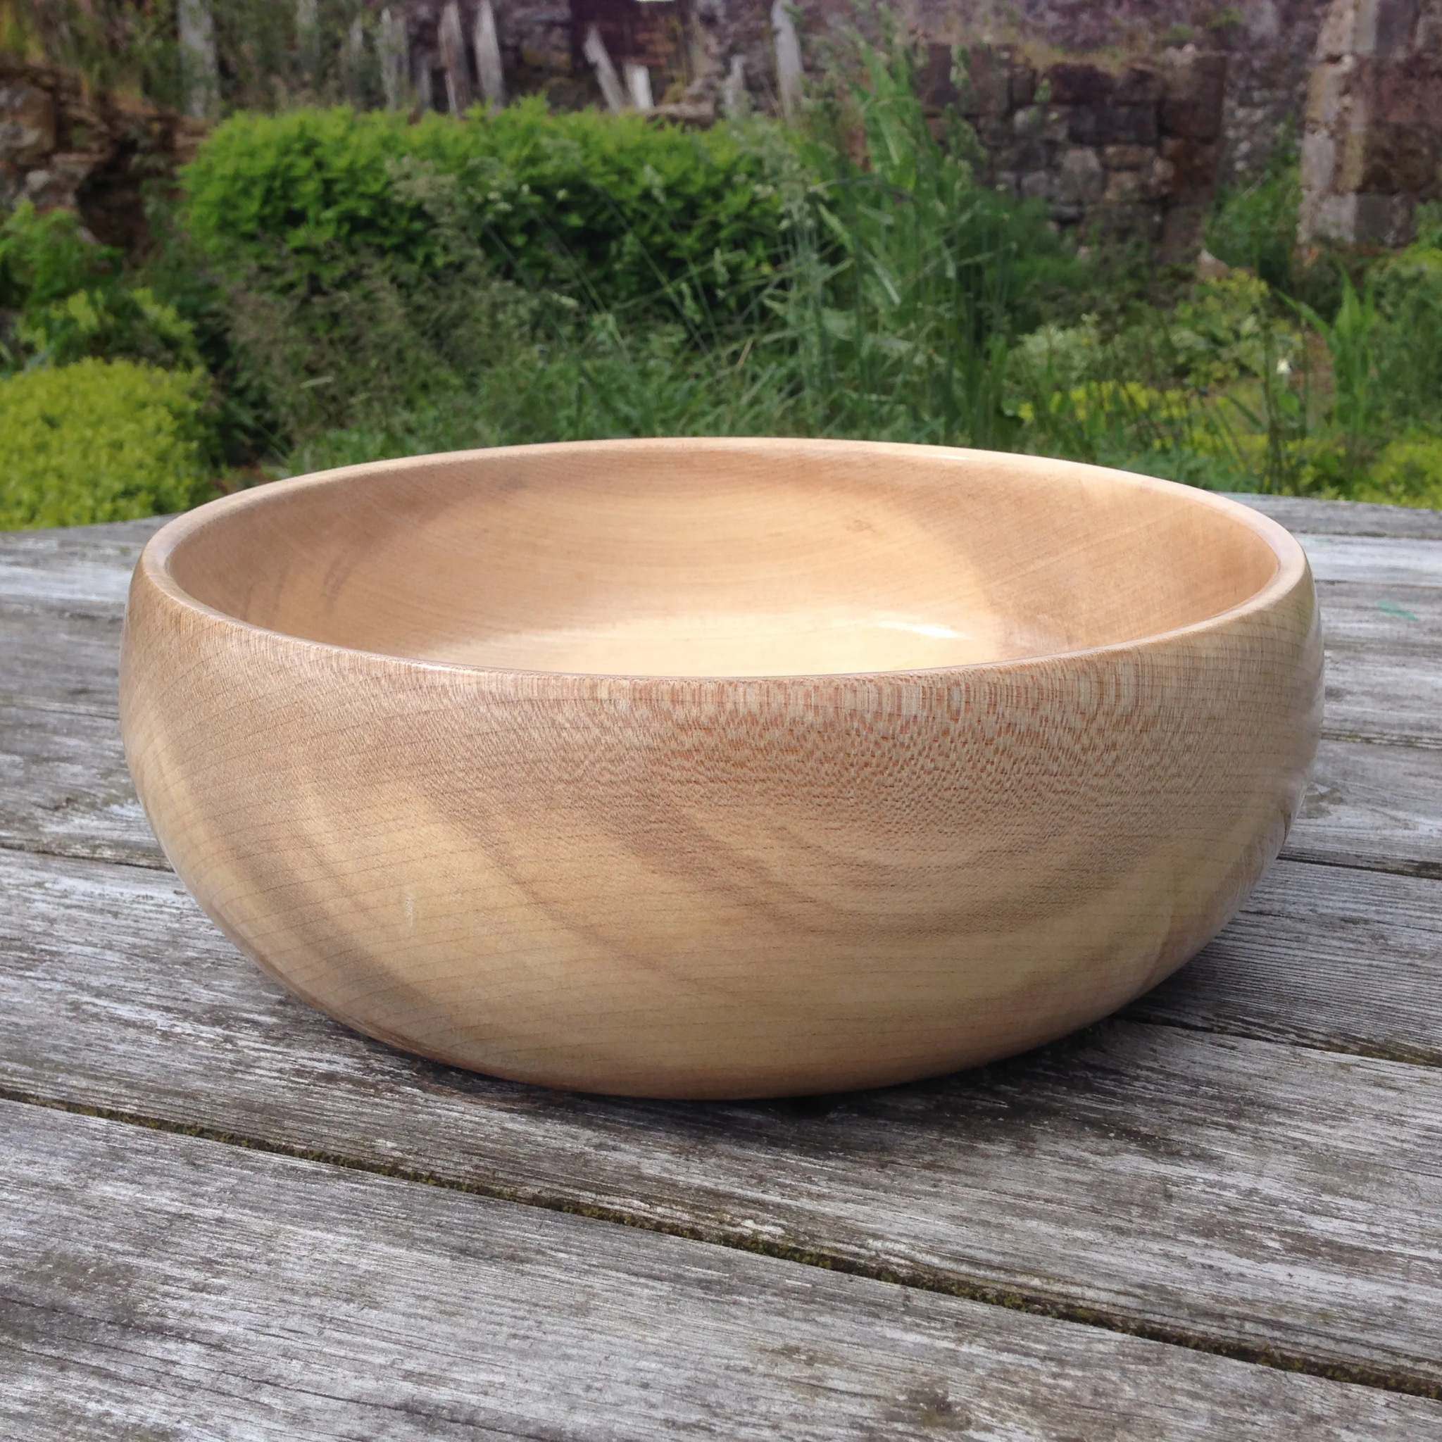
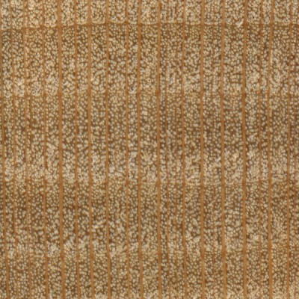
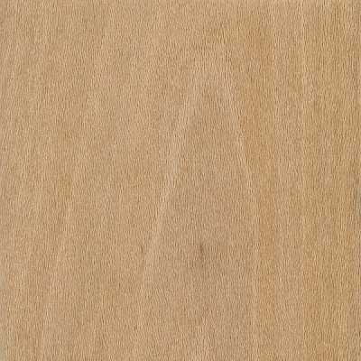
Sycamore (Platanus sp.)
Veneer, trim, crates, flooring, furniture, turned objects

Slide 18
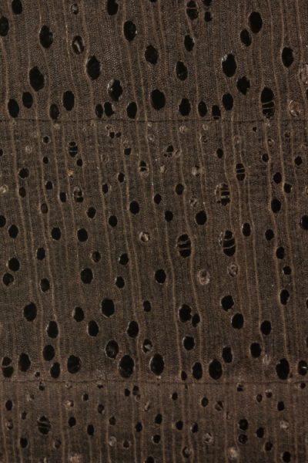
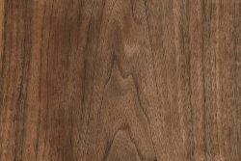
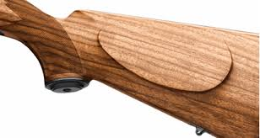
Walnut, Black (Juglans nigra)
High end furniture, cabinetry, wooden gun stocks

Slide 19
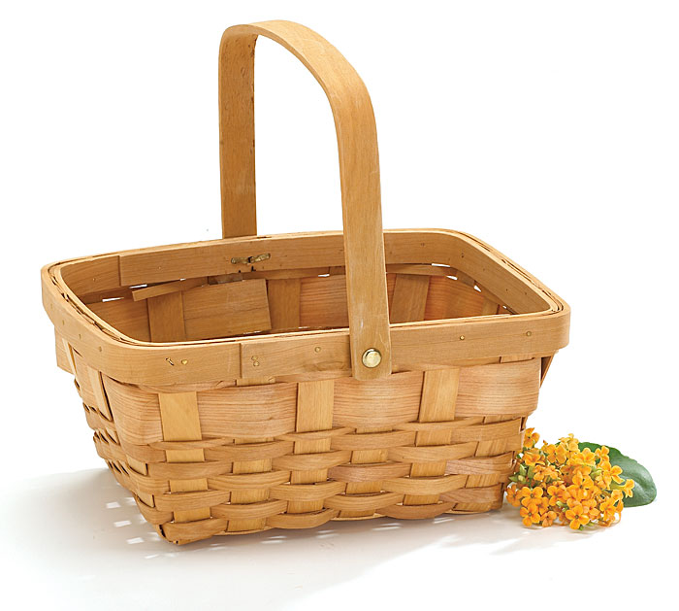
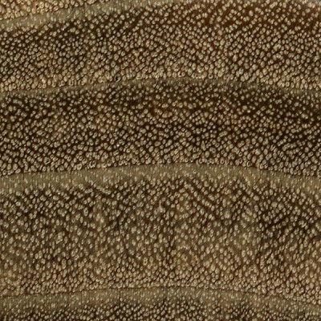
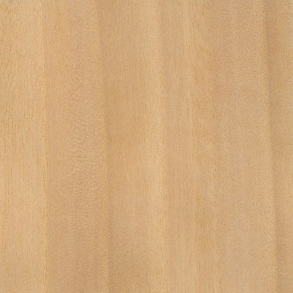
Willow, Black (Salix nigra)
Crates, furniture, baskets

Slide 20
Engineered Products

Slide 21
Glued Laminated Timber (Glulam)
Stress-rated beams made of wood laminations bonded together. Most commonly conifer species.

Slide 22
Laminated Veneer Lumber (LVL)
Made of multiple thin layers of veneer, used for headers and beams. Most commonly conifer species.

Slide 23
Medium Density Fiberboard (MDF)
Panels made with wood fibers and resins. Smooth surface and fine particles. Various hardwood and softwood species.

Slide 24
Oriented Strand Board (OSB)
Rectangular wood strands pressed with resins. Used for sheathing. Most commonly conifer species.

Slide 25
Particle Board
Coarse wood particles pressed with resins. Has rough texture and voids. Various hardwoods and softwoods.

Slide 26
Pole
Made from whole logs or cores of veneer logs. Treated; used for fences and utility purposes. Most commonly conifer species.

Slide 27
Primed Boards
Dimensional lumber with primer, used for indoor trim work. Most commonly conifer species.

Slide 28
Plywood
Wood veneer pressed with resin. Used for sheathing and furniture. Various species.

Slide 29
Tongue and Groove
Lumber with milled interlocking edges. Used for paneling. Various species.

Slide 30
Treated Dimensional Lumber
Structural lumber treated with chemicals to resist insects and decay. Various dimensions. Most commonly conifer species.

Slide 31
Untreated Dimensional Lumber
Structural lumber, various dimensions. Most commonly conifer species.

Slide 32
Veneer
Thin layers of wood used in making plywood or concealing MDF or particle board. Various species can be used.

Slide 33
Resources
The Wood Database
Wood Identification - Common Hardwoods
Identification Guide - Mississippi State Univ.
Wood Assistant
Wood Supply Research Institute
Woodworkers Guild of America
Bell Forest Products
Types of Engineered Wood

